Slide 1
Post Impressionism
Still focused on concepts of Impressionism
Light and color
Added a focus on design and composition
Not as spontaneous
2 directions
Form and Design
Cezanne and Seurat
Emotion and Expression
Van Gogh and Gauguin
End of 19th century

Slide 2
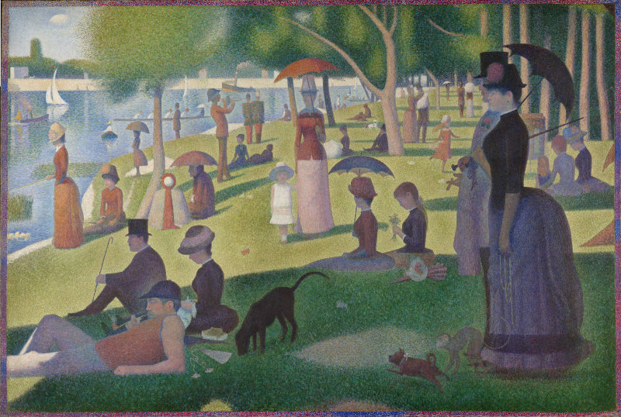
Georges Seurat
Very Methodical
Based on photographs and physics of light
Lots of sketches first
Pointillism
Creating an image with lots of dots
Very scientific and not instantaneous
A Sunday Afternoon on the Island of La Grande Jatte
Over 40 preliminary drawings

Slide 3
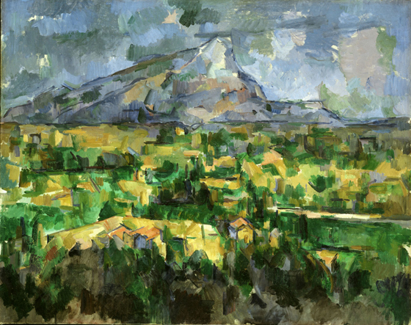
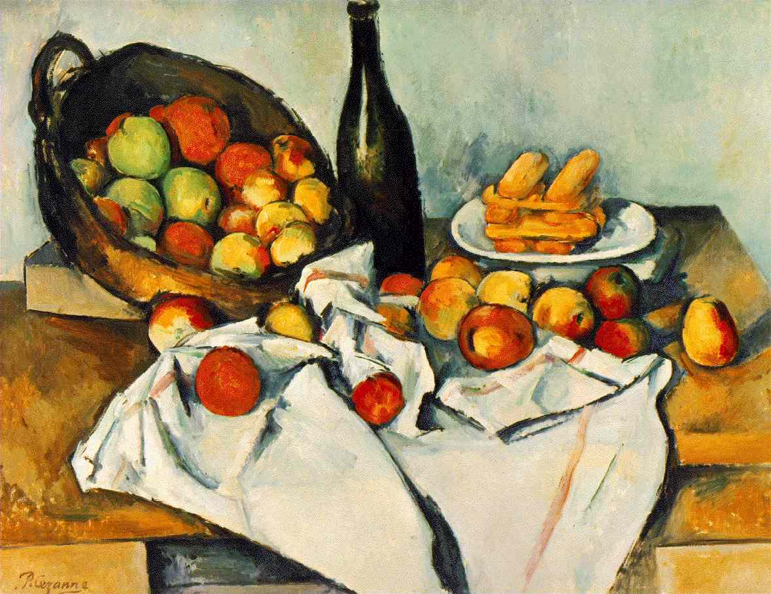
Paul Cezanne
Influential in France
Thick colors
Light seems permanent unlike impressionist
Flat images
Intense colors
Reality is not important
Mont Sainte-Victoire

Slide 4
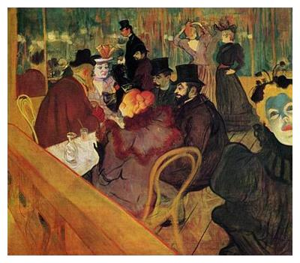
Henri de Toulouse-Lautrec
Caricature and portraits
Night life of Paris
First artist to produce modern posters for commercial purposes
At the Moulin Rouge

Slide 5
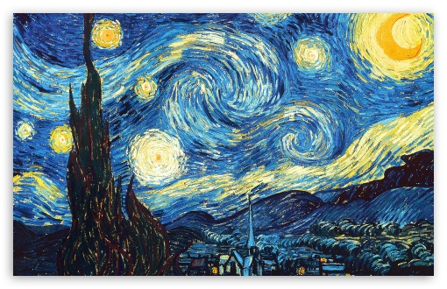
Vincent Van Gogh
Started painting at age 27
Thick impasto strokes
Expressed feelings and emotions
Expressionists
Immortalized objects with color
Contrasting colors
Starry Night

Slide 6
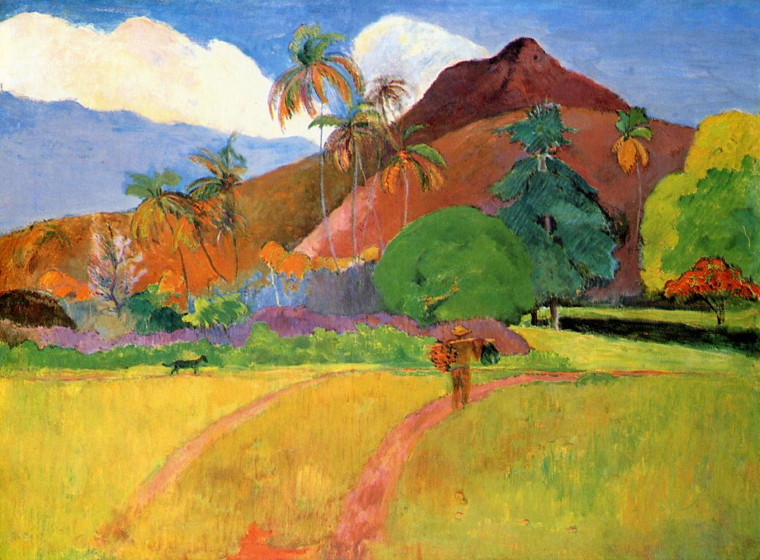
Paul Gauguin
Simple forms and symbolism rendered in a decorative and stylized way
Religious experience
Flat outlined shapes
Tahitian mountains

