Slide 1
Neoclassical
1775-1815

Slide 2
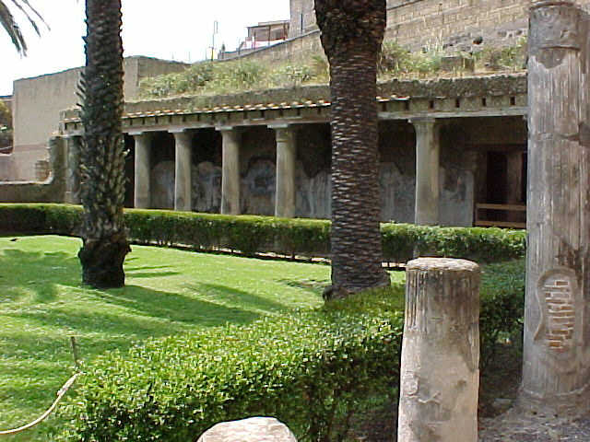
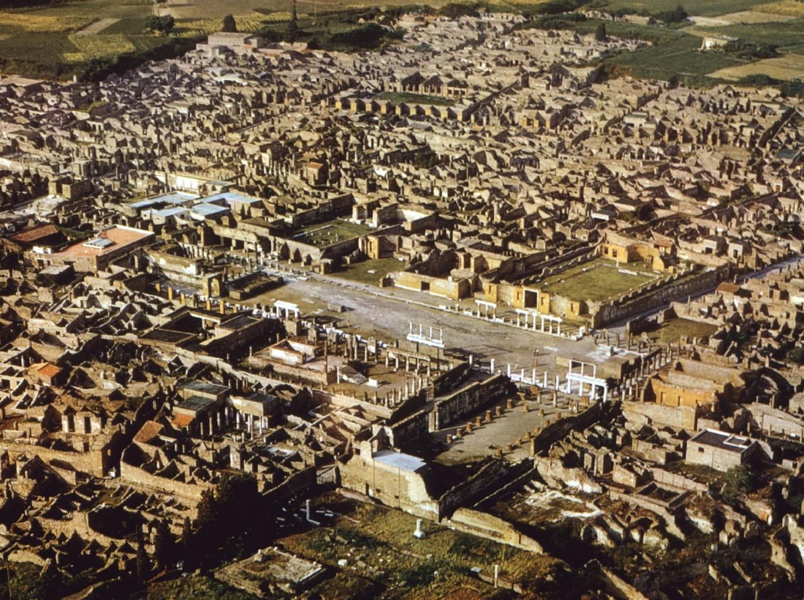
Origins of Neoclassical Art
Pompeii in 1748.
Herculaneum in 1738.

Slide 3
Origins of Neoclassical Art
American Colonies gain independence
Napoleon Bonaparte rules France
A response to Rococo and Baroque styles
Art is precise and pristine

Slide 4
Politics of Neoclassicism
Adopted as the official art style of the revolutions in France and in America.
Association with the democracy of Greece and the republicanism of Rome.
Napoleon used the style for propaganda.

Slide 5
Elements of Neoclassicism
Return to the perceived “purity” of the arts of Rome.
Model the “ideal” of the ancient Greek arts and, to a lesser extent, 16th century Renaissance classicism.
An emphasis on line and strong design

Slide 6
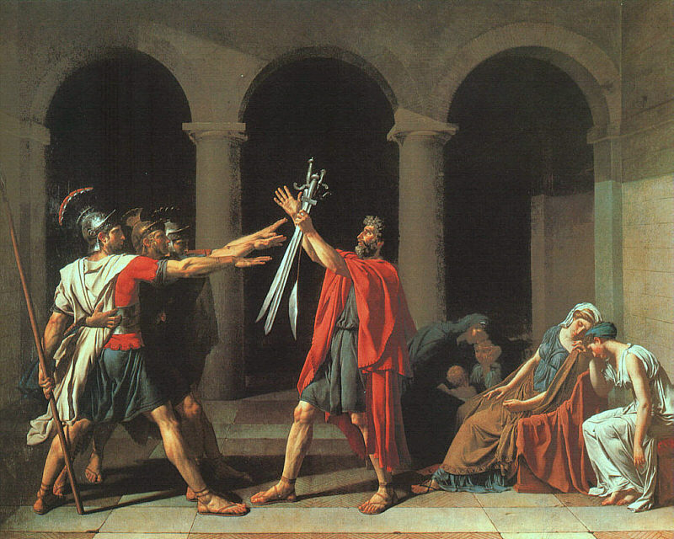
Allegorical art
Jacques-Louis David. The Oath of Horatii.
1784. Oil on canvas. 330 x 425 cm. Louvre, Paris, France.
Notes:
Dispute between Rom and Alba was to be settled by personal combat. The sons of Horatii will fight for Rome. The three brothers appear to fuse into one.

Slide 7
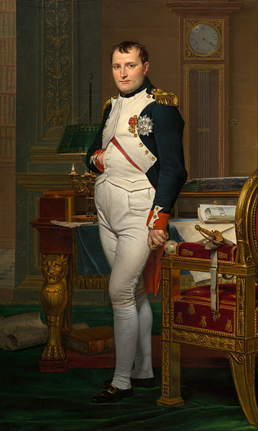
Can not see the brush strokes
Jacques-Louis David
Napoleon in his Study (1812)
Notes:
Plato in grey on left. Socrates if defiant. Personal sacrifice for the truth, not the state.

Slide 8
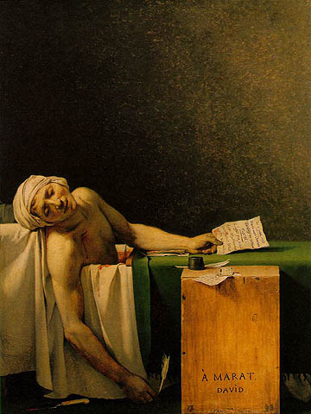
Jacques-Louis David
Death of Marat.
Oil on canvas. 1793.
Notes:
Marat was a journalist during the revolution and a Jacobin. He condemned a large number of people to the guillotine. Charlotte Corday murders him. Marat has a skin diesese and he spends a lot of time in the bath with a board across the tub and that’s where he’d write. Corday came into the house claiming to have names of traitors. She is killed four days later.
Martyr painting. Elements made to look a bit like Christ. Blood in different places. Eyes follow the arm down to the knife, the pen, and David’s honorific “To Marat” None of his nasty sores are shown.
This painting was carried through the streets

Slide 9
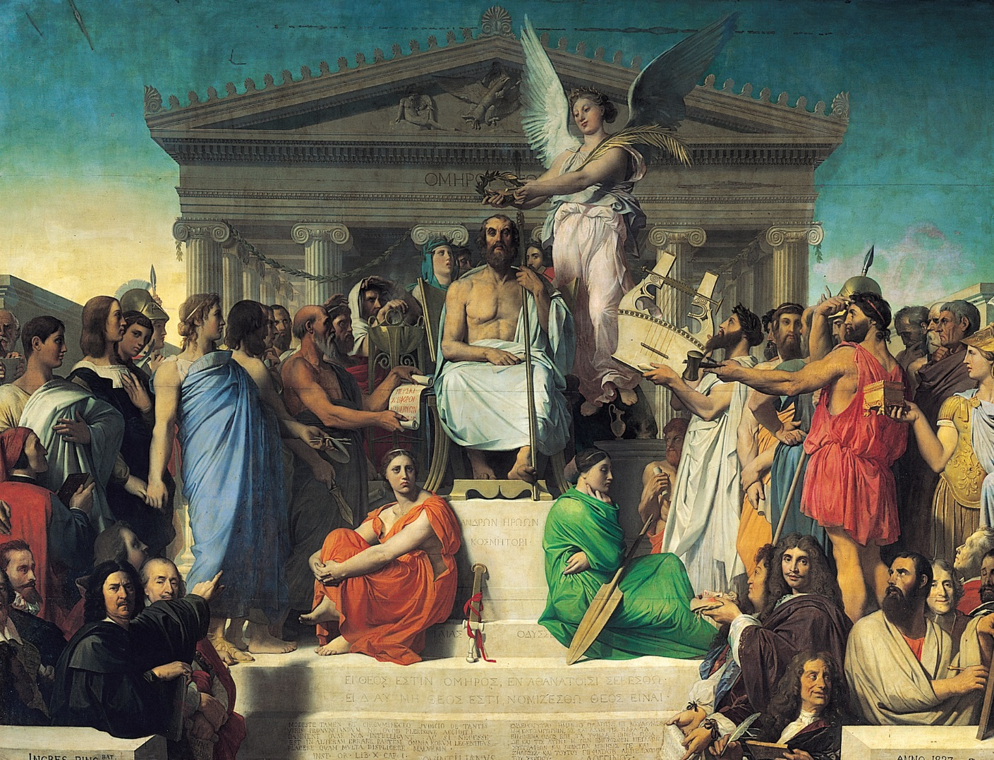
Jean-Auguste-Dominique Ingres
The Apotheosis of Homer

Slide 10
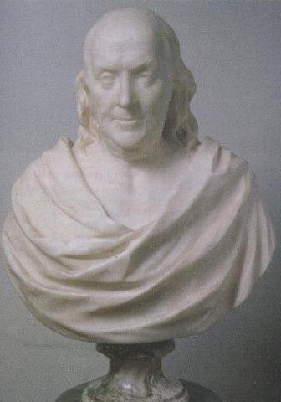
Portrait bust of
Benjamin Franklin
Jean Antoine Houdon

Slide 11
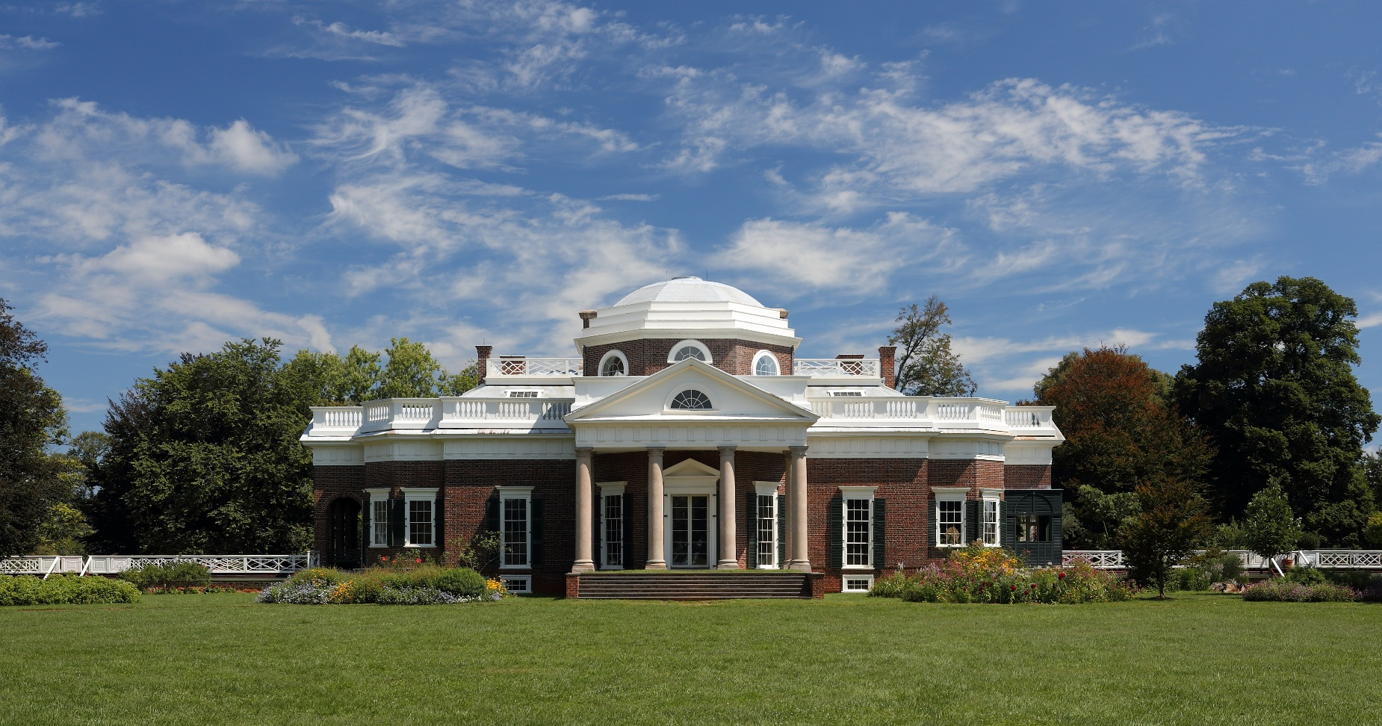
Architecture
Re-Simplified
Thomas Jefferson

Slide 12
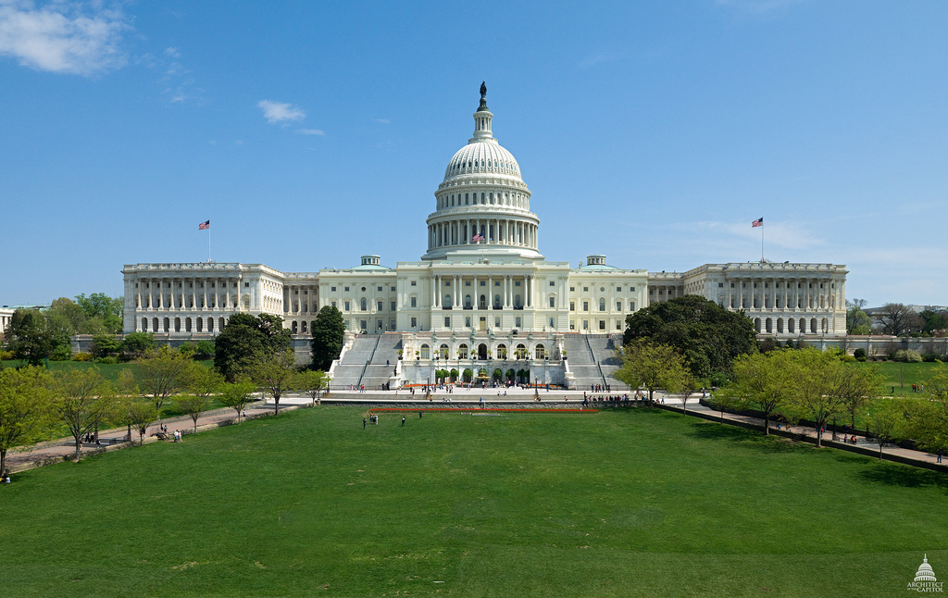
1852-1863

Slide 13
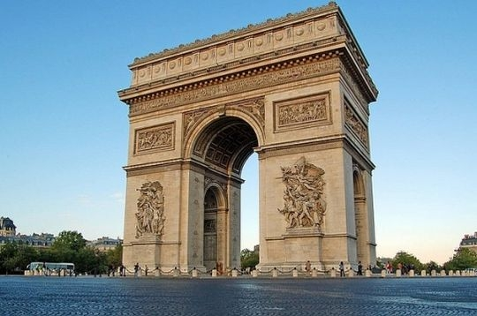
Arc de Triomphe, Paris

