Slide 1
Impressionism

Slide 2
Impressionism was a 19th century art movement that began as a loose association of Paris based artists, who began exhibiting their art publicly in the 1860’s. The name of the movement is derived from the title of a Claude Monet painting, called Impression, Sunrise

Slide 3
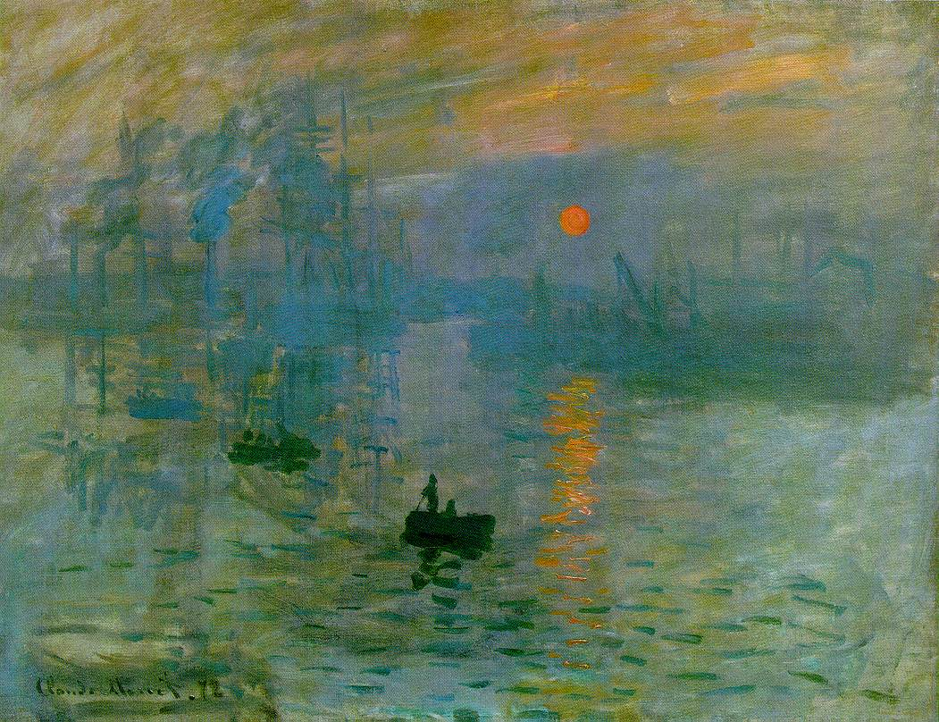
Impression - Sunrise

Slide 4
Impressionist artists felt the new technology of Photography was ruining the art of painting. They felt the need to create a new style of painting in which accurate rendering of the subject was not the main focus.

Slide 5
The Impressionists changed the approach to painting, by recreating the sensation in the eye that views the subject, rather than recreating the subject.

Slide 6
The public, at first hated the paintings, then gradually came to believe that the Impressionists had captured a fresh and original vision. The art critics of that time, continued to disapprove calling the paintings unfinished sketches.

Slide 7
Characteristics of Impressionist painting include:
Visible brushstrokes
Light Colors
Emphasis on Light and the changing qualities of it
Ordinary Subject Matter
Unusual Visual Angles
Open Compositions

Slide 8
Visible Brushstrokes

Slide 9
Light Colors

Slide 10
Emphasis on Light

Slide 11
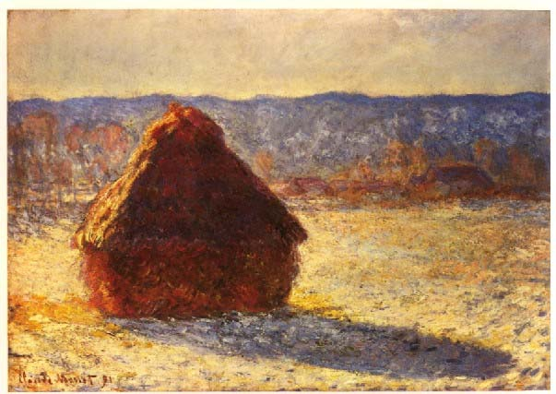
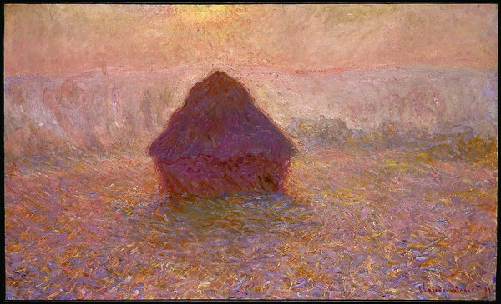
The Changing Qualities of Light
Haystack - Morning
Haystack - Mist

Slide 12
Ordinary Subject Matter

Slide 13
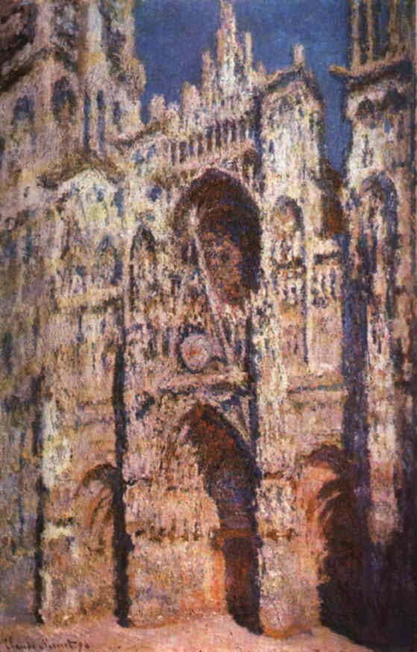
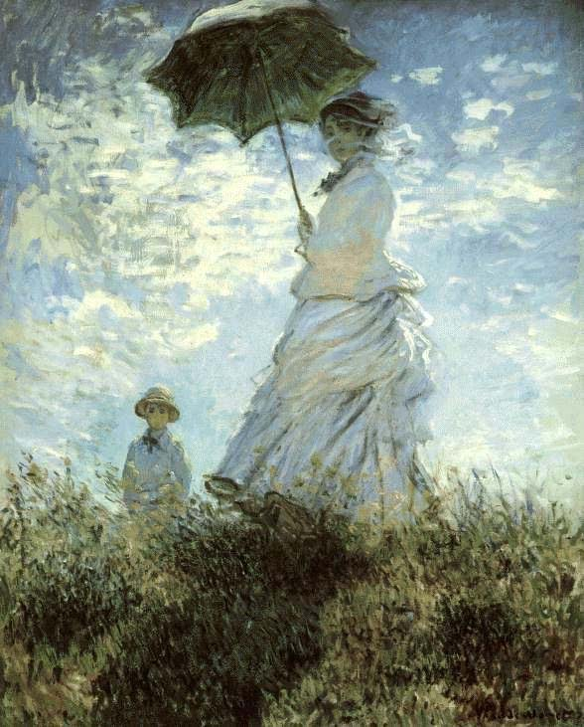
Unusual Visual Angles

Slide 14
Open Compositions

Slide 15
Today the Impressionist style is very much alive and a very successful technique of painting. Though many artists have painted in the Impressionist style, the following artists were the innovators and masters of their style:

Slide 16
Masters of Impressionism
Claude Monet – Lilly ponds & Gardens
Edouard Manet- Cropped compositions
Auguste Renoir – People Outdoors
Edgar Degas – Dancers and Theater
Camille Pissarro – Cities and Streets
Mar Cassatt– Mothers and children

Slide 17
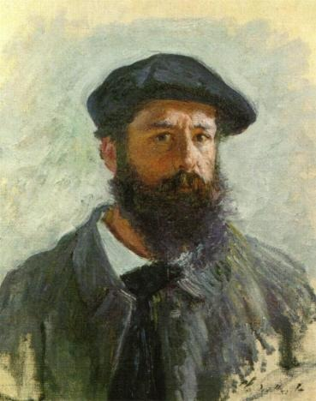
Paintings by Claude Monet
Self Portrait

Slide 18
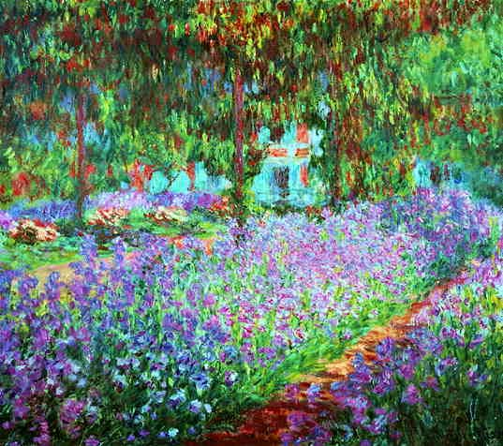
Artists Garden at Giverny - 1886

Slide 19
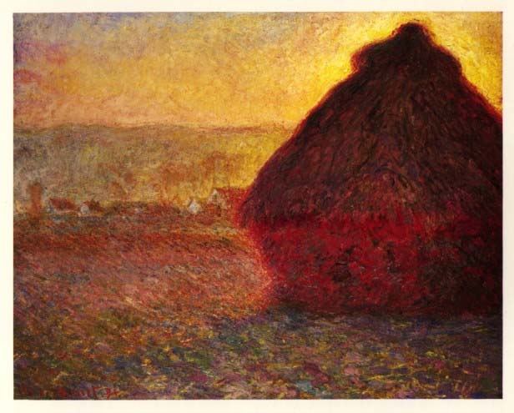
Haystack – Sunset - 1872

Slide 20
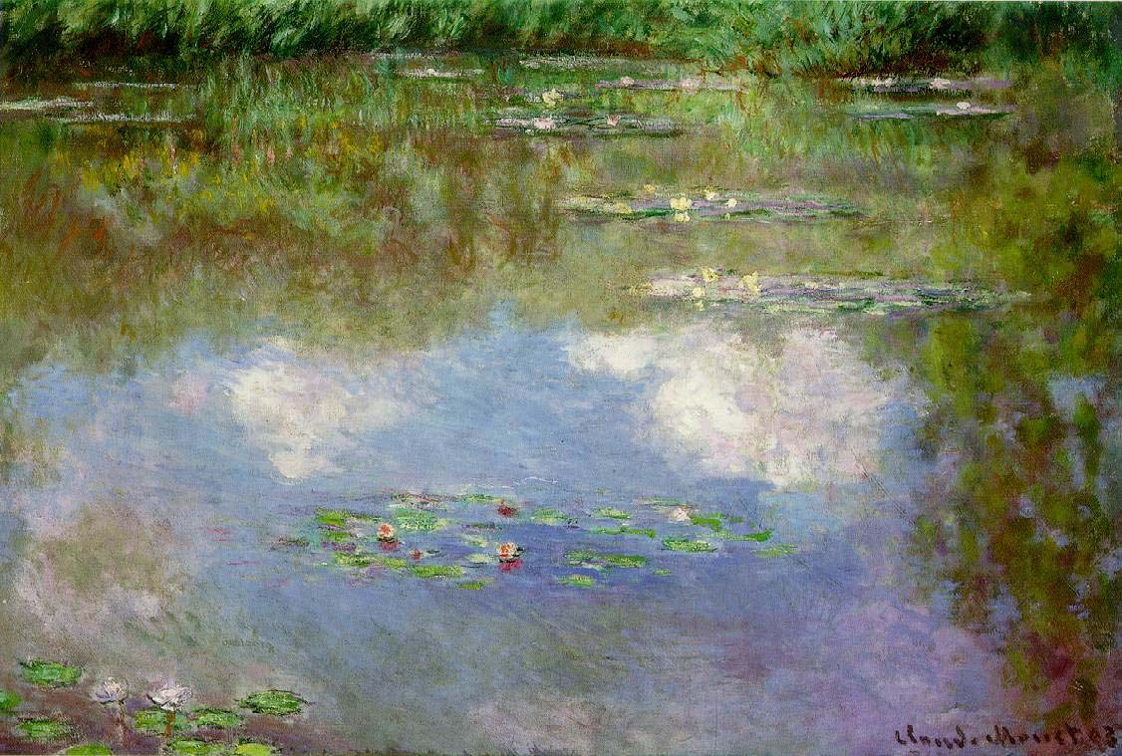
Water lilies – The Clouds - 1903

Slide 21
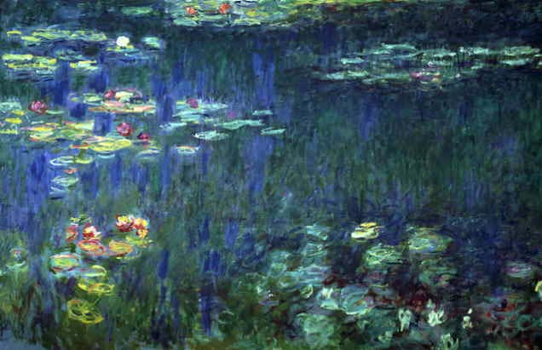
Water lilies – Green Reflection - 1906

Slide 22
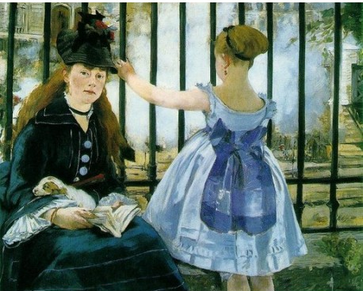
Paintings by Edouard Manet

Slide 23
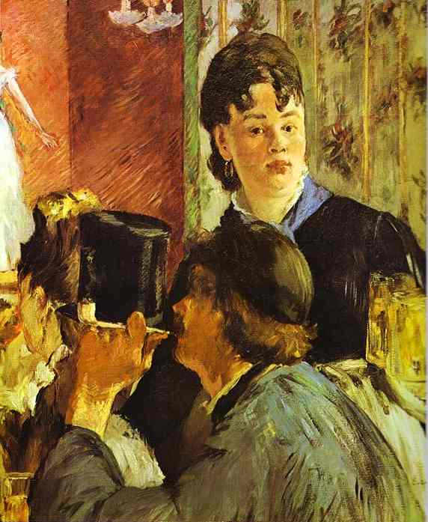

Slide 24
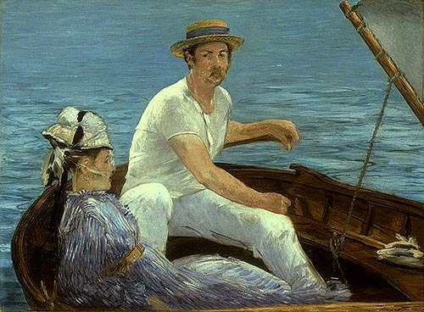

Slide 25
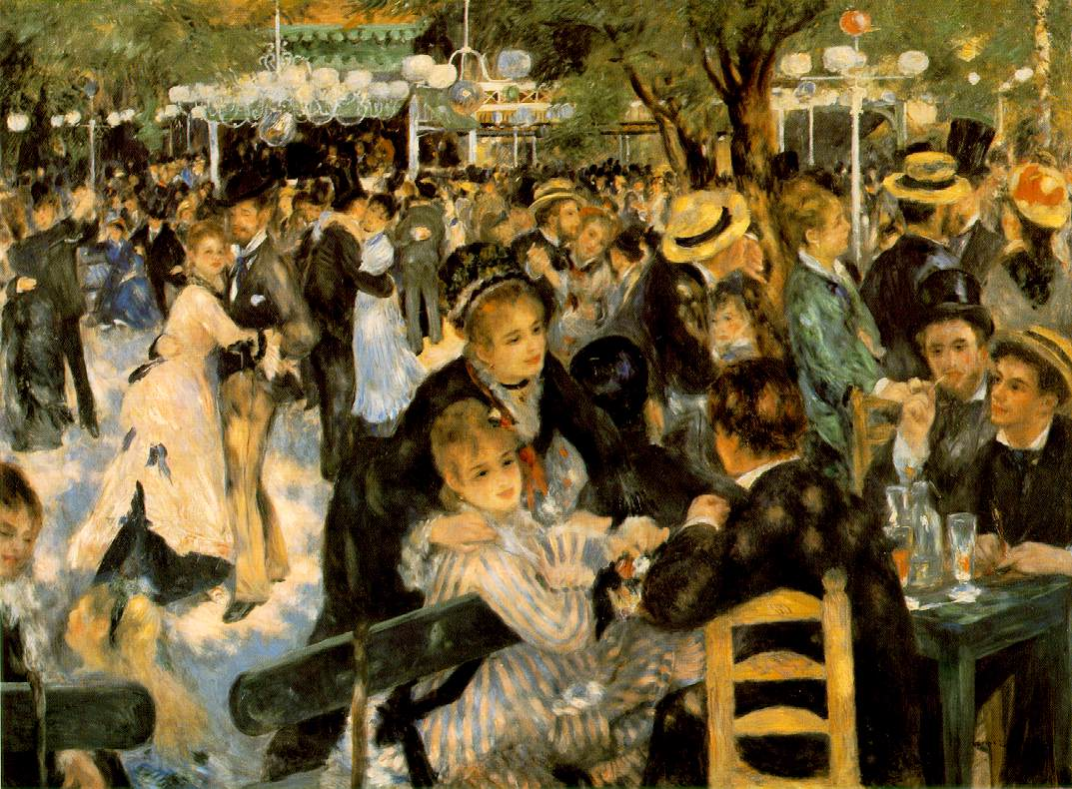
Paintings by Auguste Renoir

Slide 26
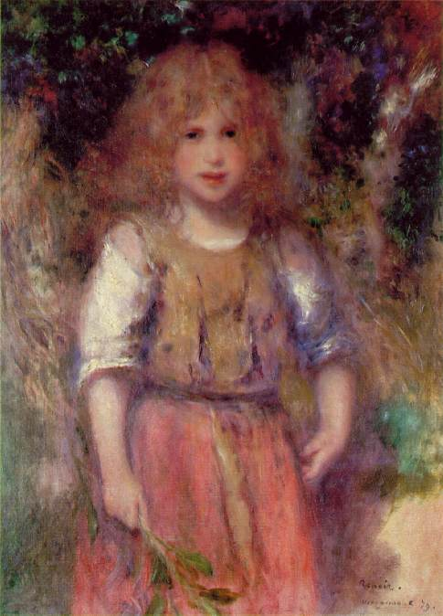
Gypsy Girl - 1879

Slide 27
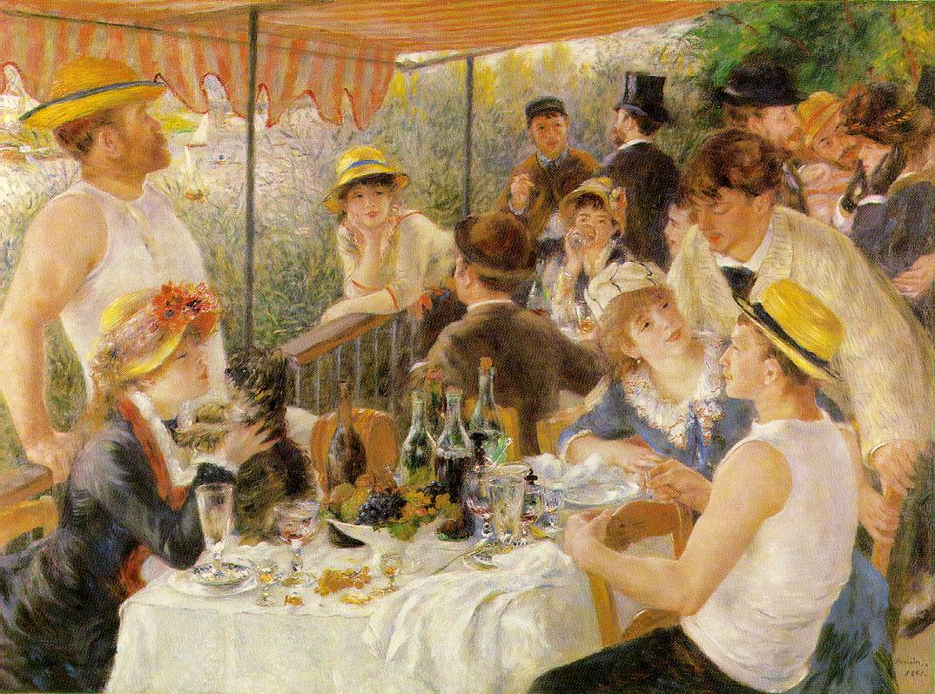
The Boating Party - 1979

Slide 28
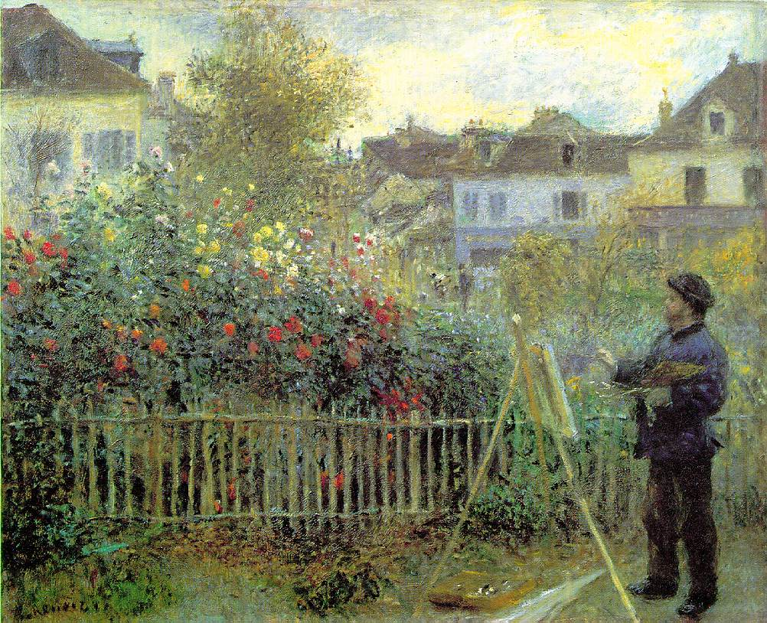
Monet painting in his Garden - 1873

Slide 29
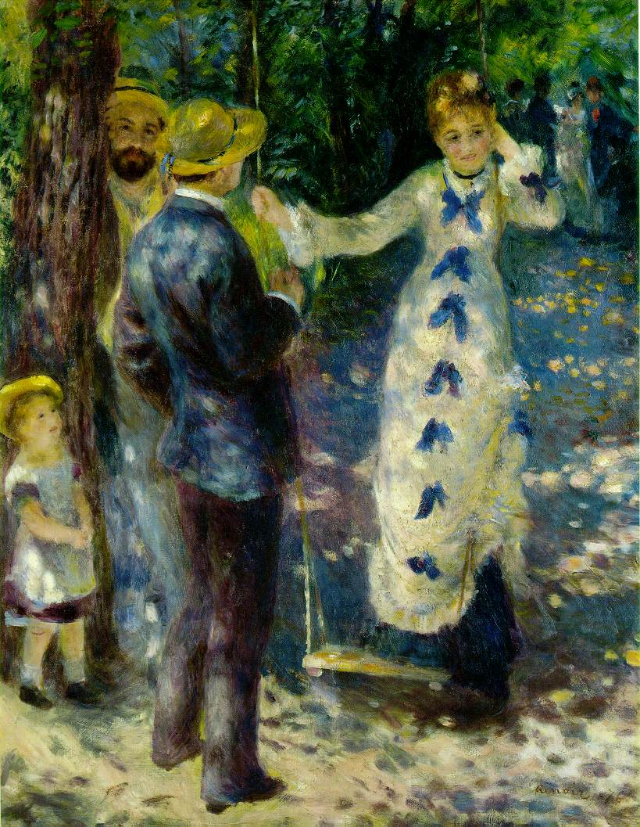
The Swing 1876

Slide 30
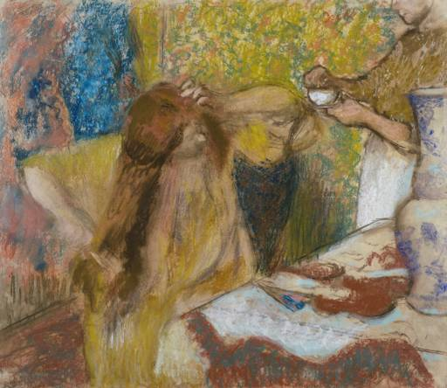
Paintings By Edgar Degas

Slide 31
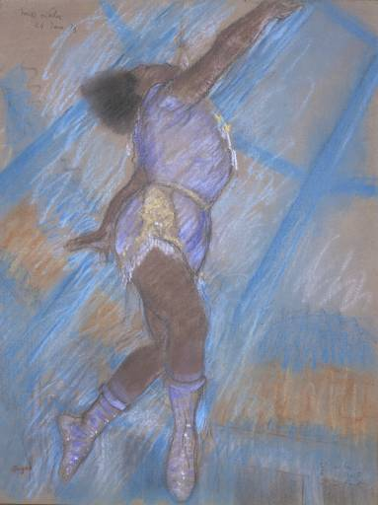
Miss la la at the circus Fernando

Slide 32
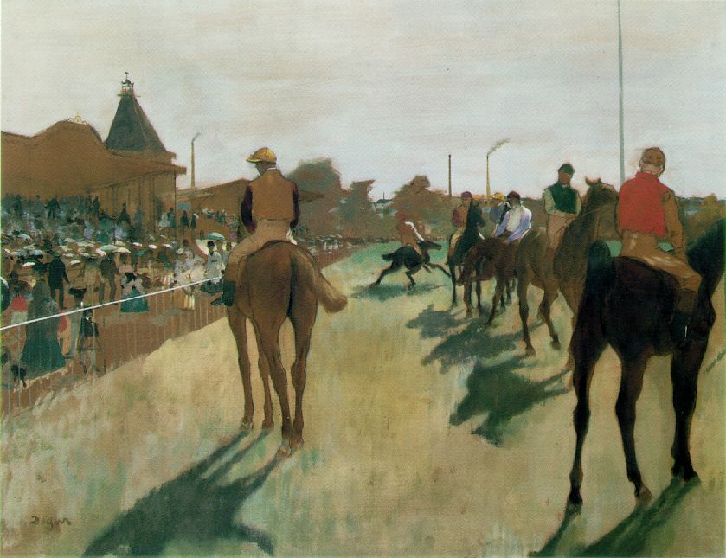
Horses Before the Stands - 1876

Slide 33
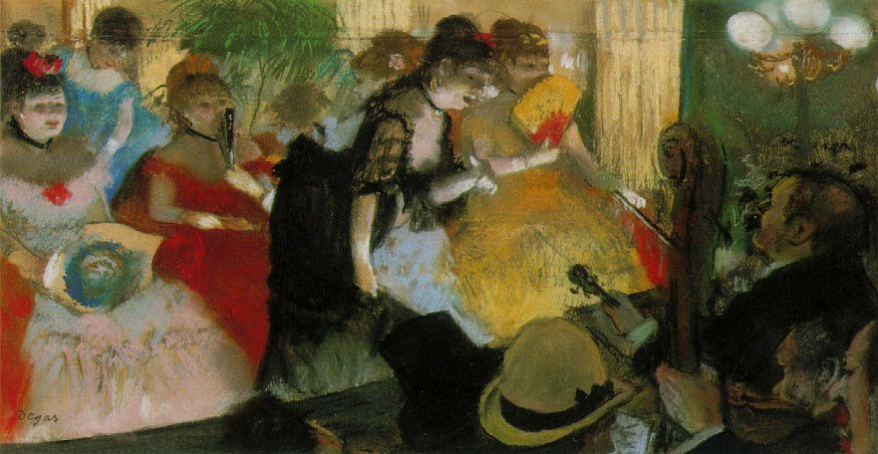
Cabaret - 1877

Slide 34
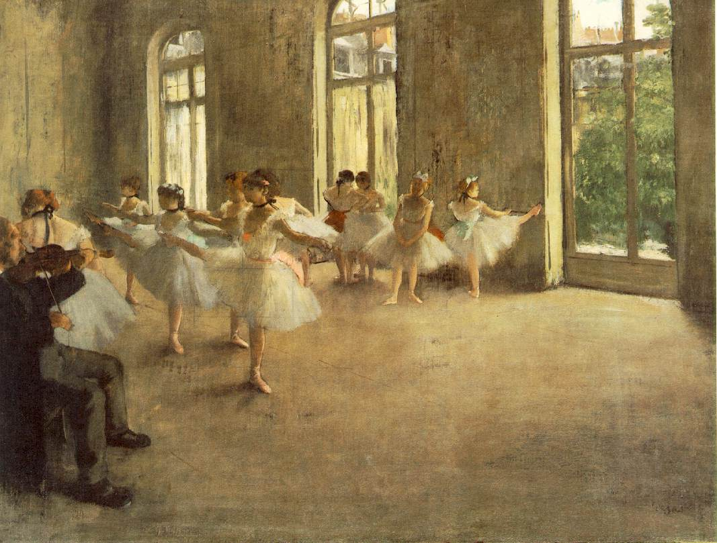
The Rehearsal - 1878

Slide 35
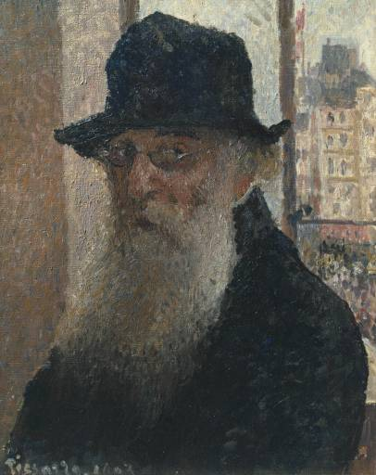
Paintings by Camille Pissaro
Self Portrait

Slide 36
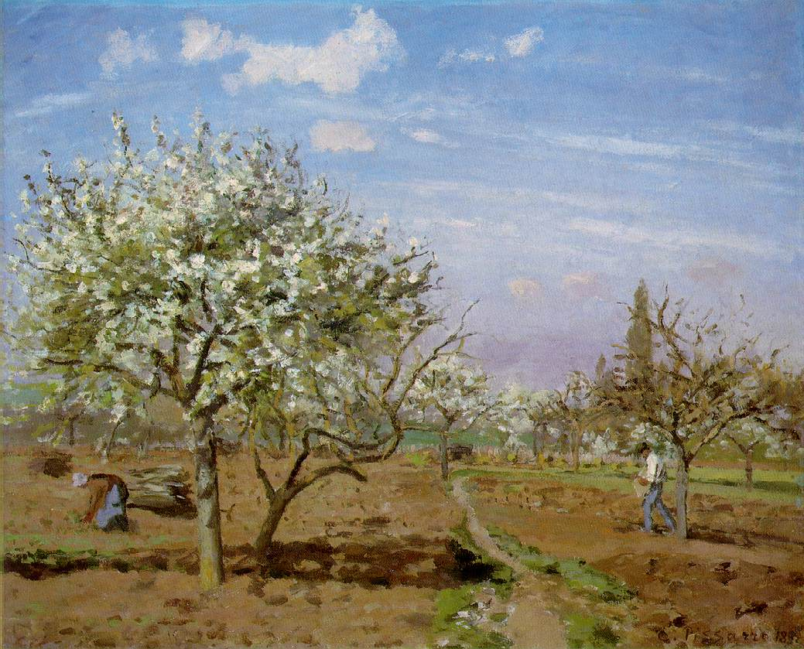
The Orchard - 1872

Slide 37
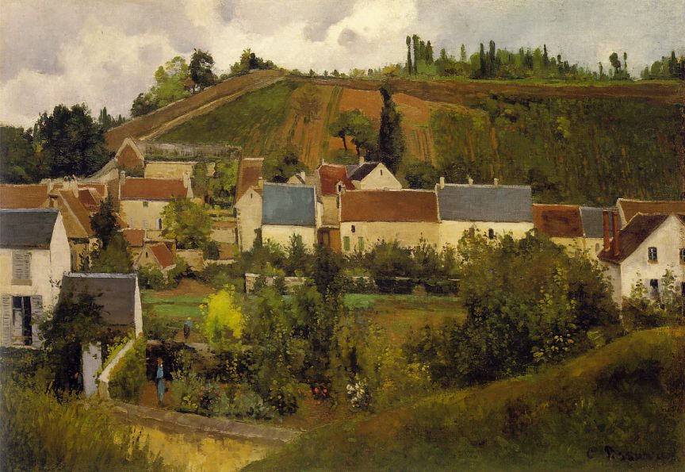
Jallais Hills - 1876

Slide 38
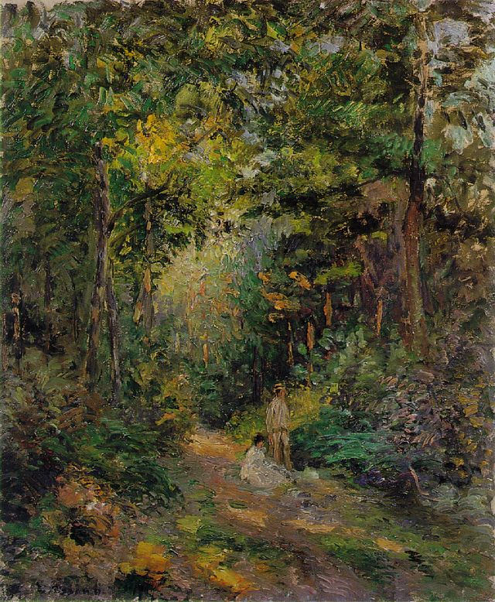
Path Through the Woods - 1876

Slide 39
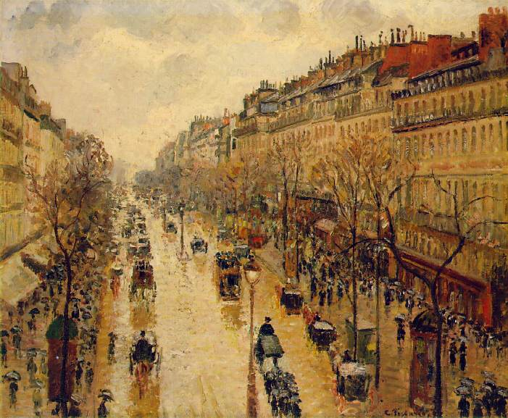
Boulavarde Montmarte – Rainy Afternoon - 1897

Slide 40
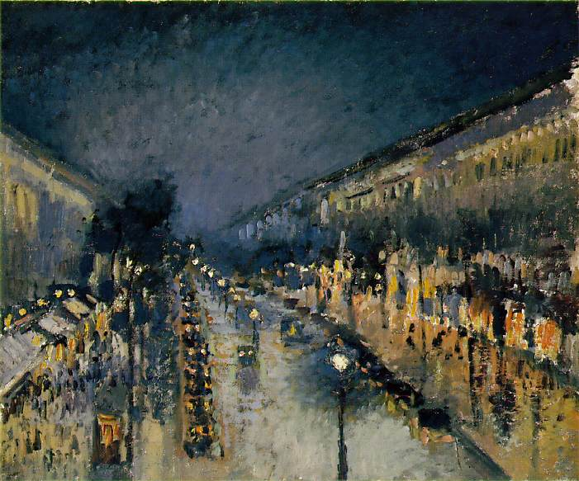
Boulavarde Montmarte – Night - 1897

Slide 41
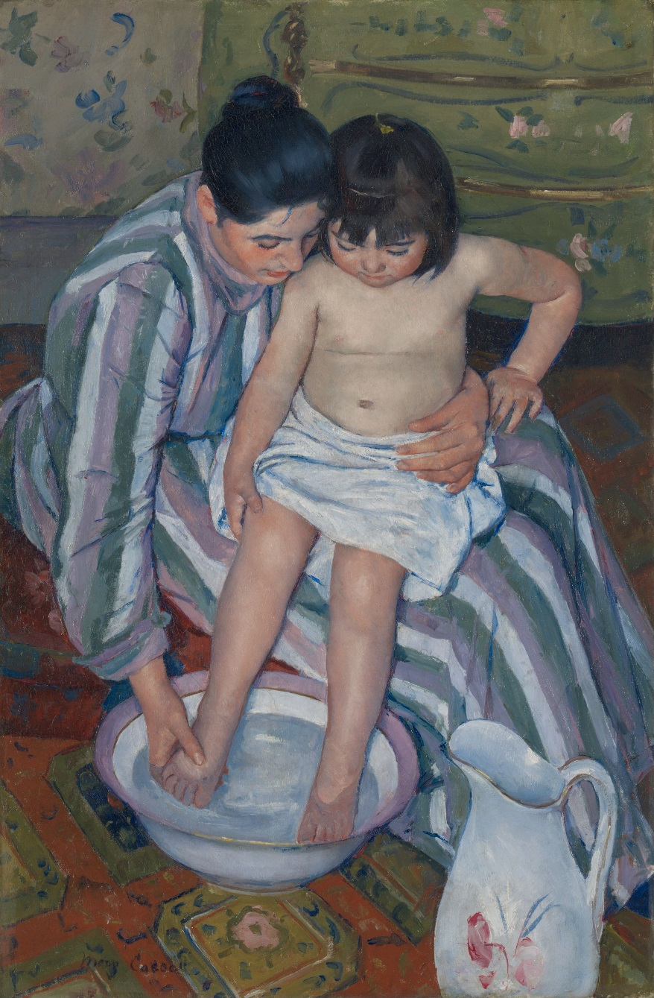
Paintings By Mary Cassatt

Slide 42
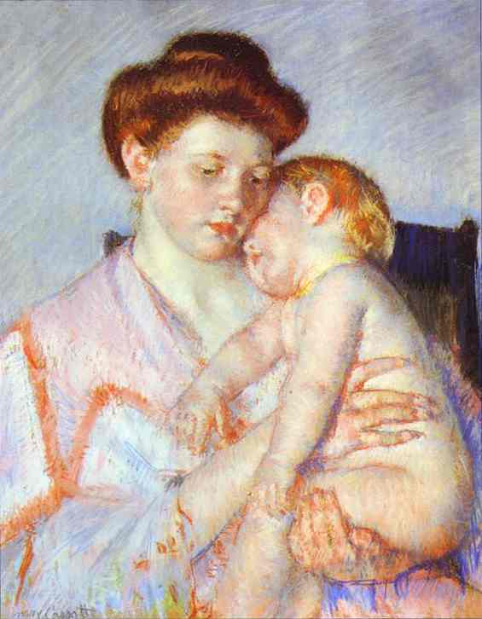
Sleeping Baby - 1910

Slide 43
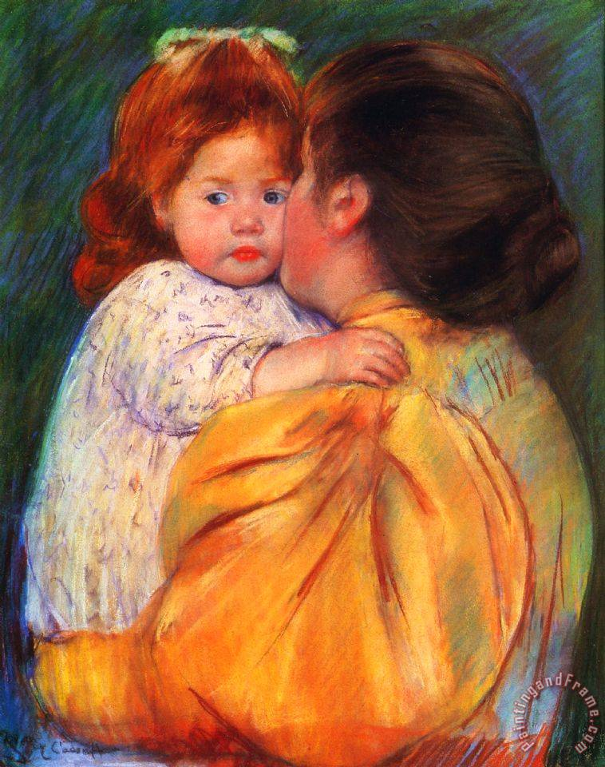
Maternal Kiss

Slide 44
Painting techniques developed and used by the Impressionists…

Slide 45
Short, thick strokes of paint are used to quickly capture the essence of the subject, rather than its details.

Slide 47
Colors are applied side-by-side with as little mixing as possible, creating a vibrant surface. The optical mixing of colors occurs in the eye of the viewer. Optical Mixing – Broken Color

Slide 49
The play of natural light is emphasized. Close attention is paid to the reflection of colors from object to object.

Slide 51
Grays and dark tones are produced by mixing complimentary colors. In pure Impressionism the use of black paint is avoided.

Slide 52
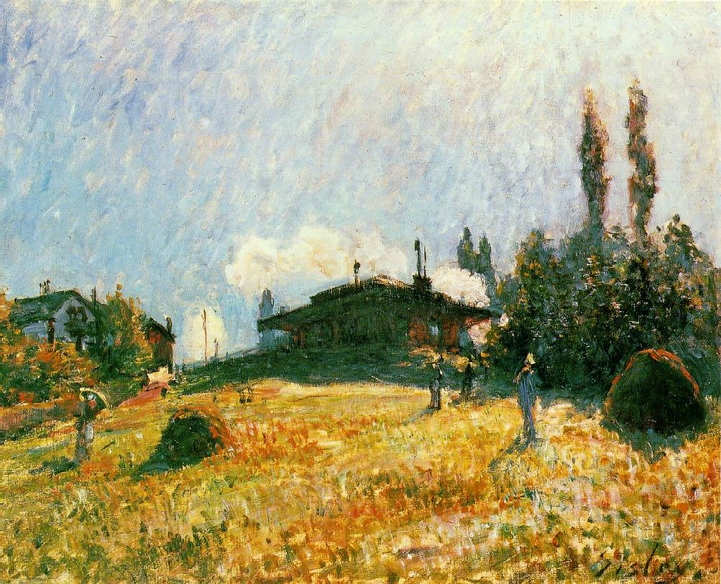

Slide 53
In paintings made en plein air (outdoors), shadows are boldly painted with the blue of the sky as it is reflected onto surfaces, giving a sense of freshness and openness that was not captured in painting previously. (Blue shadows on snow inspired the technique.)

Slide 54
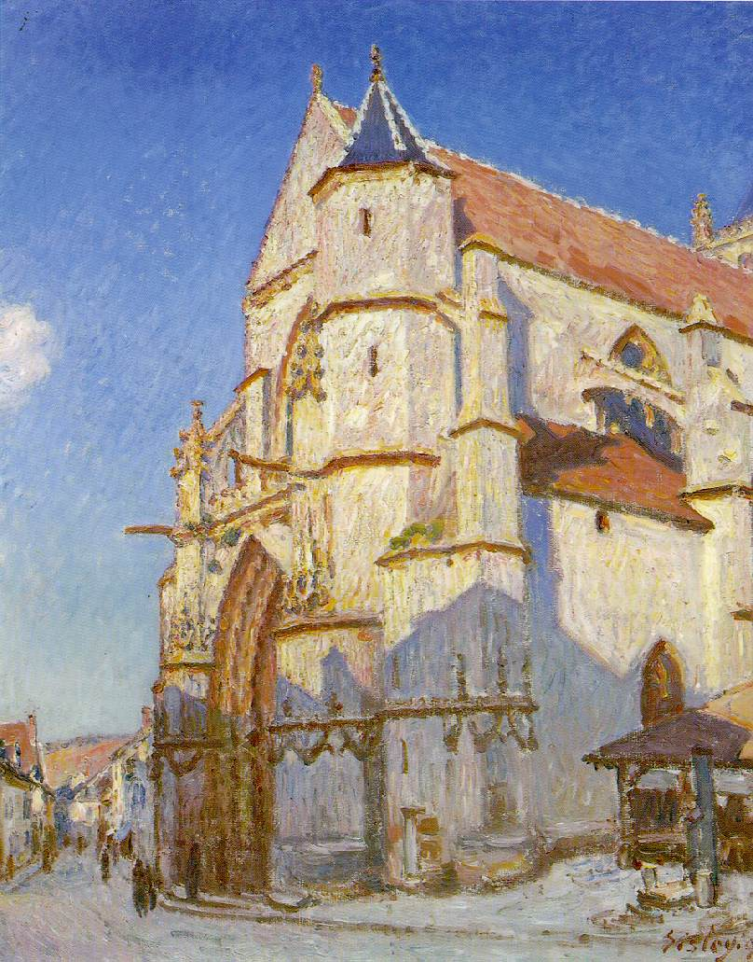

Slide 55
Impressionism became the birth of Modern Art. All of the major art movements which would follow, including Post Impressionism, Fauvism, Cubism, Surrealism, Abstract Expressionism and Pop Art owe their beginnings to Impressionism.

Slide 56
Advanced Art – Impressionism
Lesson Objectives – Students will have a general understanding of the theory and characteristics of the Impressionist style of art and the major artists of the style. Students will be able to analyze light more objectively and learn to paint using the techniques of the impressionist style.
Activities
1 Students will be shown power point on Impressionism. Create a list of artists, characteristics and techniques of the Impressionist style
2 Students will find examples of Impressionist style of painting from the internet at (ARTCHIVE). They will print 1 example of the artist of their choice and attempt to accurately reproduce the colors and brush strokes of the painting. Size will be 6x8.
3 Students will produce an original painting executed in the Impressionist style. Size will be 11x14.
4 Students will be given a test on characteristics, techniques, and artist work identification.
Assessment –Will be graded according the response to instruction, degree and quality of completion, craftsmanship, originality and appropriate classroom behavior.
Materials- poster board, tempera paint, acrylic paint
Standards
1-KNOWLEDGE - STUDENTS KNOW AND APPLY VISUAL ARTS MEDIA, TECHNIQUES AND PROCESSES.
2-APPLICATION - STUDENTS USE KNOWLEDGE OF VISUAL CHARACTERISTICS, PURPOSES AND FUNCTIONS.
"3-CONTENT - STUDENTS CHOOSE, APPLY AND EVALUATE A RANGE OF SUBJECT MATTER, SYMBOLS AND IDEAS.
"4-CONTEXT - STUDENTS UNDERSTAND THE VISUAL ARTS IN RELATION TO HISTORY AND CULTURE.
"5-INTERPRETATION - STUDENTS ANALYZE AND ASSESS CHARACTERISTICS, MERITS AND MEANINGS IN THEIR OWN ARTWORK AND THE WORK OF OTHERS.

