Slide 1
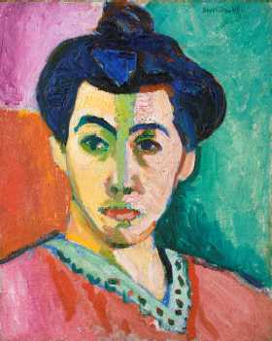
Fauvism and Expressionism
1885-1910
Portrait of Madame Matisse (The Green Line)
1905
Oil and Tempera on Canvas
40.5 x 32.5 inches

Slide 2
Impressionism (1865–1885) | Capturing fleeting effects of natural light | Monet, Manet, Renoir, Pissarro, Cassatt, Morisot, Degas | Franco-Prussian War (1870–1871); Unification of Germany (1871)
Post-Impressionism (1885–1910) | A soft revolt against Impressionism | Van Gogh, Gauguin, Cézanne, Seurat | Belle Époque (late-19th-century Golden Age); Japan defeats Russia (1905)
Fauvism and Expressionism (1900–1935) | Harsh colors and flat surfaces (Fauvism); emotion distorting form | Matisse, Kirchner, Kandinsky, Marc | Boxer Rebellion in China (1900); World War (1914–1918)
Cubism, Futurism, Supremativism, Constructivism, De Stijl (1905–1920) | Pre– and Post–World War 1 art experiments: new forms to express modern life | Picasso, Braque, Leger, Boccioni, Severini, Malevich | Russian Revolution (1917); American women franchised (1920)
Dada and Surrealism (1917–1950) | Ridiculous art; painting dreamsand exploring the unconscious | Duchamp, Dalí, Ernst, Magritte,de Chirico, Kahlo | Disillusionment after World War I; The Great Depression (1929–1938); World War II (1939–1945) and Nazi horrors; atomic bombs dropped on Japan (1945)
Abstract Expressionism (1940s–1950s) and Pop Art (1960s) | Post–World War II: pure abstraction and expression without form; popular art absorbs consumerism | Gorky, Pollock, de Kooning, Rothko, Warhol, Lichtenstein | Cold War and Vietnam War (U.S. enters 1965); U.S.S.R. suppresses Hungarian revolt (1956) Czechoslovakian revolt (1968)

Slide 3
Key Points:
Both movements were all about feelings- very intense and emotional
It’s a philosophy of art not a style
Exploding color!
Avante-garde
Fauvism was very short lived (1904-1908)
Started in Paris and picked up by a group of German artists who called themselves Die Brucke (The Bridge) and Der Blaue Reiter (The Blue Rider)
Expressionism (the term) was coined in 1911 to describe an exhibition of Fauves.

Slide 4
Who's Who?
The Fauves- intense bright, clashing colors; distorted forms and perspectives; vigorous brushstrokes; flat linear patterns; bare canvas as part of the overall design. Translation "Wild Beasts"
Henri Matisse
Andre Derain (duh REN)
The Expressionists- emotional angst, violent colors, abstract forms and emotional subjects; attempt to express the contemporary mind.
Edvard Munch
Matisse (yup...he was both)
Wassily Kandinsky
Henri Rousseau

Slide 5
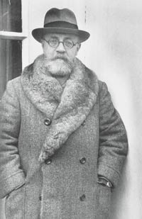
Henri Matisse (1869-1954)
He suffered a bout of appendicitis as a child and his mother gave him a box of paints. He later said, “From the moment I held the box of colors in my hands, I knew this was my life. I threw myself into it like a beast that plunges towards the thing it loves.”
Painted traditional themes (nudes, landscapes, portraits and still life) but with exaggerated, vibrant colors.
He tried painting with Seurat's Pointillism,but found it tedious- dab, dab, dab.
Known for bright colors, cut out paper images, and lots of energy in his works.
At the end of his life, when he was ill, he would draw and paint from his bed with a pencil or brush attached to a long stick.

Slide 6
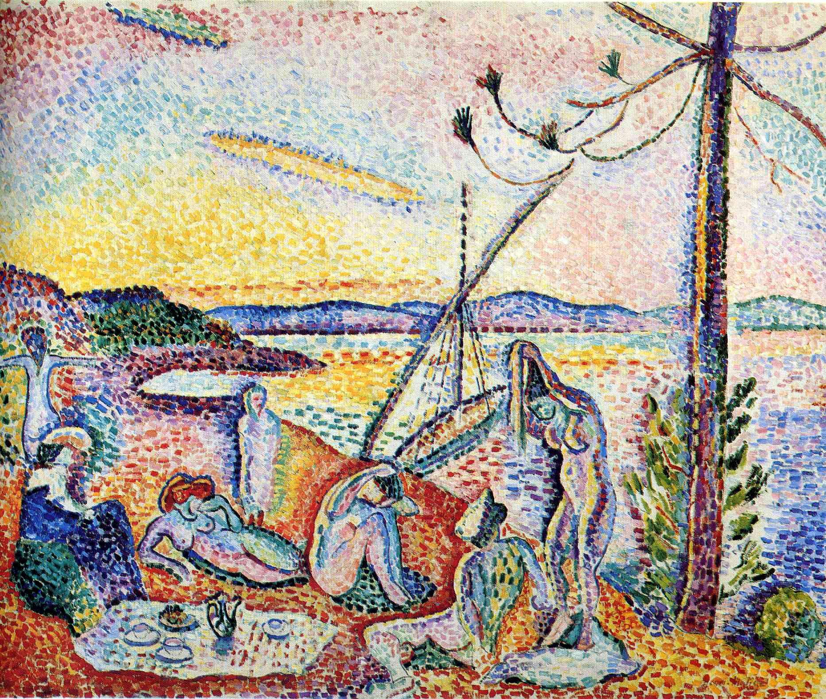
Luxury, Serenity and Pleasure (Luxe, Calme at Volupe 1904
98 x 118cm Oil on canvas

Slide 7
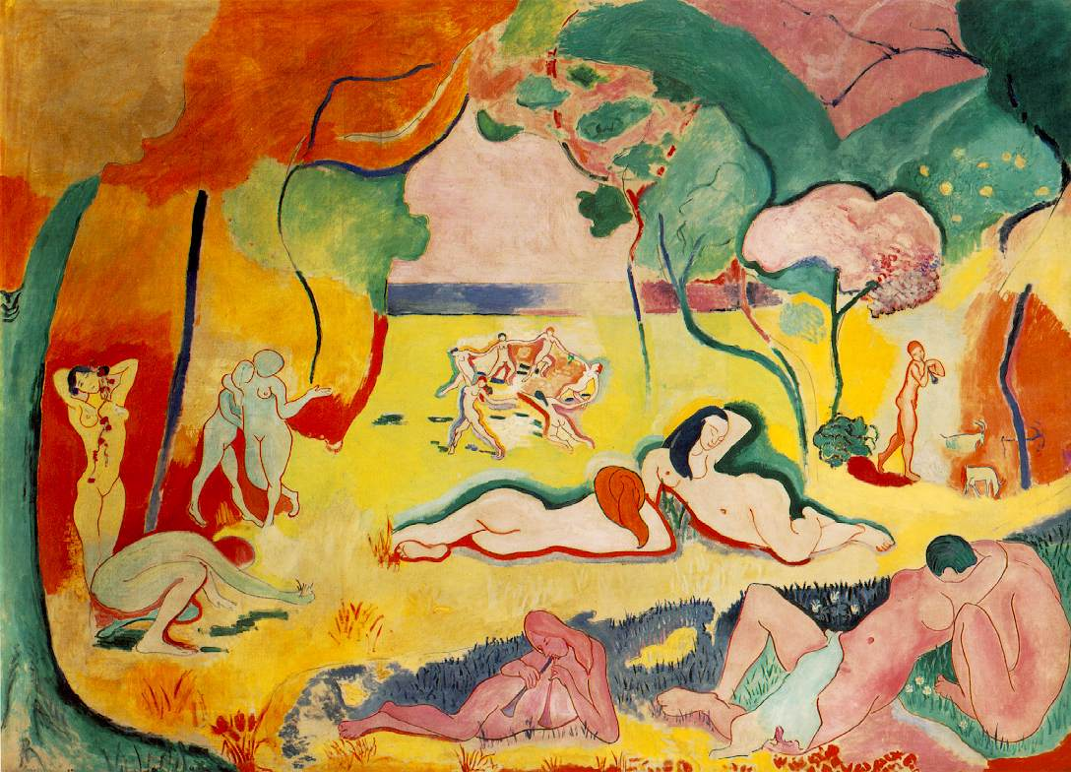
"My choice of colors does not rest on any scientific theory; it is based on observation, on sensitivity, on felt experience."
– Henri Matisse
The Joy of Life 1905-06
175 x 241 cm Oil on Canvas

Slide 8
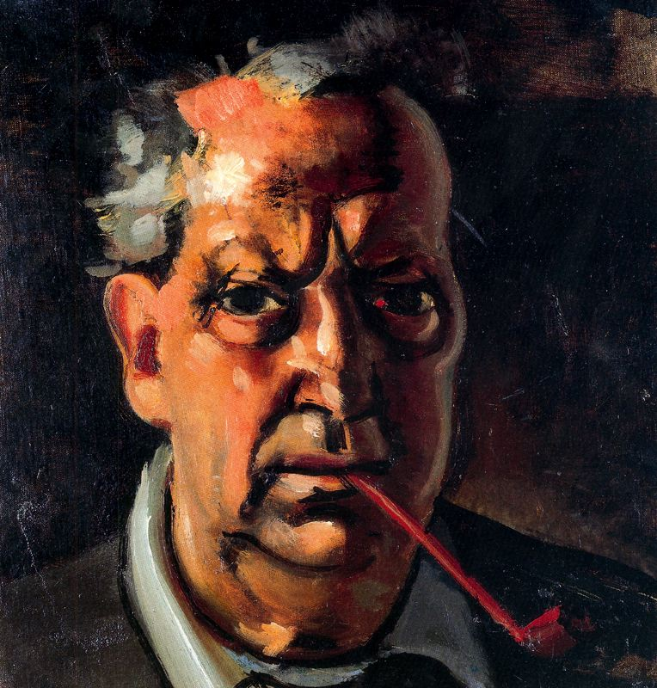
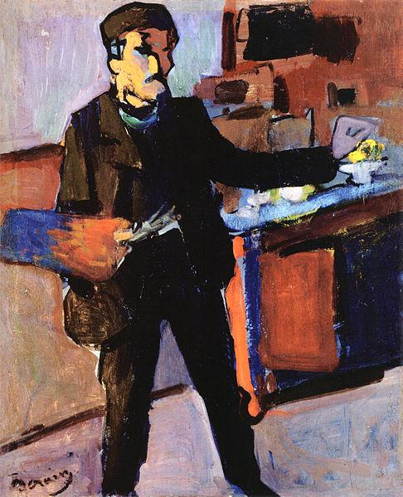
Andre Derain (1880-1954)
French artist, painter, sculptor and co-founder of Fauvism with Henri Matisse.
Father was a pastry chef- middle class. Lived in Paris.
Hated school.
Good friends with Matisse.
Used Pointillism early in his career, truly embraced Fauvism- COLOR!

Slide 9
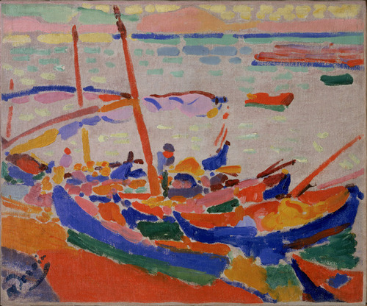
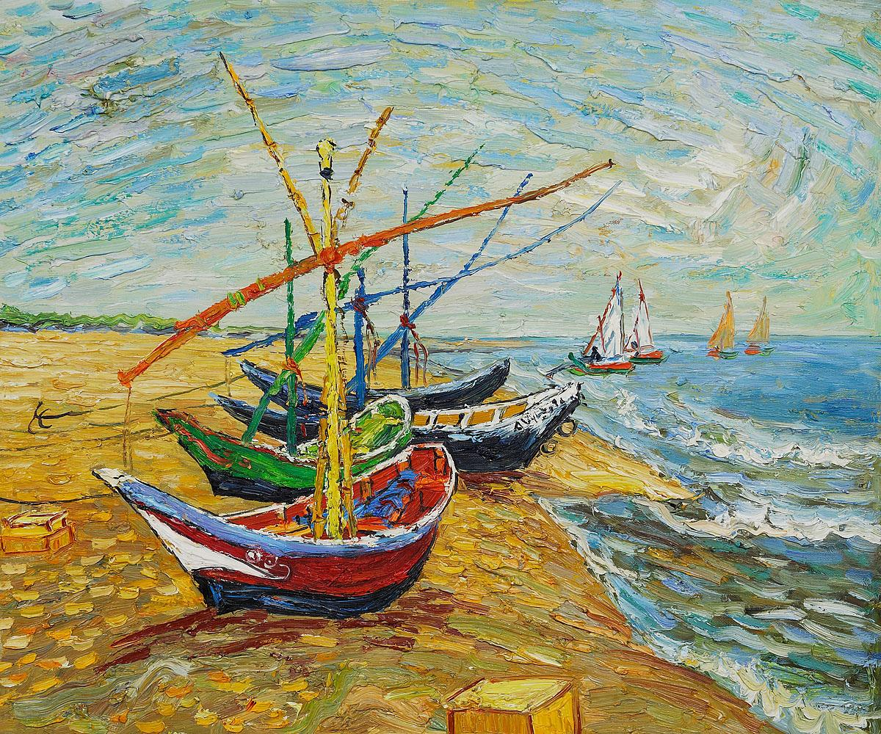
van Gogh's Fishing Boats
Fishing Boats, 1905, Oil on Canvas, 15 1/8 x 18 1/4 in

Slide 10
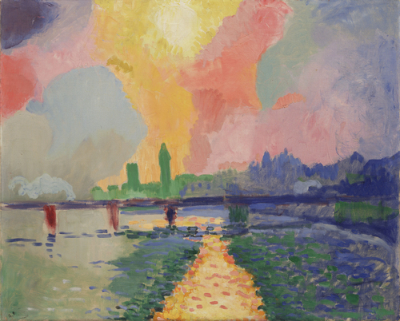
Charring Cross Bridge 1905-06, Oil on Canvas 32 1/8 x 39 5/8"

Slide 11
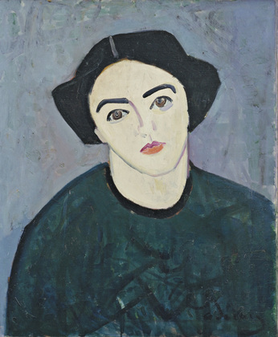
Madame Derain in Green
1907
Oil on Canvas
28 3/4 x 23 5/8"

Slide 12
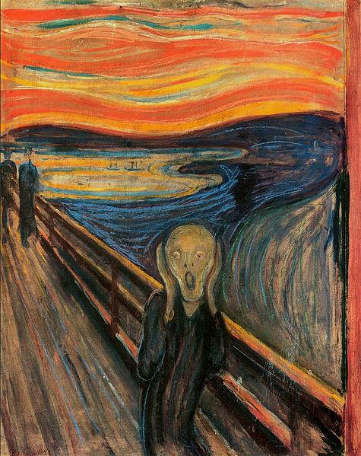
Expressionism
Weird and wacky
Communicating their inner vision- distorted!
Munch, Rousseau and Kandinsky
Edvard Munch
The Scream
1893
Oil, tempera, and pastel on cardboard

Slide 13
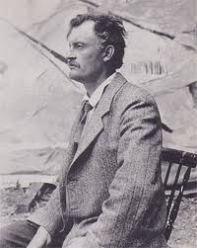
Edvard Munch (1863-1944)
Norwegian painter and printmaker
Intensely evocative treatment of psychological themes
Born in Norway in 1863
His mother and sister died of tuberculosis when he was very young.
Painted all his life

Slide 14
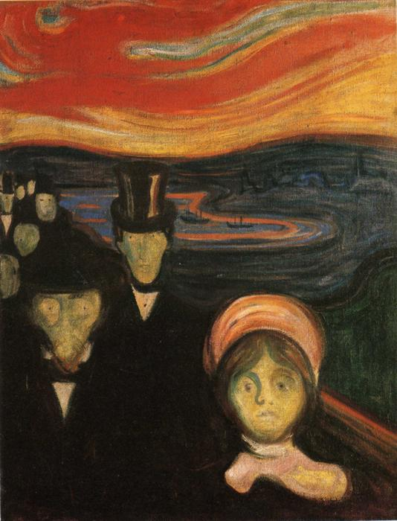
Anxiety
1894

Slide 15
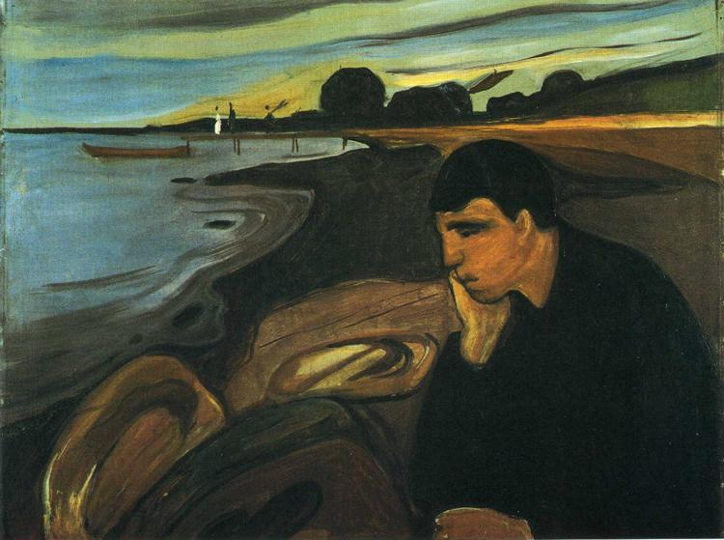
Melancholy 1894

Slide 16
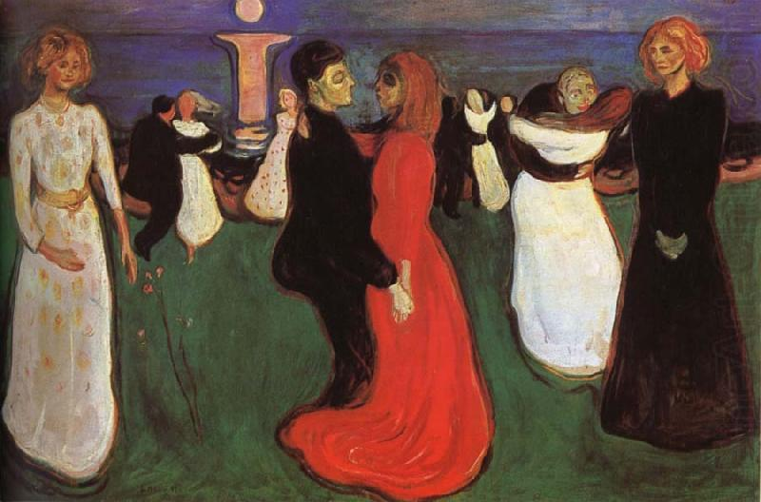
The Dance of Life 1899

Slide 17
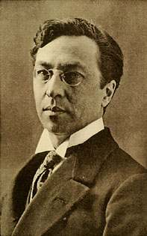
Wassily Kandinsky (1866-1944)
Wassily Wassilyevich Kandinsky was an influential Russian painter and art theorist.
He is credited with painting the first purely abstract works. Non-objective
At first painted only in black and white.
Influential member of The Blue Rider group.
Inspired by music!

Slide 18
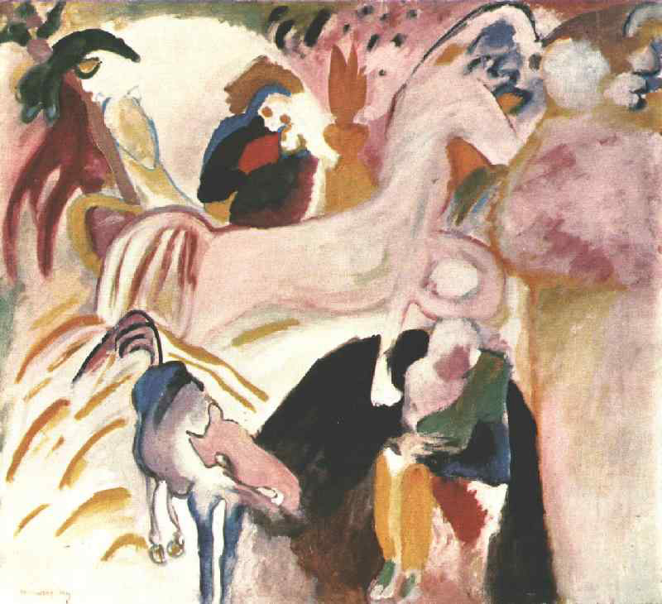
Horses
1909

Slide 19
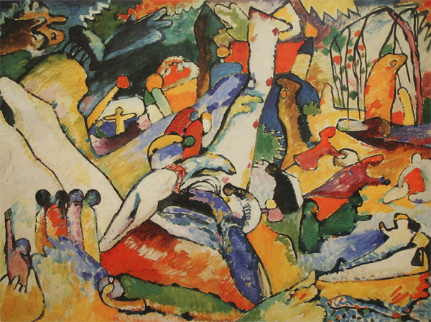

Slide 20
"Study to "Composition II""
1910 Oil on Canvas
97,5х130,5 sm

Slide 21
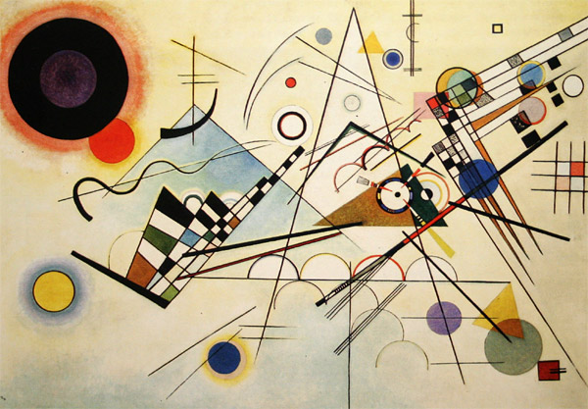
"Composition VIII". 1923 Oil on canvas
New York, The Solomon R. Guggenheim Museum

Slide 22
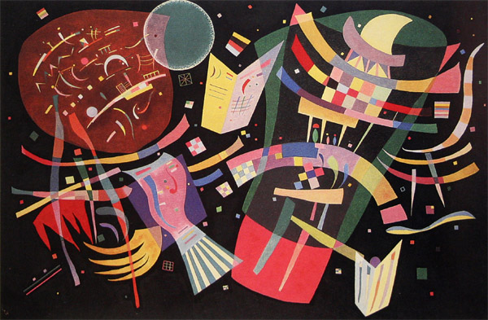
"Composition X". 1939 Dusseldorf, Kunstsammlung Nordrhein-Westfalen, Germany

Slide 23
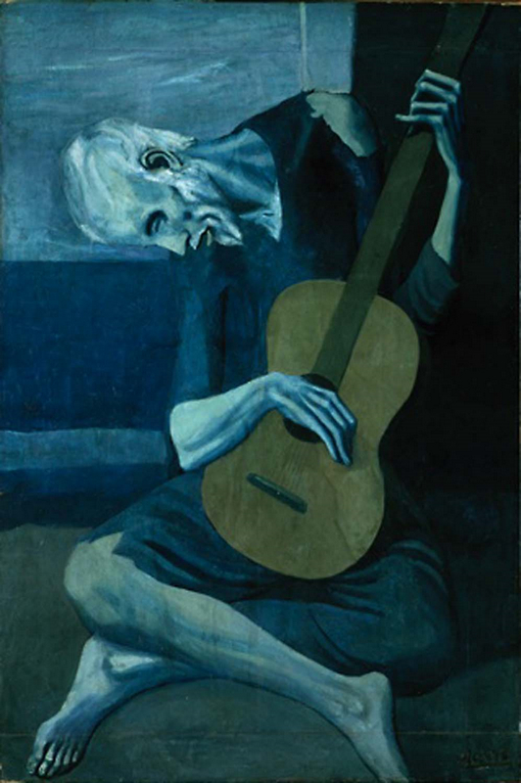
Pablo Picasso
Early work is extremly expressive
Blue period
Poor and homeless

Slide 24
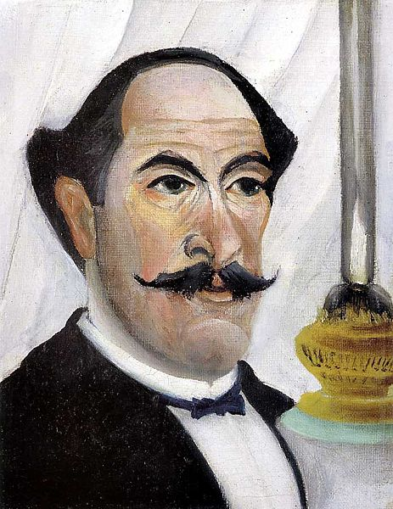
Henri Rousseau (1844-1910)
Considered by some to be a Post-Impressionist
French painter
Worked in a toll booth.
Painted exotic jungle scenes but never in fact left France.
His style is considered "primitive."

Slide 25
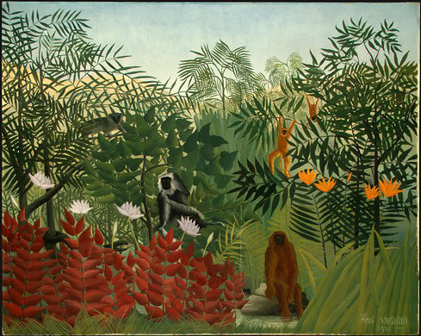
Henri Rousseau, Tropical Forest with Monkeys, 1910, National Gallery of Art, John Hay Whitney Collection
Rousseau visited the zoos and botanical gardens in Paris to sketch and get inspiration.

Slide 26
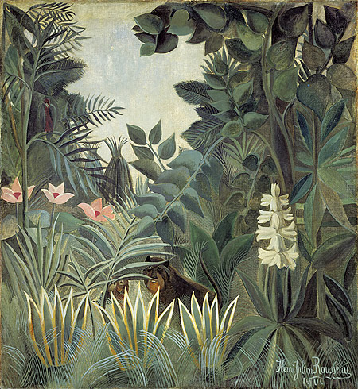
Henri Rousseau, The Equatorial Jungle, 1909, National Gallery of Art, Chester Dale Collection

Slide 27
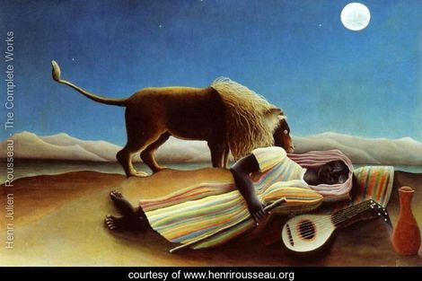
Sleeping Gypsy
1897 Oil on Canvas

Slide 28
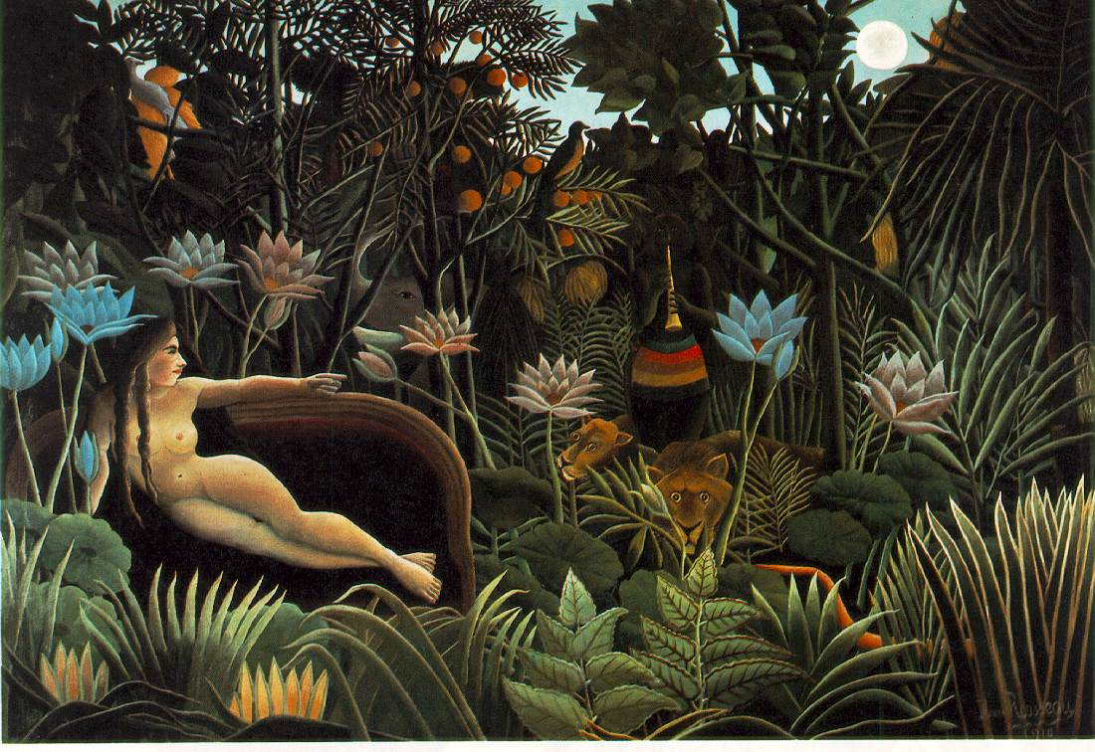
The Dream
1910 (160 Kb); Oil on canvas, 6' 8 1/2" x 9' 9 1/2"; The Museum of Modern Art, New York

Slide 29
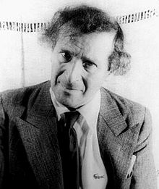
Marc Chagall (1887-1985)
Russian artist
Worked in many mediums
1906 moved to St Petersburg to study art
1910 moved to Paris
Influenced by Fauvism, Expressionism and Cubism
Dreamlike paintings

Slide 30
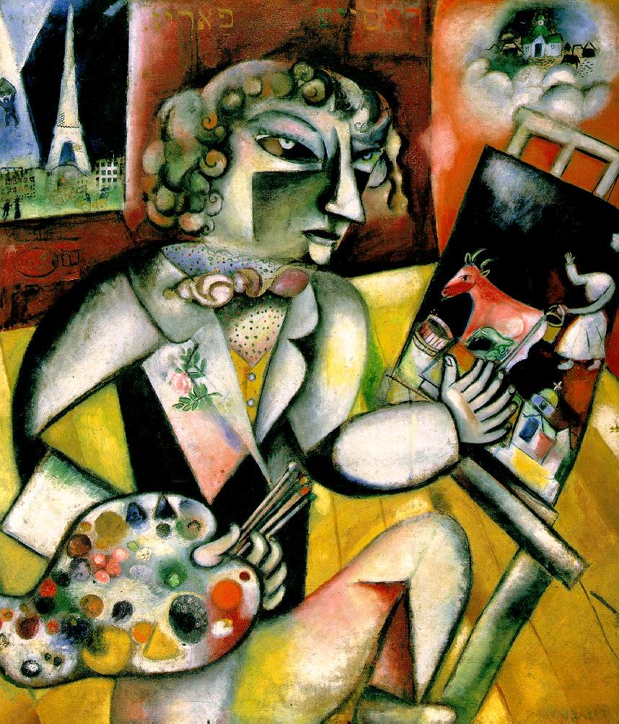
Self Portrait with Seven Fingers
1913
Oil on canvas

Slide 31
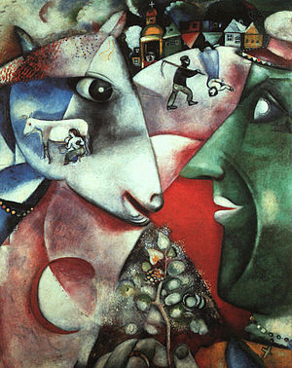
I and the Village
1911
Oil

Slide 32
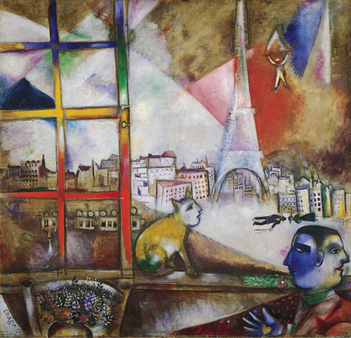
Paris Through Window
1913
Oil

Slide 33
http://www.henri-matisse.net/photographs.html
http://www.henri-matisse.net/
http://www.biography.com/people/henri-matisse-9402564
http://www.artchive.com
http://www.artchive.com/artchive/D/derain.html
http://www.edvardmunch.org/
http://www.wassilykandinsky.net/

