Slide 1
#TBT Africa & Pre-Columbian Art

Slide 2
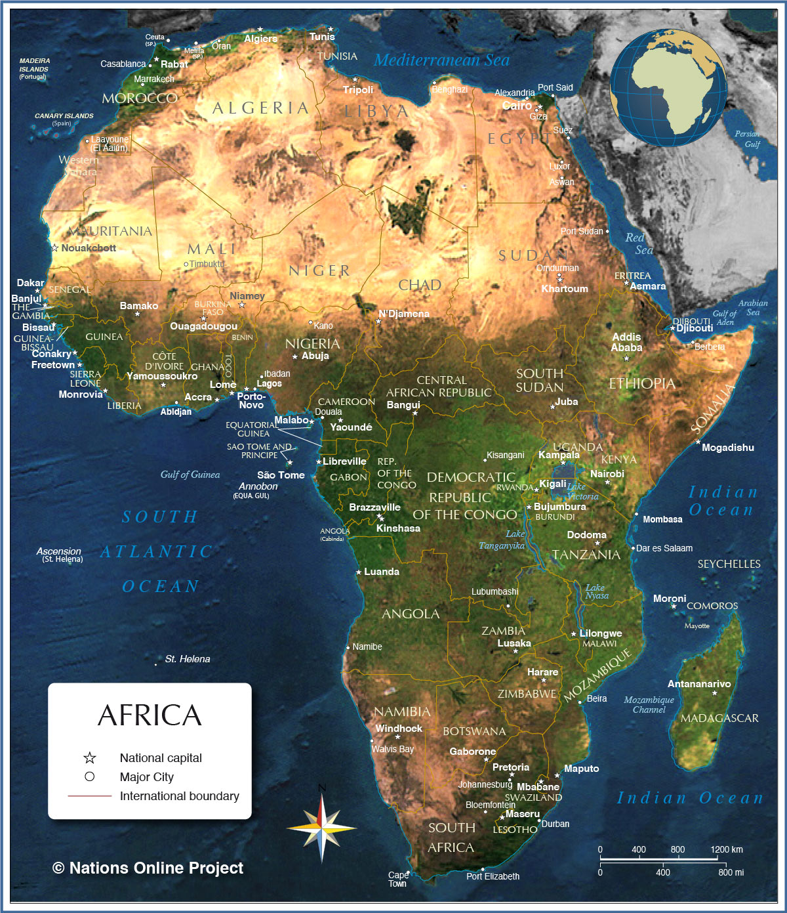
Sub –Sahara Africa
Nomadic in desert
Farming in Savannah and rainforest
Kingdoms of Guinea Coast and Nigeria
Craftsmanship
Geometric Abstraction
Religious orientation

Slide 3
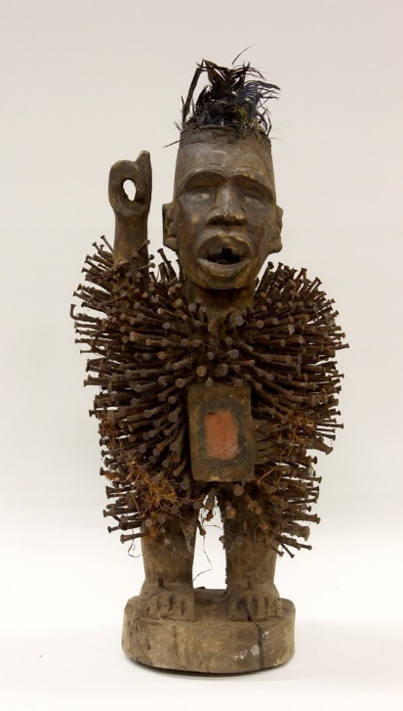
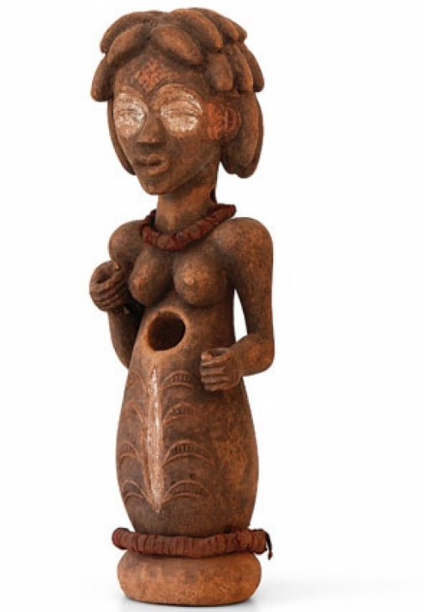
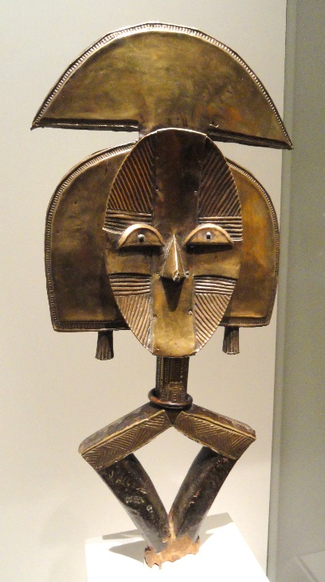
Africa
Cult figures- shrines
Fetish figures- mystical powers
Reliquary figures- guardians

Slide 4
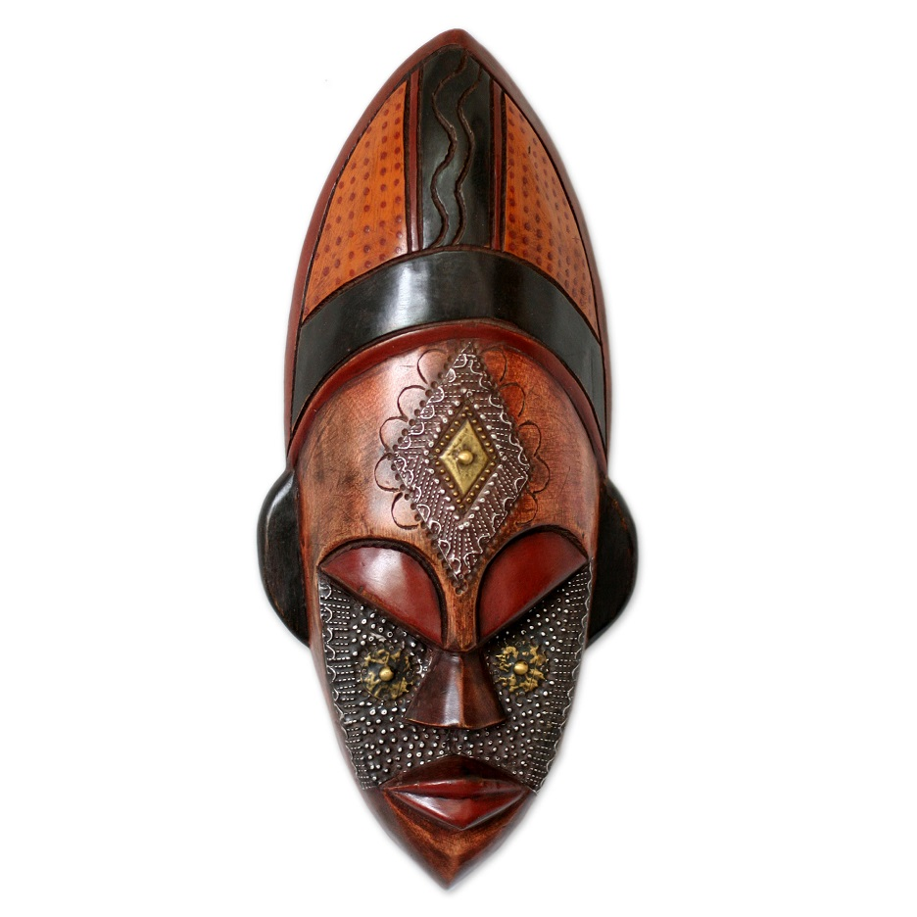
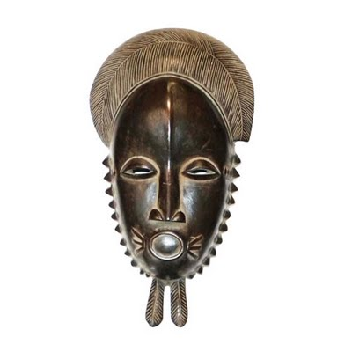
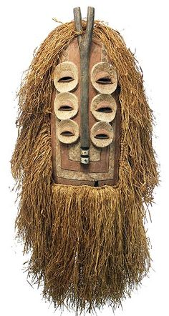
MASKS

Slide 5
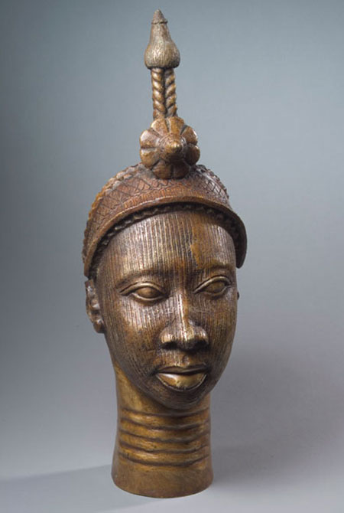
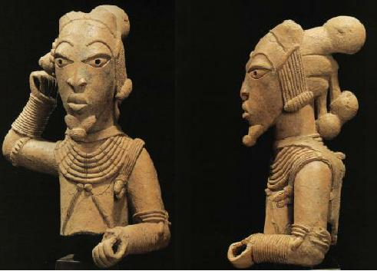
Nigeria and other Kingdoms
Art for the rulers
Decoration

Slide 7
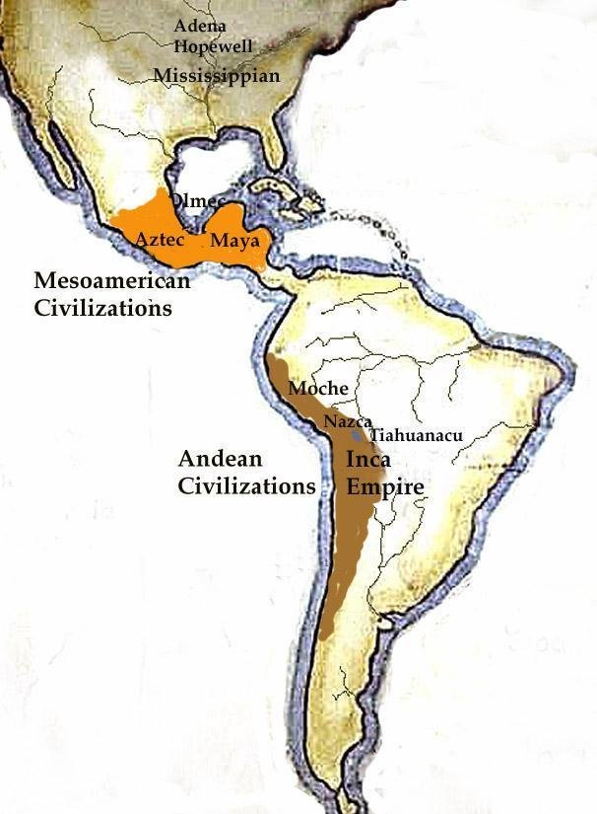
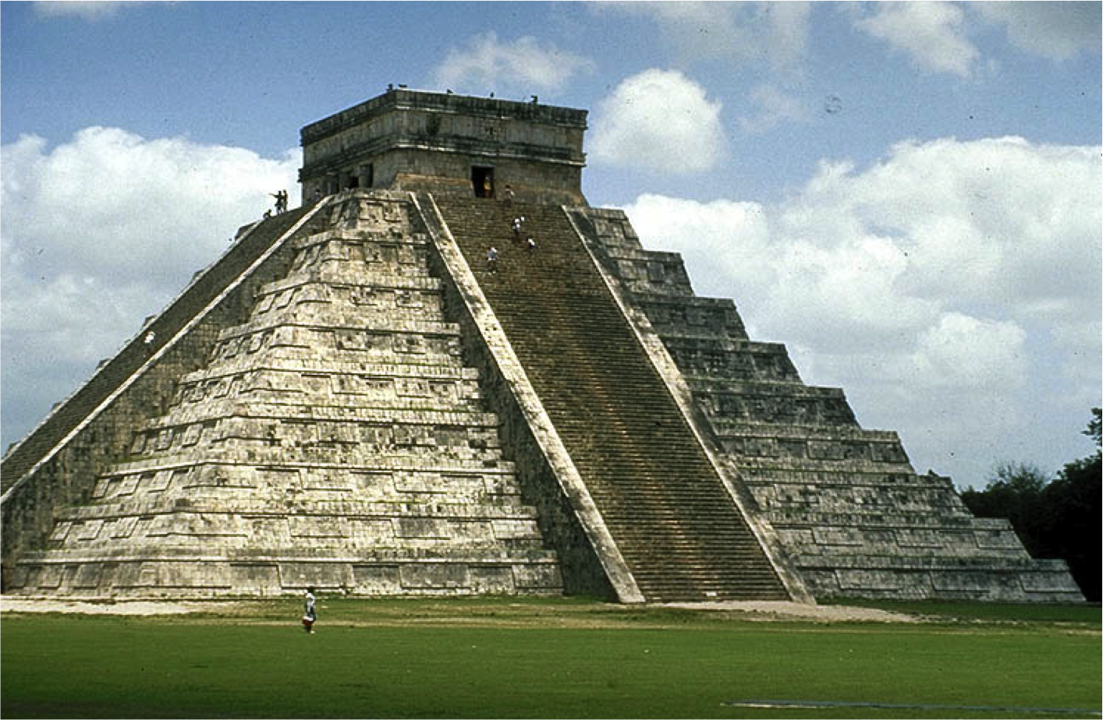
Pre-Columbian Art
Mesoamerica
Andean
Very different than western art
Architecture
Sculpture
Metalwork
Fabrics

Slide 8
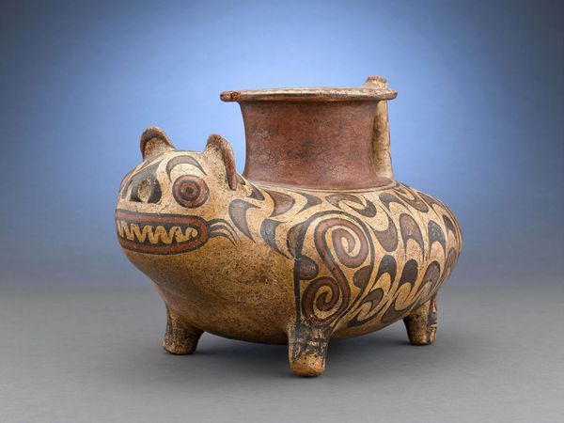
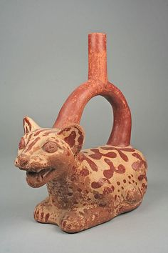

Slide 9
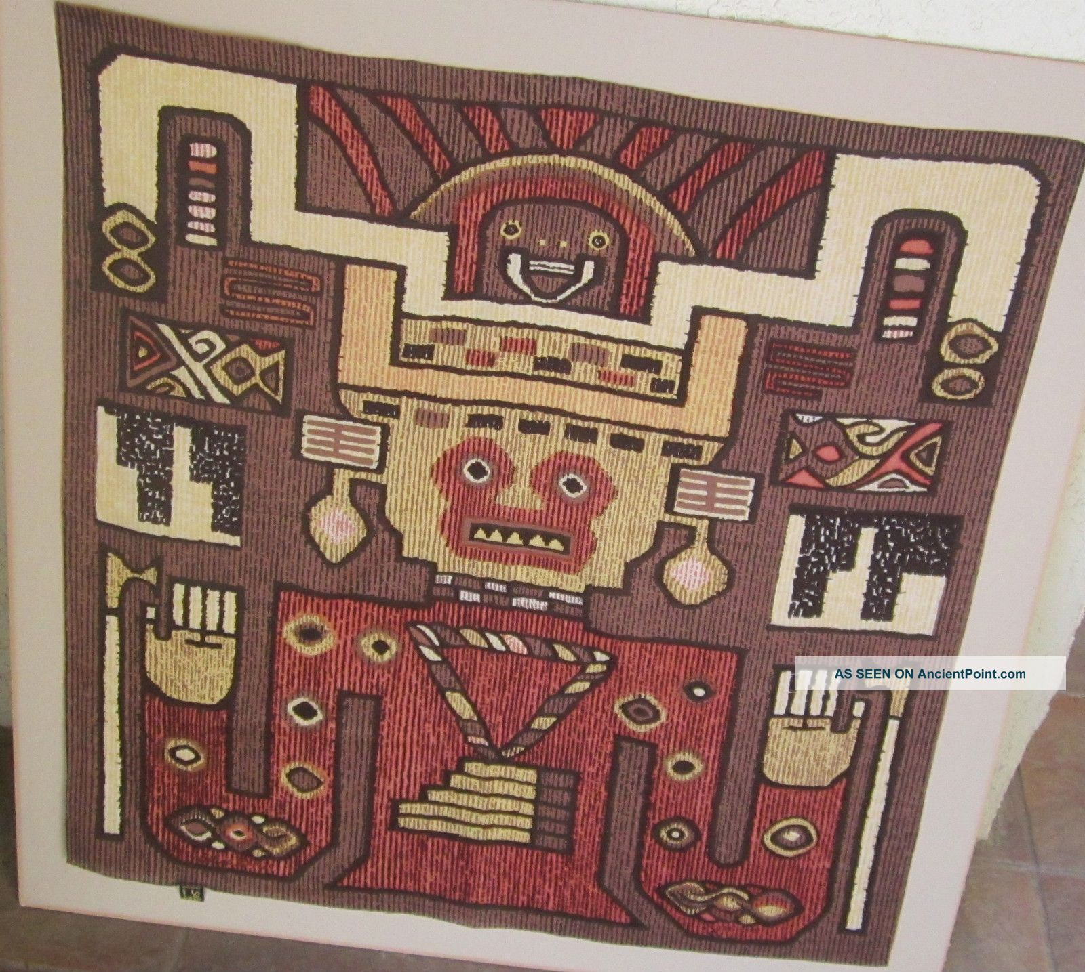
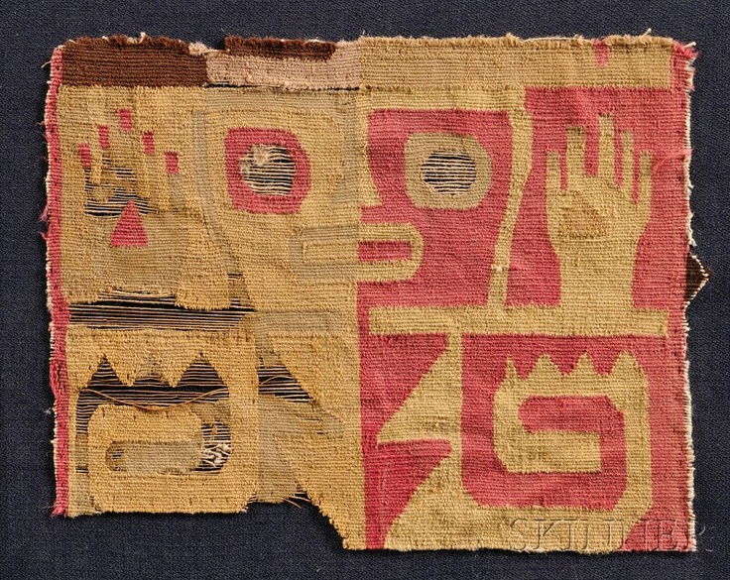
Cochineal
Carmine

Slide 10
