Slide 1
#TBT
ROMANESQUE AND GOTHIC

Slide 2
Romanesque
11th-12th century
Developed mainly in rural areas
Very religious focused
1st international artistic movement
Spread by the church
-Pilgrimages
-Crusades

Slide 3
Romanesque Architecture
Mainly Churches and Monasteries
Characteristics
Thick walls made of stone
Few windows and dark interiors
Use of semicircular arches
More Vaults
Barrel Vaults
Groin Vaults
Latin cross plan
Ambulatory

Slide 4
Thick Walls

Slide 8
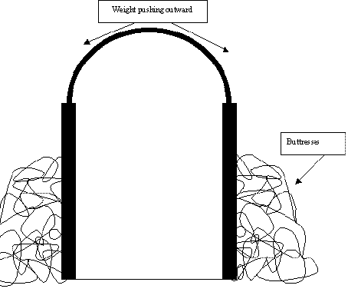
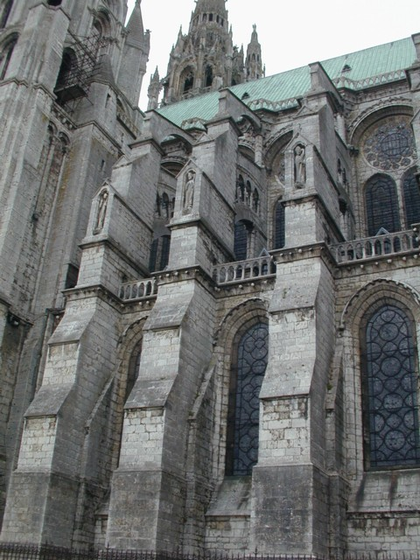
Buttresses
Help to hold up the large walls from the outside

Slide 11
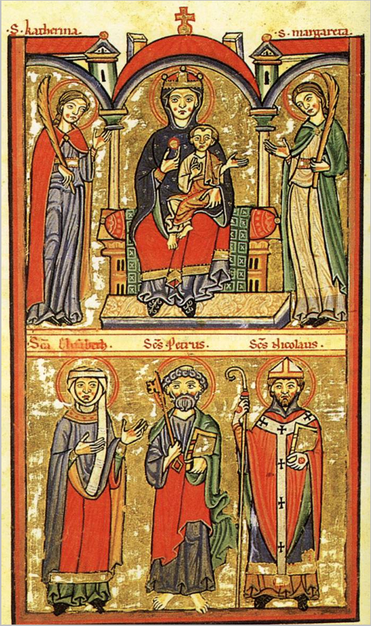
Romanesque ART
Made to decorate churches
Religious topics
Didactic purpose- teach people Christian beliefs
Rigid, unnatural, inexpressive figures
Sculptures
Stone
Doorways and capitals
Painting
Frescos
Two-dimensional
Little background detail

Slide 12
tympanum

Slide 16
Gothic
13th-15th
People move to cities
Cathedrals become centers of cities
Gothic- first used to ridicule because it wasn’t Greek
UNITY
sculpture and painting begin to separate from architecture
Taller is better

Slide 17
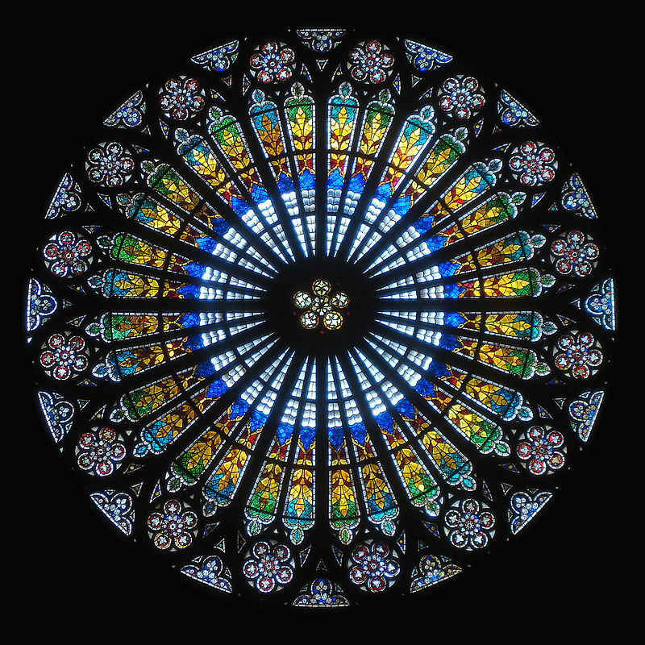
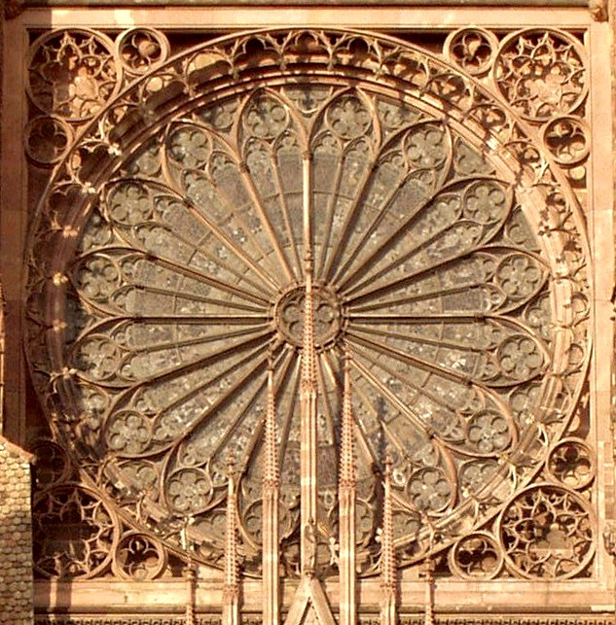
God is light
More windows and open space
Stained glass windows
ROSE WINDOWS
Strasbourg Cathedral.

Slide 18
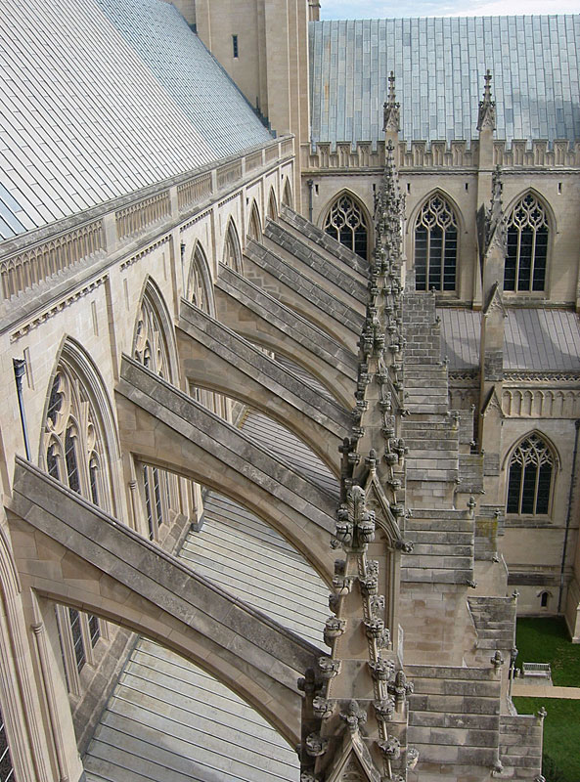
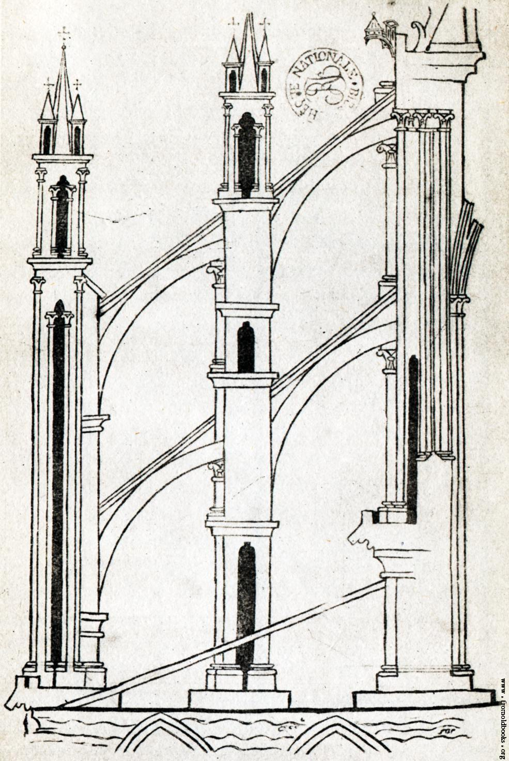
More windows- less support possible…
Flying Buttresses

Slide 20
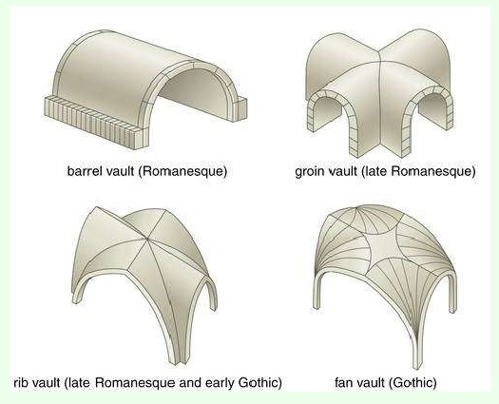
What is happening to the vaults?

Slide 21
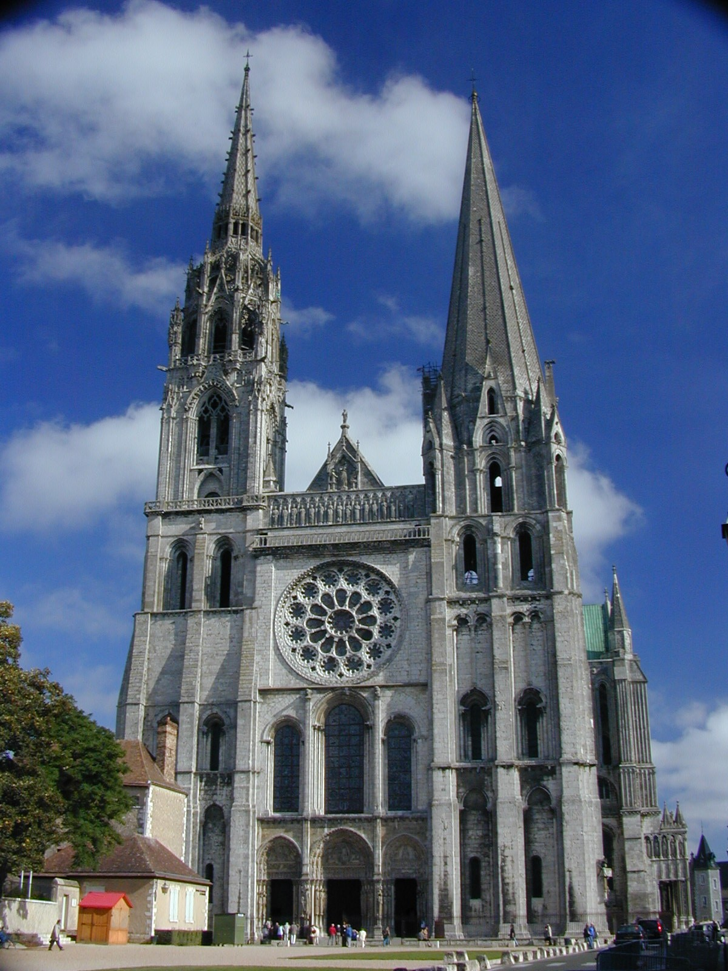
Chartres Cathedral
France
1194 to 1250

Slide 22
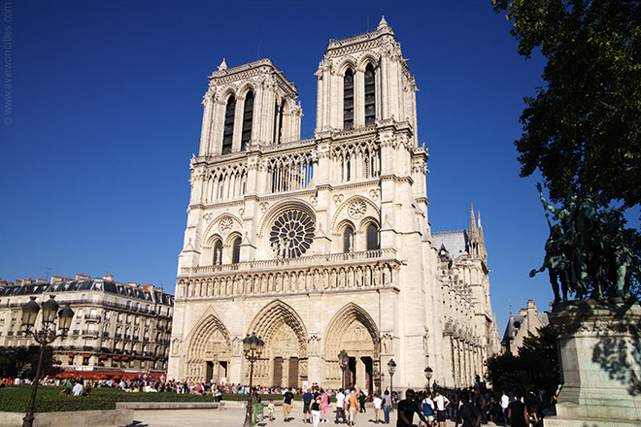
Notre Dame Paris, France 1160-1250-1345

Slide 23
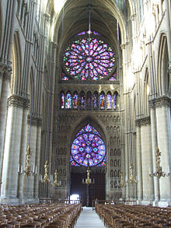
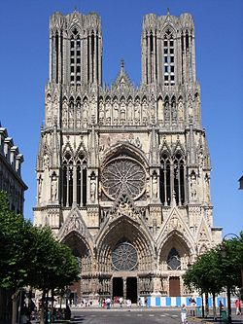
Reims Cathedral Reims, France

Slide 24
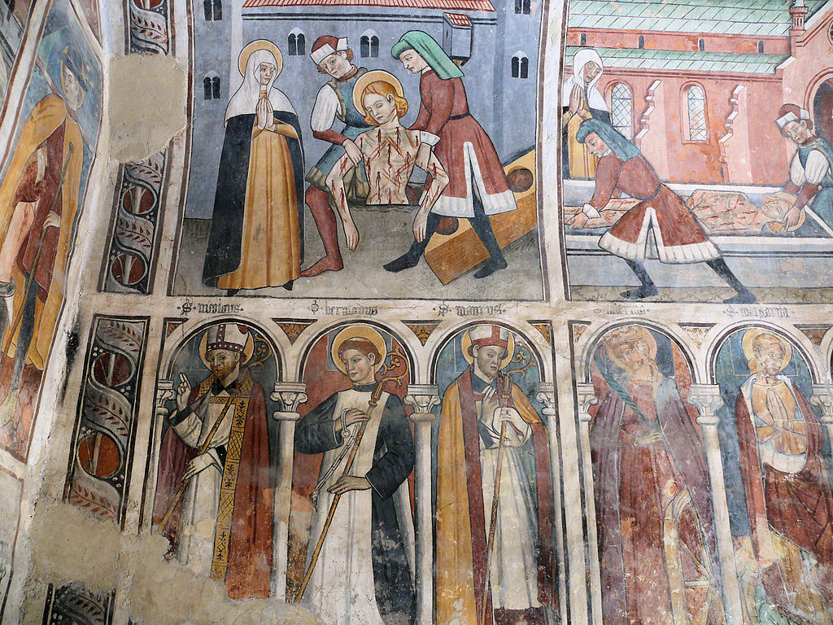
ART
Began to become independent from architecture (especially paintings)
Still didactic mainly
Some decorative
Artists start to become famous
Still considered craftsmen

Slide 25
Sculpture
Religious and educational purposes
Mostly stone
Wood started becoming popular
Independent from architecture
More realistic
Curved lines showing movement
Expressing feelings

Slide 27
What are the differences between the Gothic and Romanesque crosses?

Slide 28
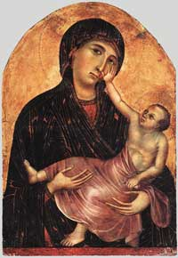
Painting
Religious subjects
Rich people started hiring portraits
Bright colors and gold
Background landscapes
Realism and movement

