Slide 1
Dada and Surrealism

Slide 2
Dada
Began in 1915
Switzerland
World War 1
A protest against the degradation of society
Protest of the war
Nonsense attitude
Anti-Art

Slide 3
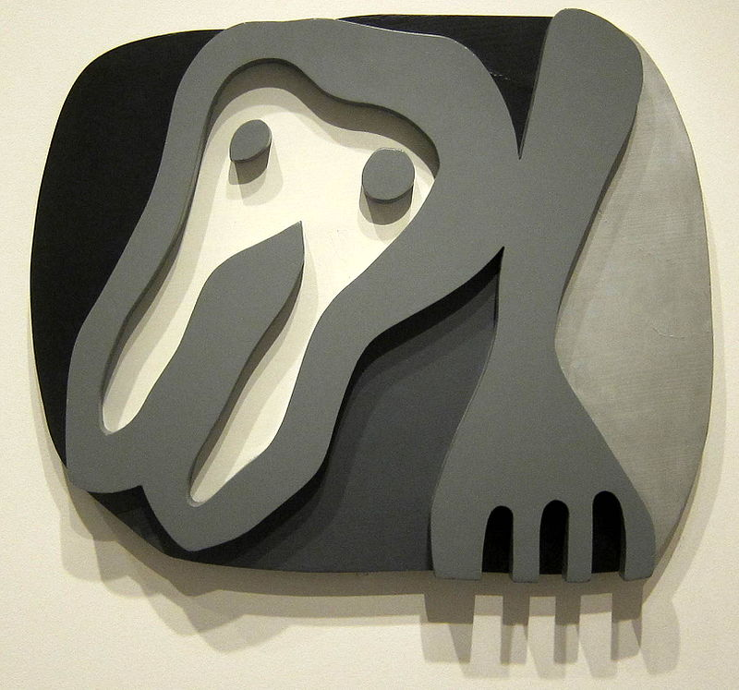
Jean Arp
Biomorphic Shapes
Shirt Front and Fork, painted wood, 1922

Slide 4
Constellations

Slide 5
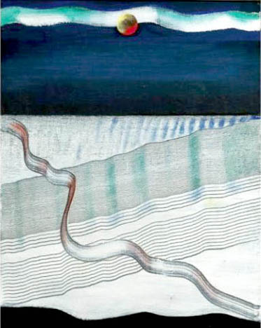
Max Ernst
La Mer

Slide 6
Surrealism
Post war
Began with writers
Psychology
Unconscious mind
A better reality
Dream
Sigmund Freud

Slide 7
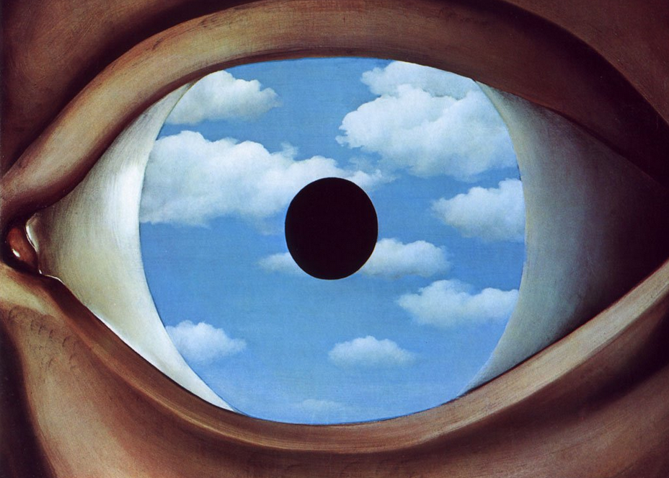
Rene Magritte
The False Mirror

Slide 8
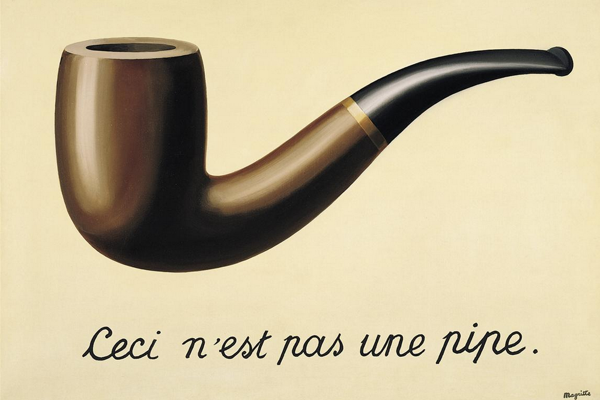

Slide 9
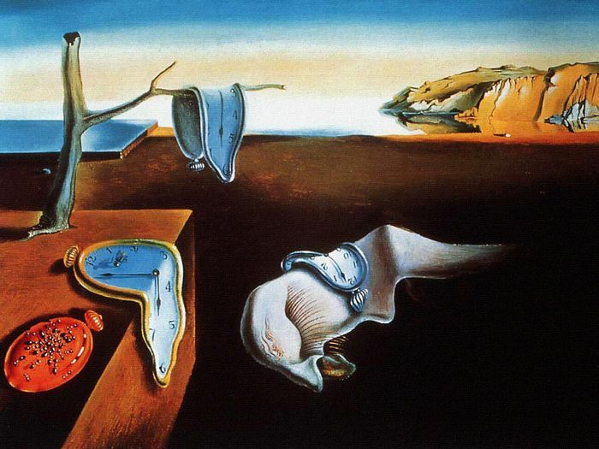
Salvador Dali
Persistence of Memory

Slide 10
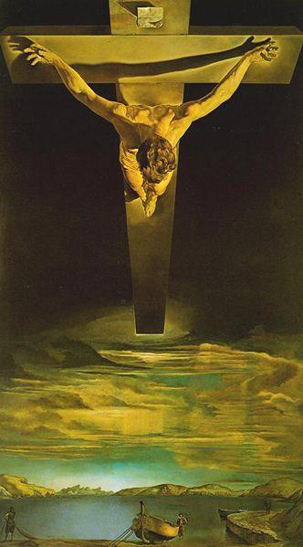
Christ of St. John of the Cross

Slide 11
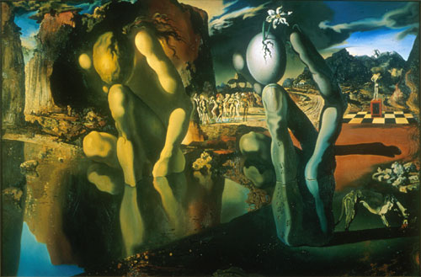
The Metamorphosis of Narcissus, 1937, Salvador Dali

