Slide 1
Romanticism
A rebuttal to neoclassic traditions
Interest in Medieval stories
Called romances
Individualism vs the system
Emotion vs intellect
Color, emotion, content and passion
Crossed all forms of art

Slide 2
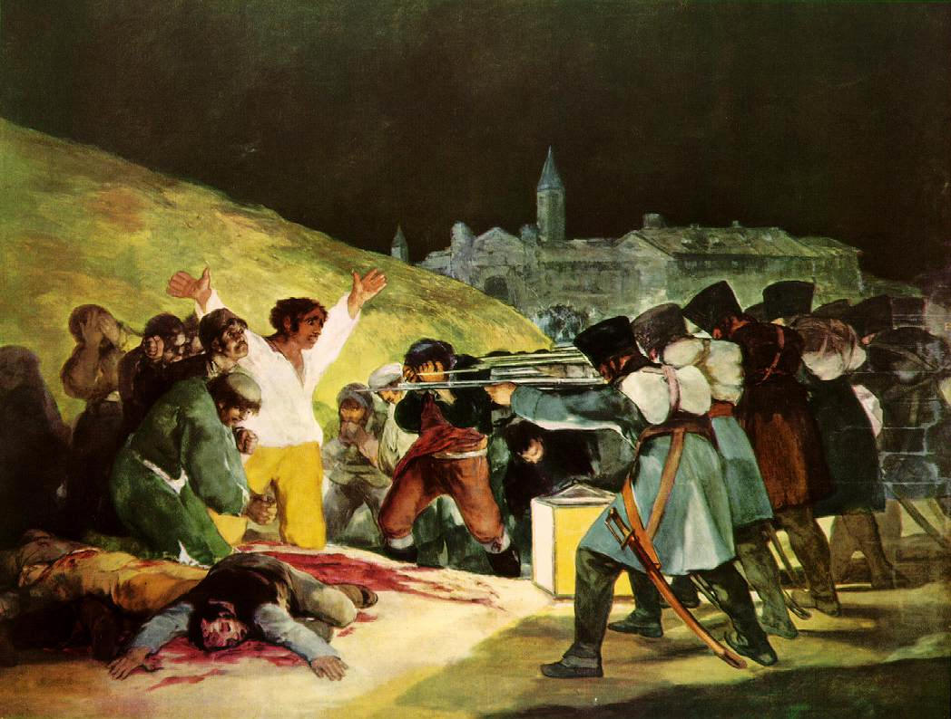
Francisco Goya
Not worried about formal aspects, more worried about the impact
Third of May 1808, 1814
Slaughtering of Spanish soldiers by French soldiers

Slide 3
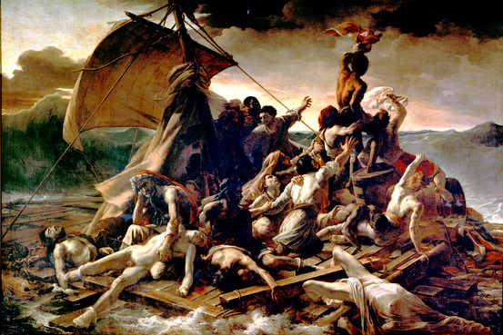
Theodore Gericault
Raft of the “Medusa”, 1818-1819
Went to the extreme for emotion

Slide 4
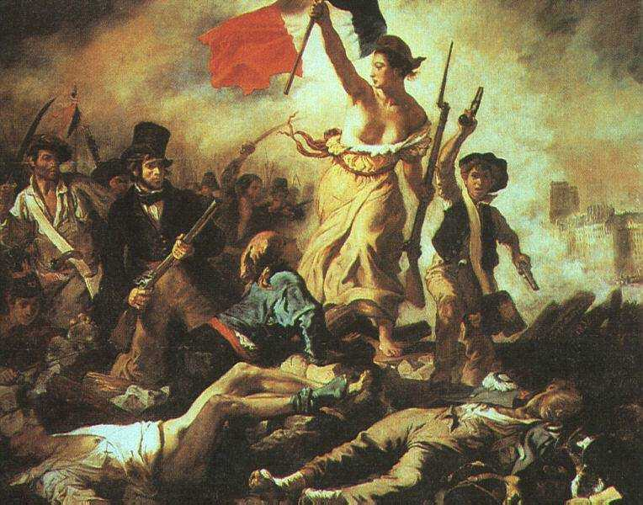
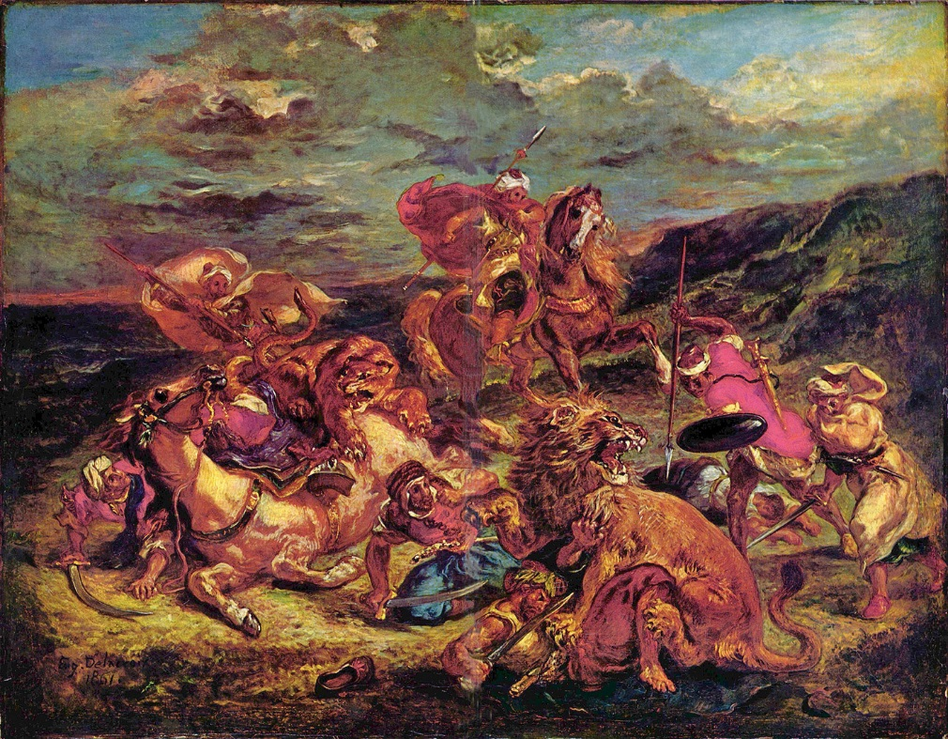
Eugene Delacoix
Change in style
Painted from photographs

Slide 5
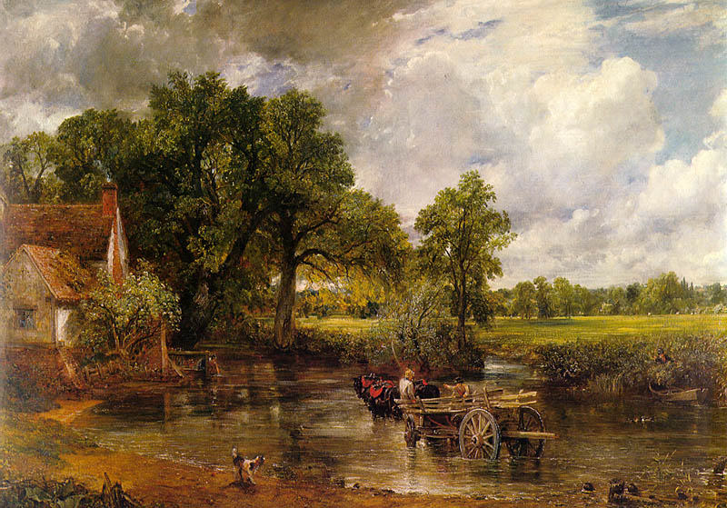
John Constable
Reflection of water was mocked
First large scale landscapes
The Hay Wain
1821

Slide 6
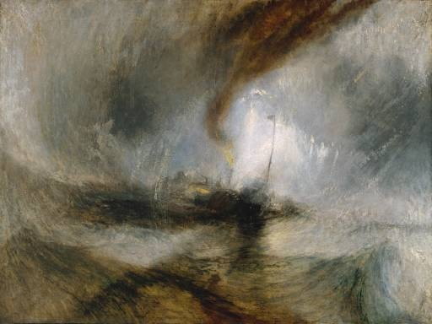
Joseph Mallord William Turner
Changes in style
Nonrepresentational art
Does not represent anything specific
Snow Strom: Steam-Boat off a Harbor’s Mouth

Slide 7
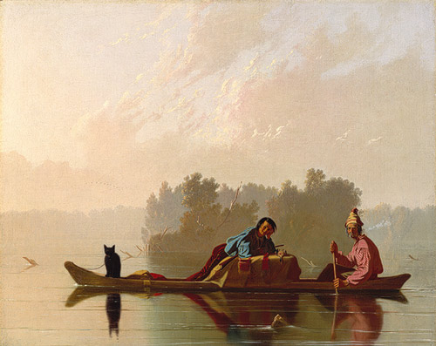
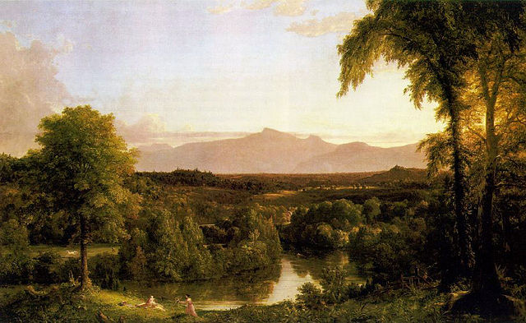
Thomas Cole & George Caleb Bingham
American artists!

Slide 8
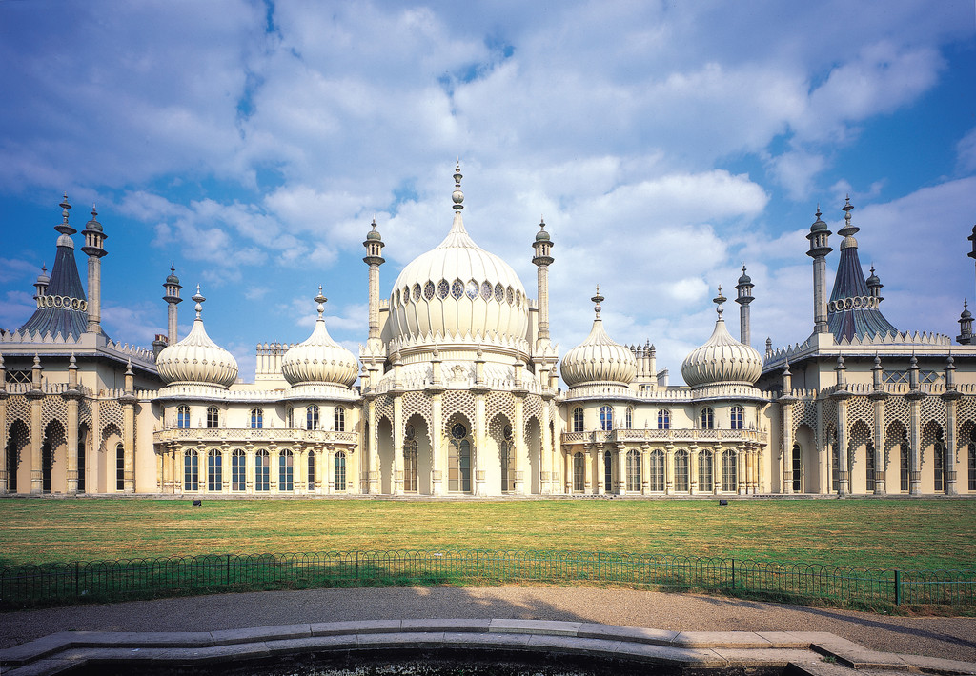
Architecture
Return of many styles
Royal Pavilion 1815-1818, Brighton, England

Slide 9
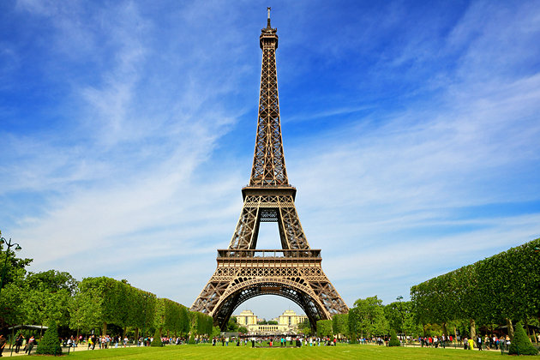
Architecture
Return of many styles
Eiffel Tower, Paris, France 1832-1923

