Slide 1
#TBT NATIVE AMERICAN ART

Slide 2
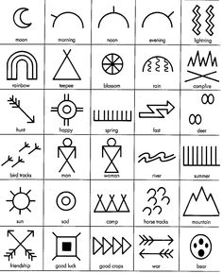
Deep connection with spirituality and nature
Traced back to cave painting, stonework and earthenware
Each piece relates to the indigenous people
Important Symbols: Sun, Moon, bear, eagles, people, and more
Everything is well made

Slide 3
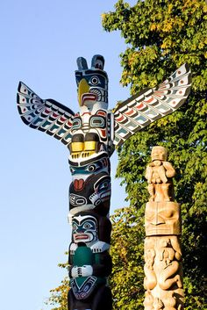
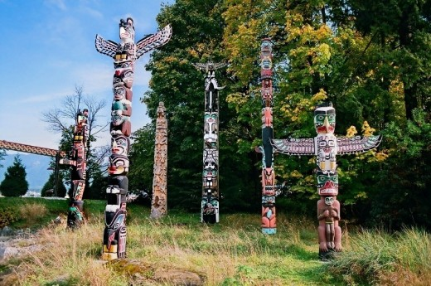
Totem Poles
Family stories
Spiritual stories

Slide 4
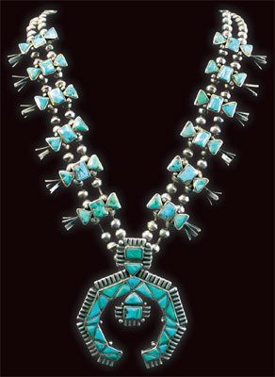
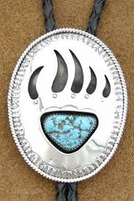
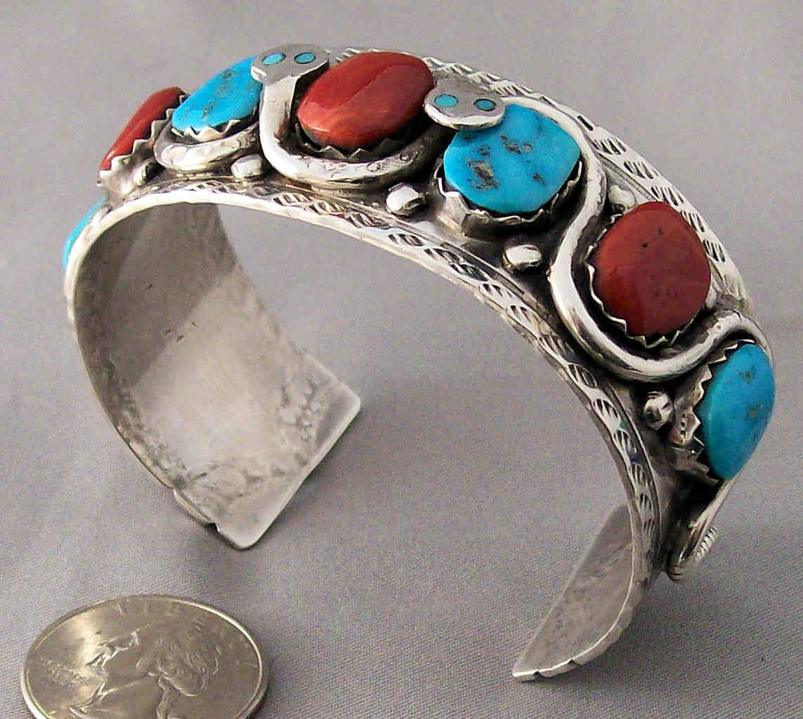
Jewelry
Used to…
Adorn
Protect
Honor

Slide 5
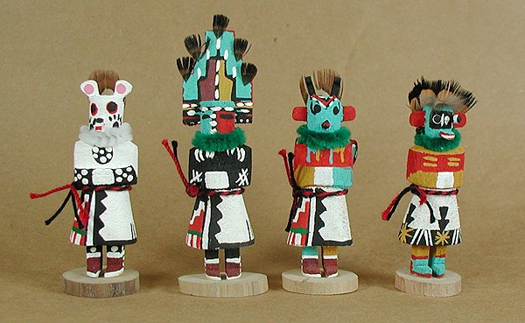
Hopi - Kachina Dolls

Slide 6
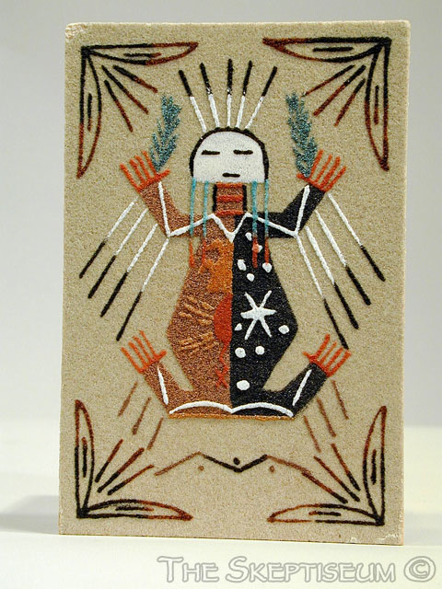
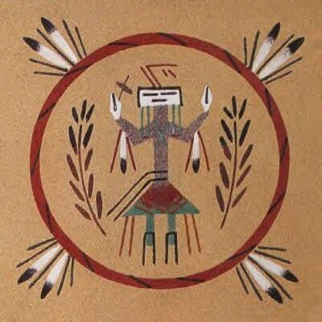
Navajo – Sand Painting for healing

Slide 7
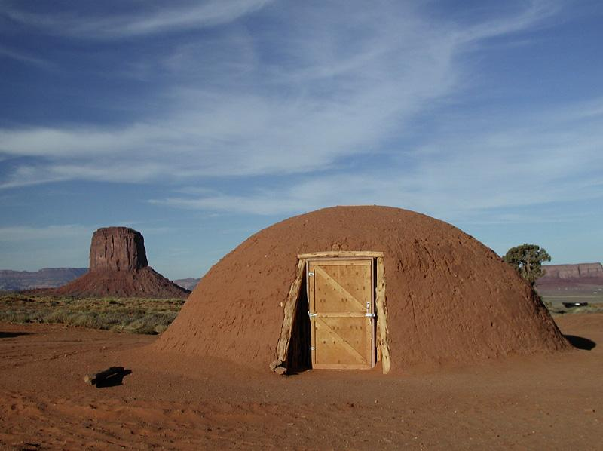
Hogans

