Slide 1
Mannerism
1525-1600

Slide 2
Mannerism
Connects the Renaissance to Baroque Period
Crisp frozen shapes
Elongated Bodies
Distorted forms
Strong ties to High Renaissance
Not a single style, a mixture of styles
Strong emotions
Still quite a bit of religious figures

Slide 3
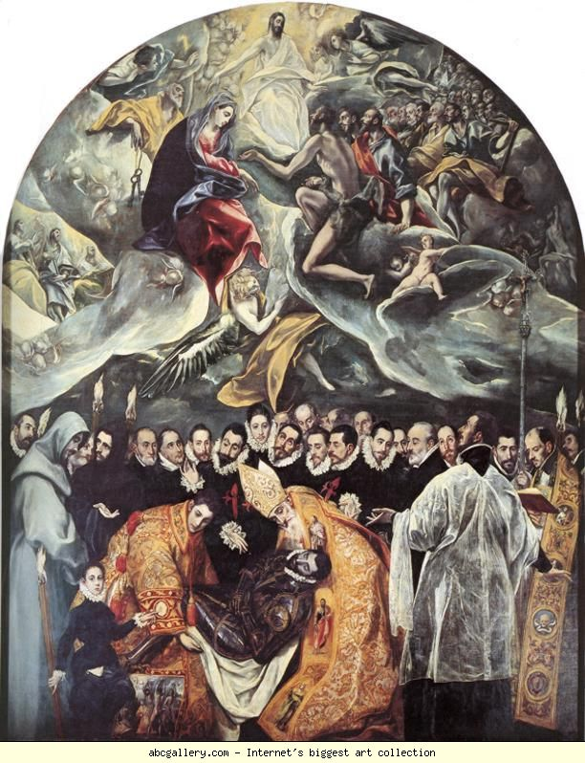
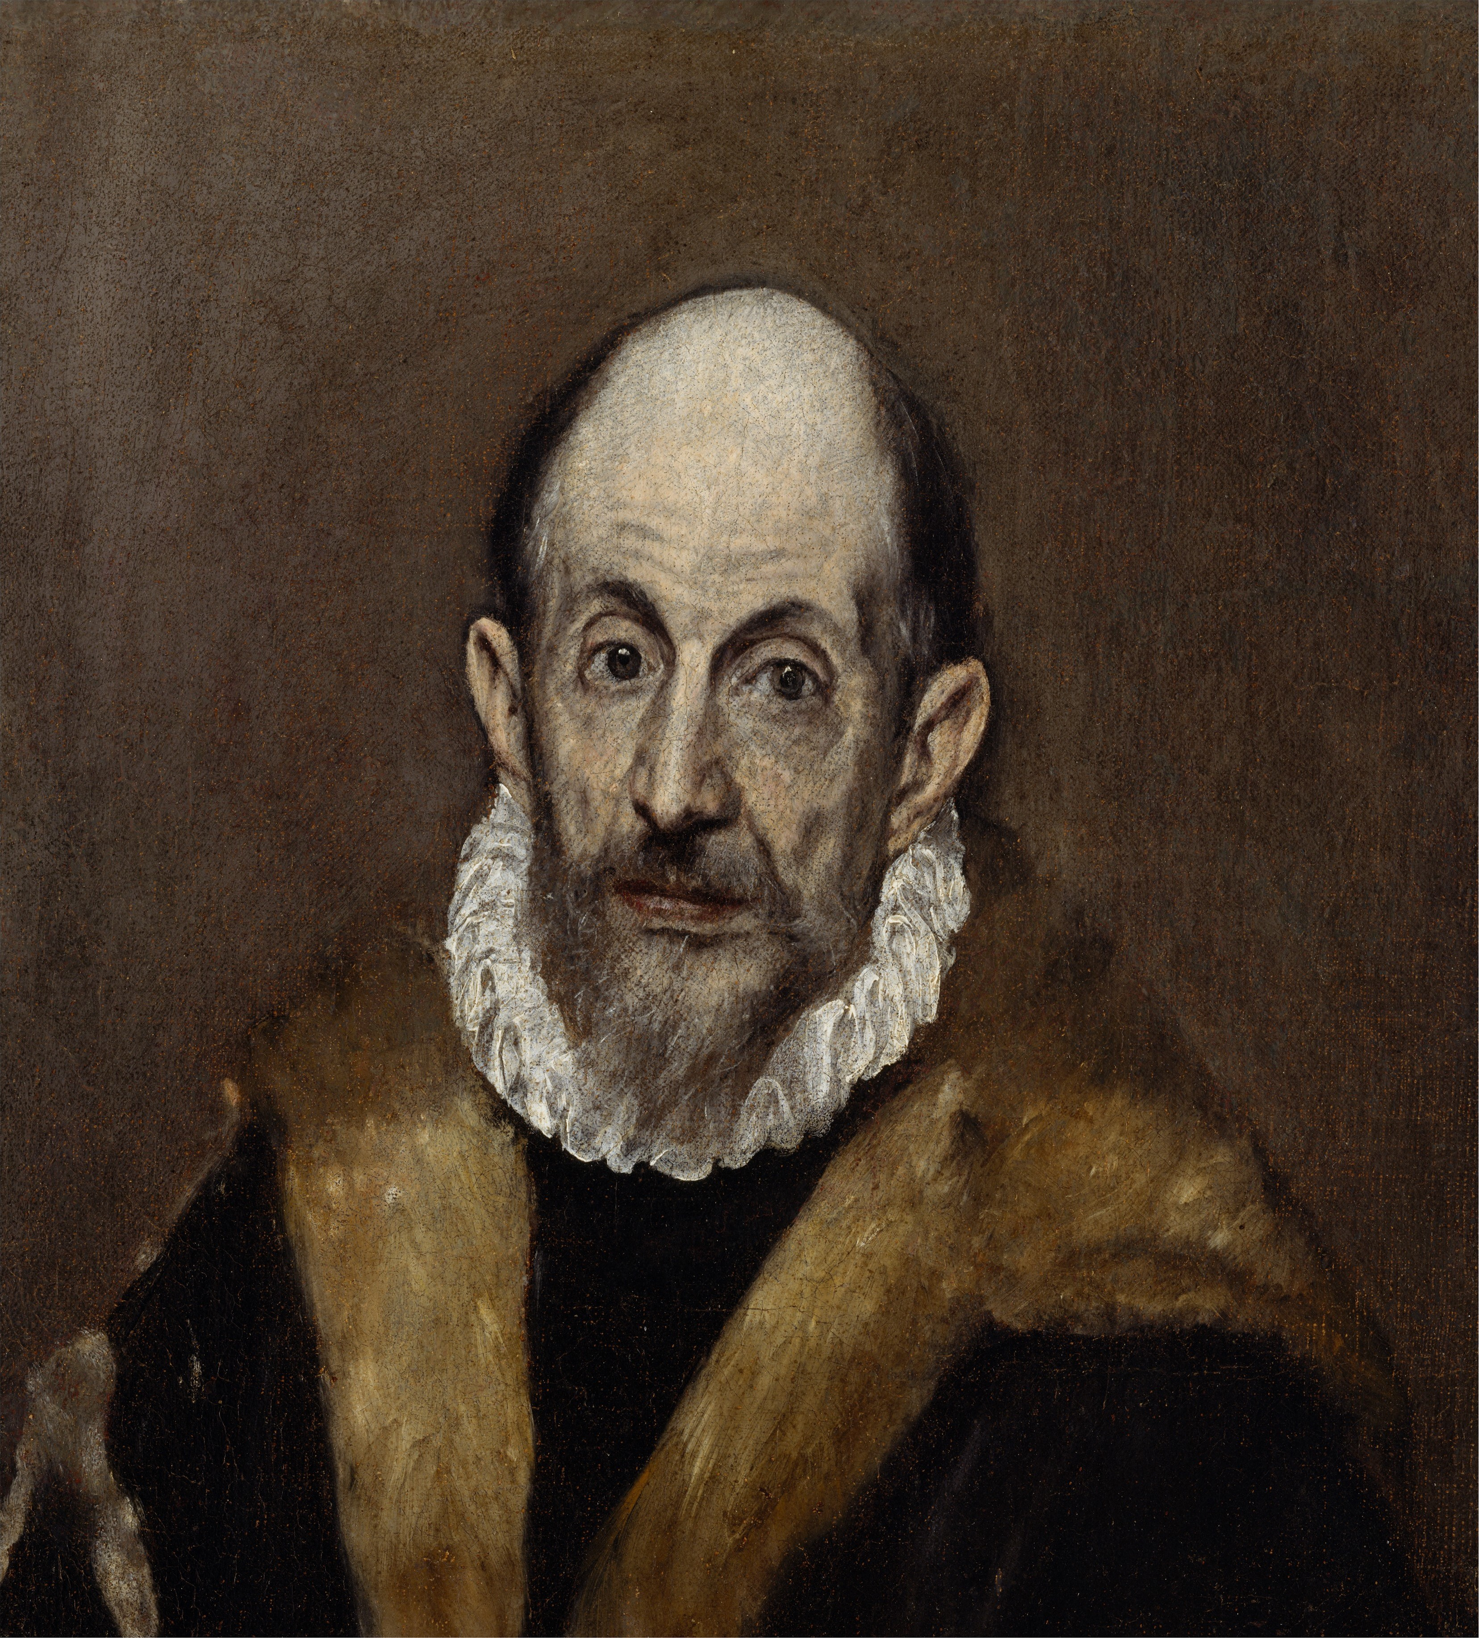
El Greco
Means “the Greek” but worked in Spain
Mixed byzantine and Italian Mannerist
The Burial of count Orgaz

Slide 4
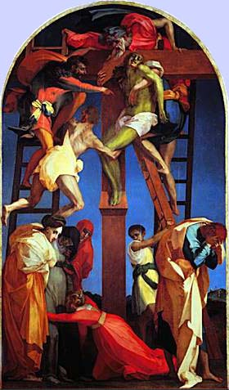
Rosso Fiorentino
Rejected Renaissance
Crowds figures around edges
The Decent from the Cross

Slide 5
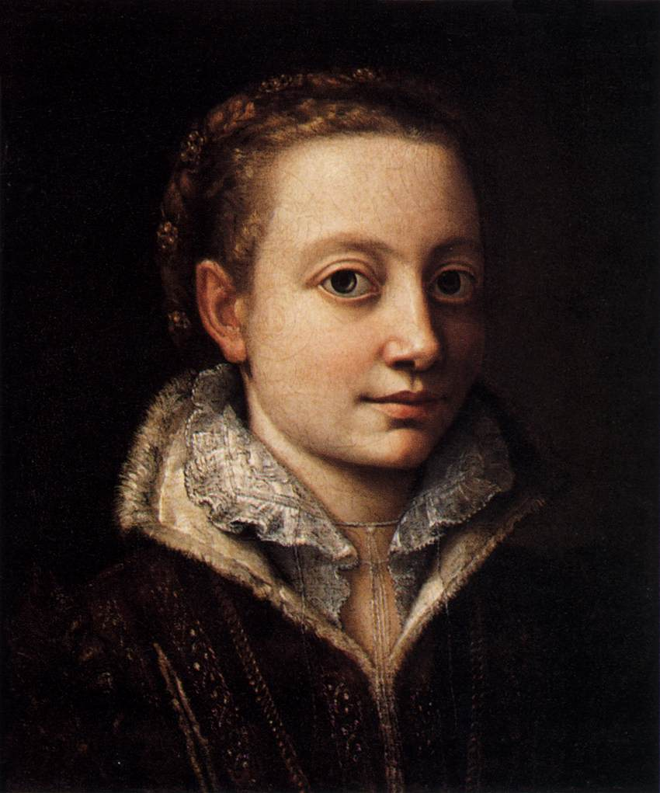
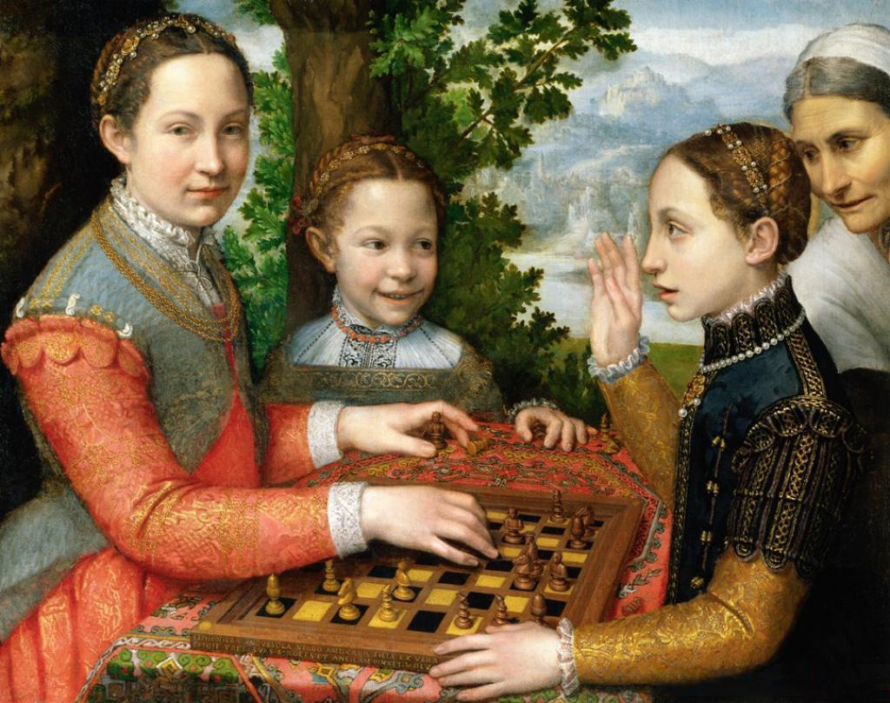
Sofonisba Anguissola
Child prodigy
Introduced genre into portraiture
Everyday activity

Slide 6
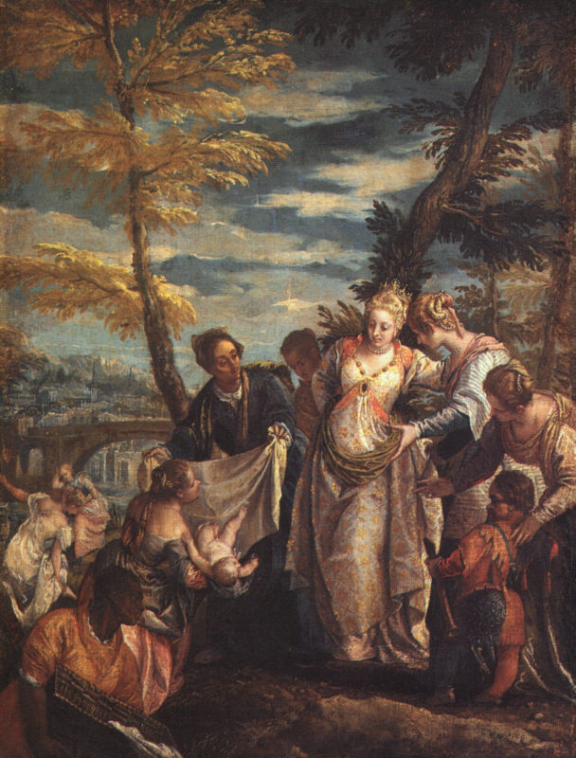
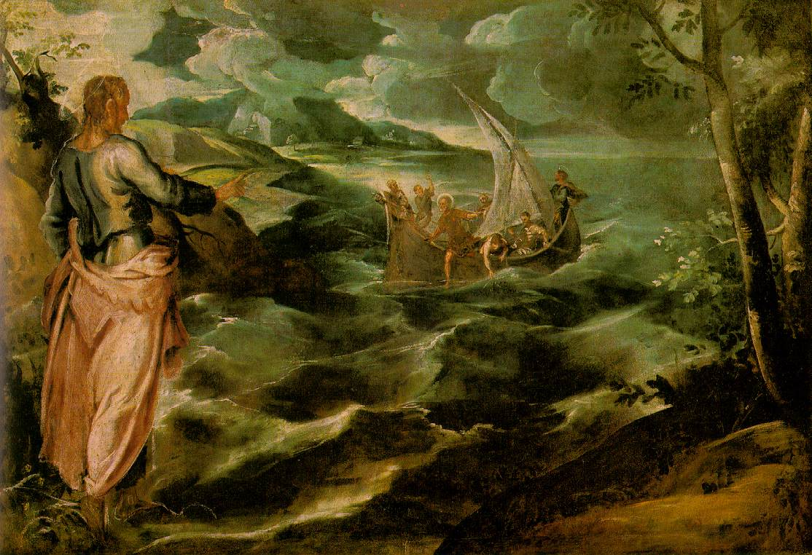
Tintoretto & Veronese
Finding of Moses
Christ at the Sea of Galilee

Slide 7
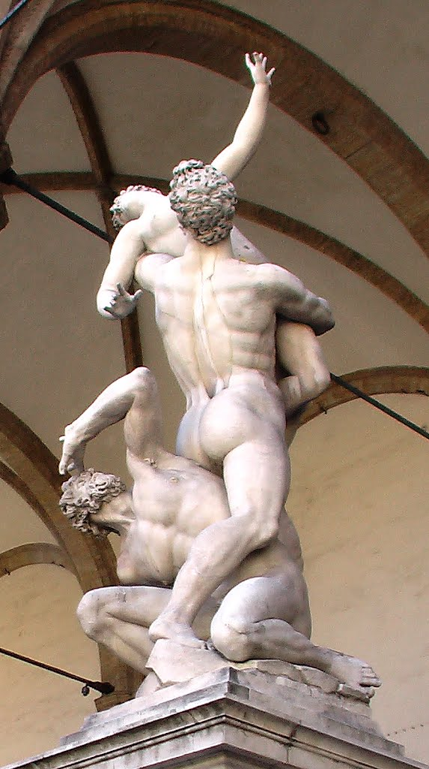
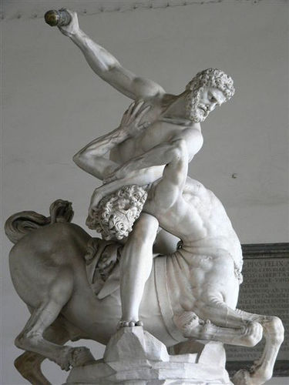
Giovanni Bologna
Sculptures viewed from all angles
No front

