Slide 1
Abstract Expressionism
1950’s
Post WW II
New York
Emotions and Feelings

Slide 2
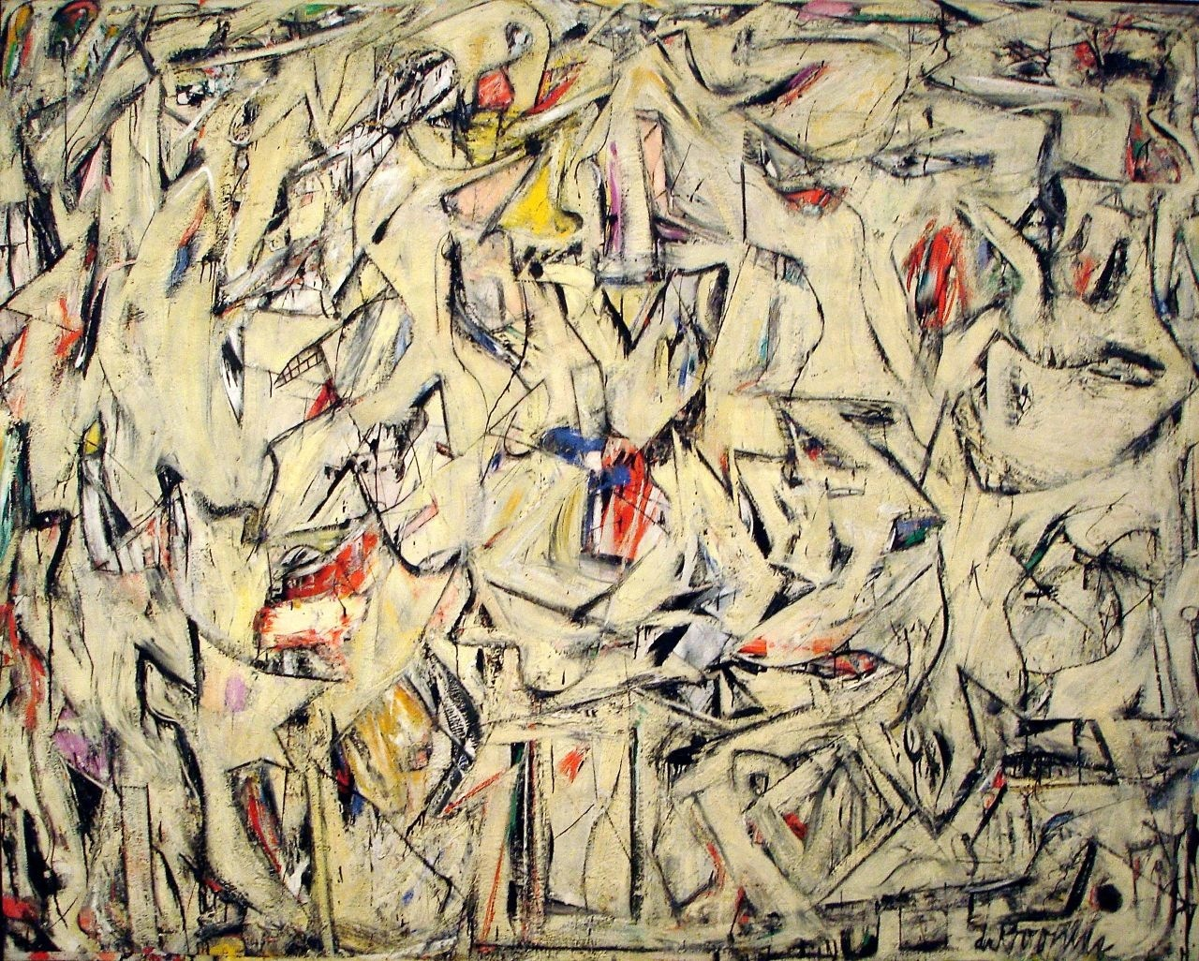
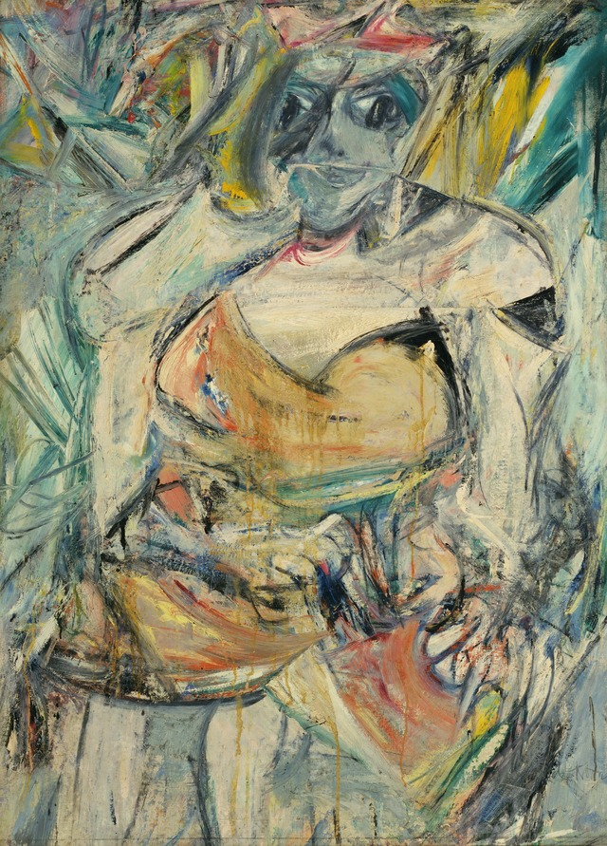
Willem de Kooning

Slide 3
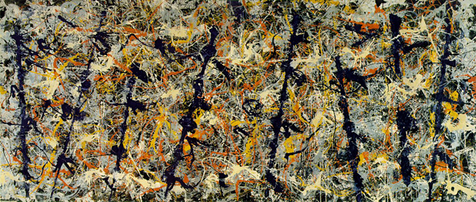
Jackson Pollock

Slide 4
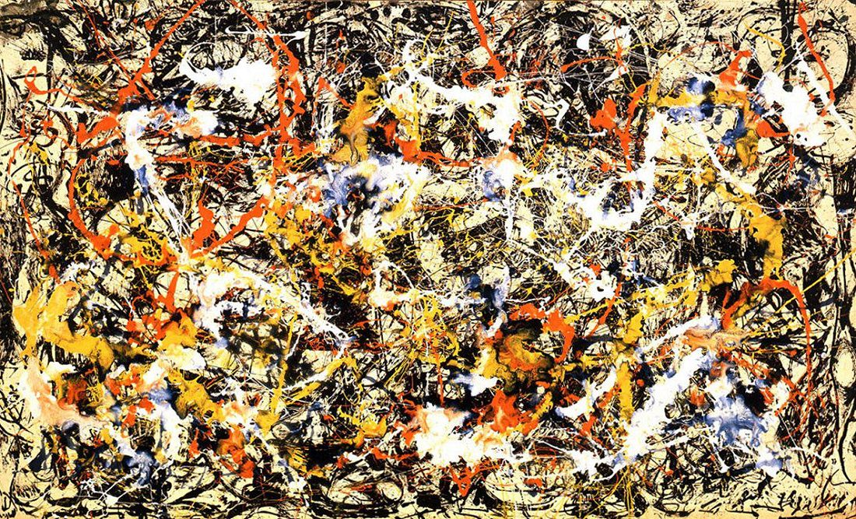

Slide 5
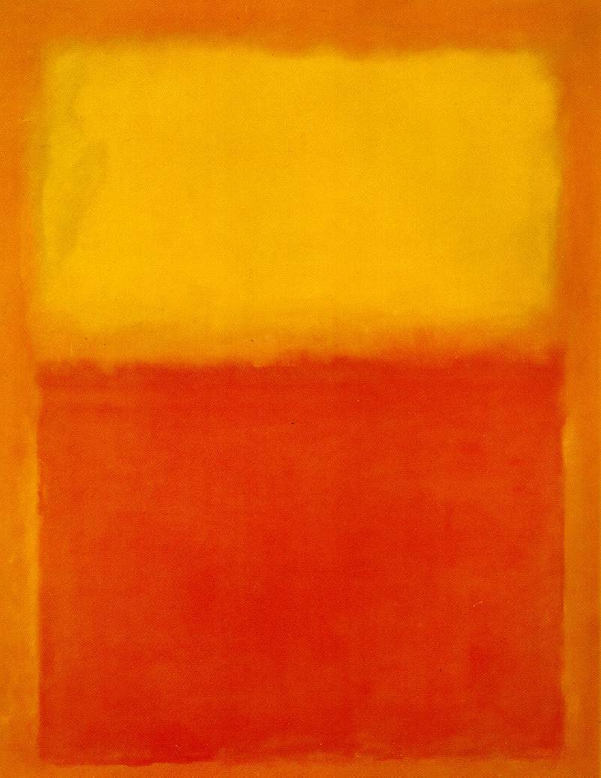
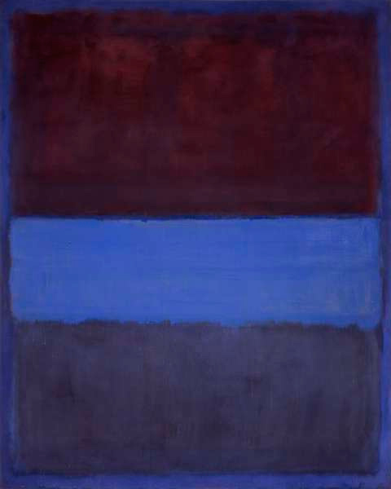
Mark Rothko

Slide 6
Color field
Solid fields of color
Large scale
60s-70s

Slide 7
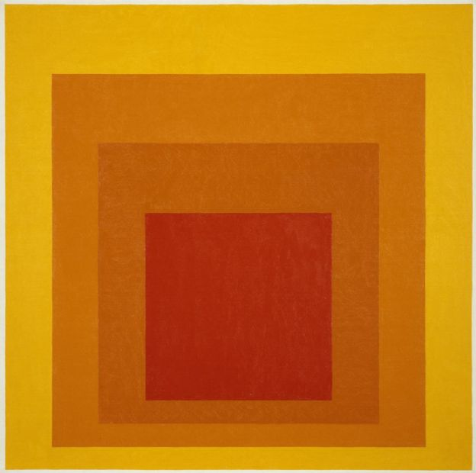
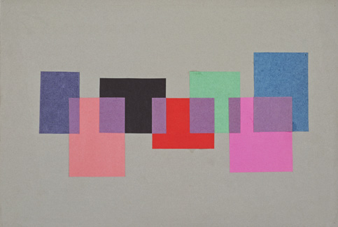
Josef Albers

Slide 8
Barnett Newman

Slide 9
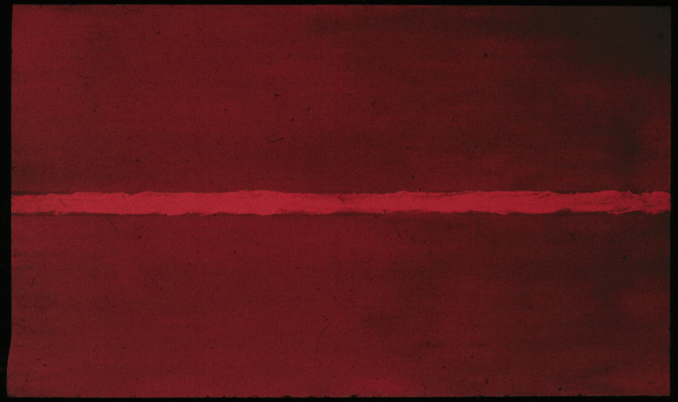

Slide 10
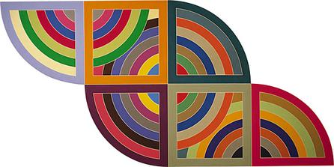
Frank Stella

Slide 11
