Slide 1
Realism
Another 19th century style
Other 19th Century styles (-ism’s)…
Neoclassicism
Romanticism

Slide 2
Realism
Primarily Painters
What type of paint?
Only what you can see and experience
Natural and realistic
Not well received
Glorified working class
Lacked spirit
Rejected by the academies

Slide 3
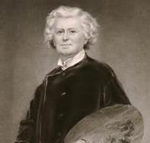
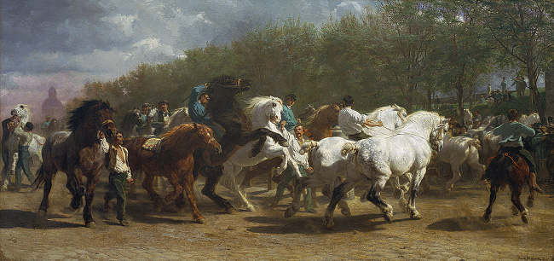
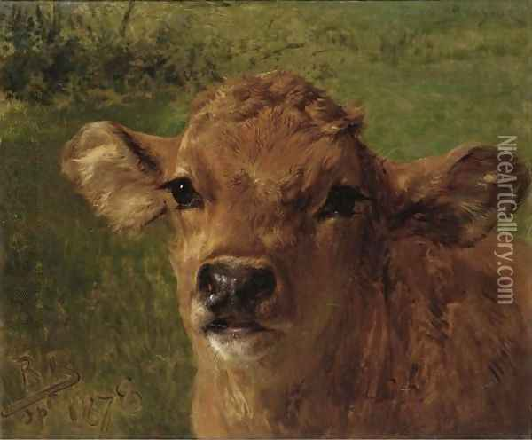
Rosa Bonheur
Natural paintings
Animals
Acted like a man
The Horse Fair, 1853

Slide 4
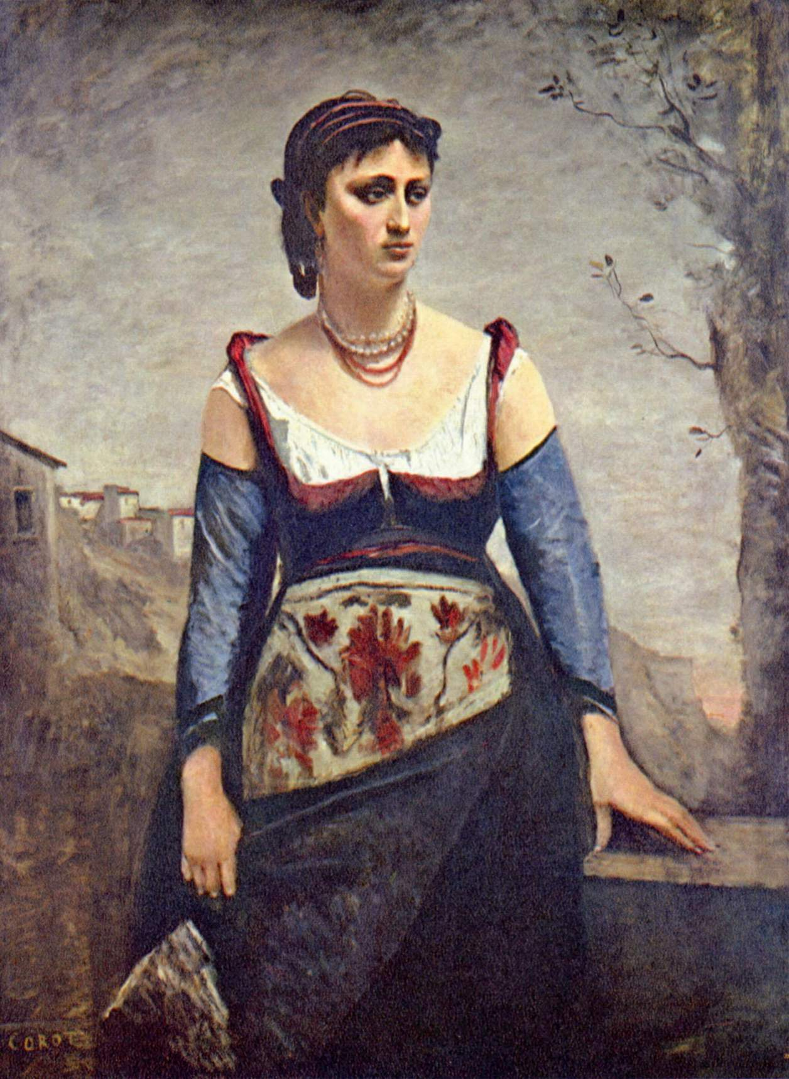
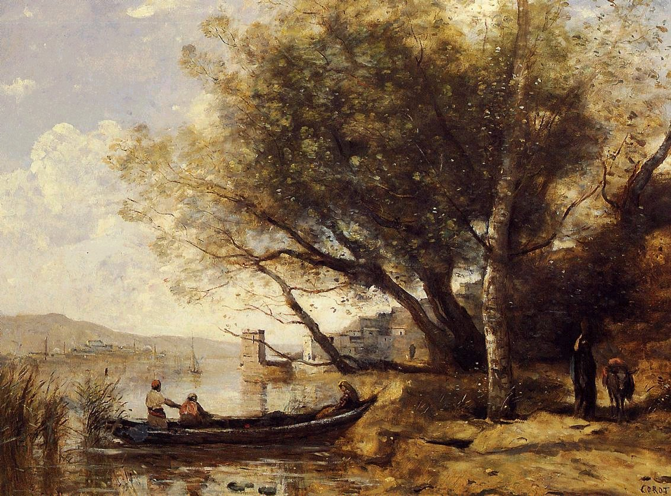
Jean-Baptiste- Camille Corot
Clearness of light
Harmony of human and environment
Limited pallet
No attachment to the painting
Bornova, İzmir, 1873
Agostina, 1866

Slide 5
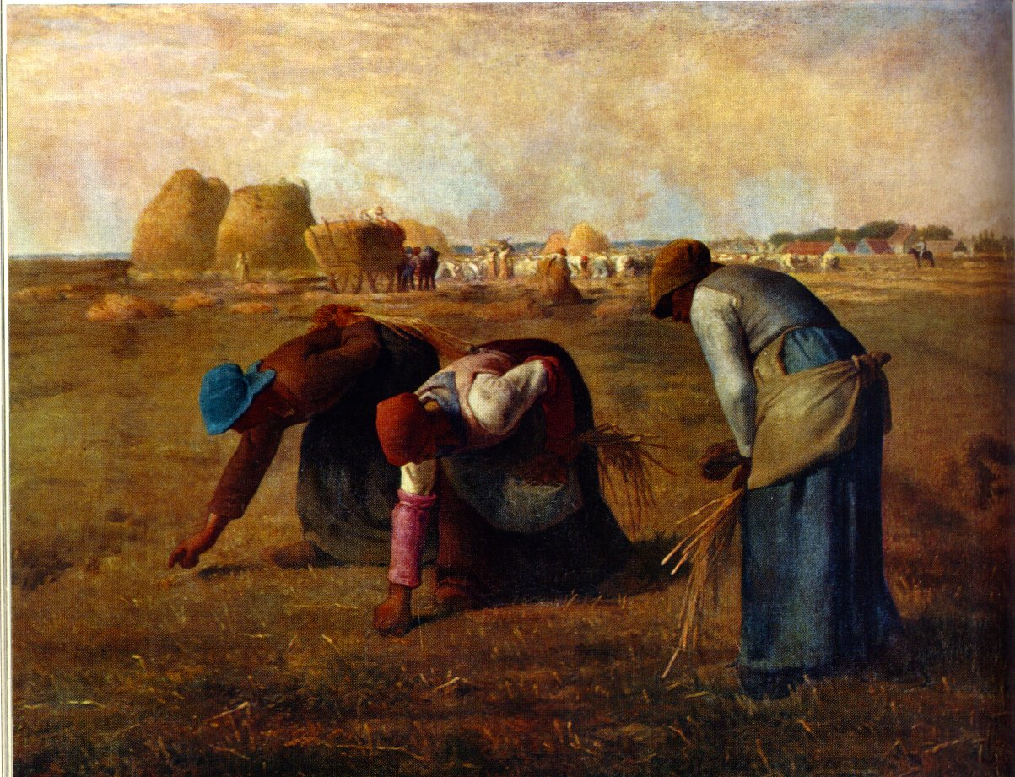
Jean Francois Millet
Common activates
What term do we know for that?
Present workers as dignified people
The Gleaners, 1857

Slide 6
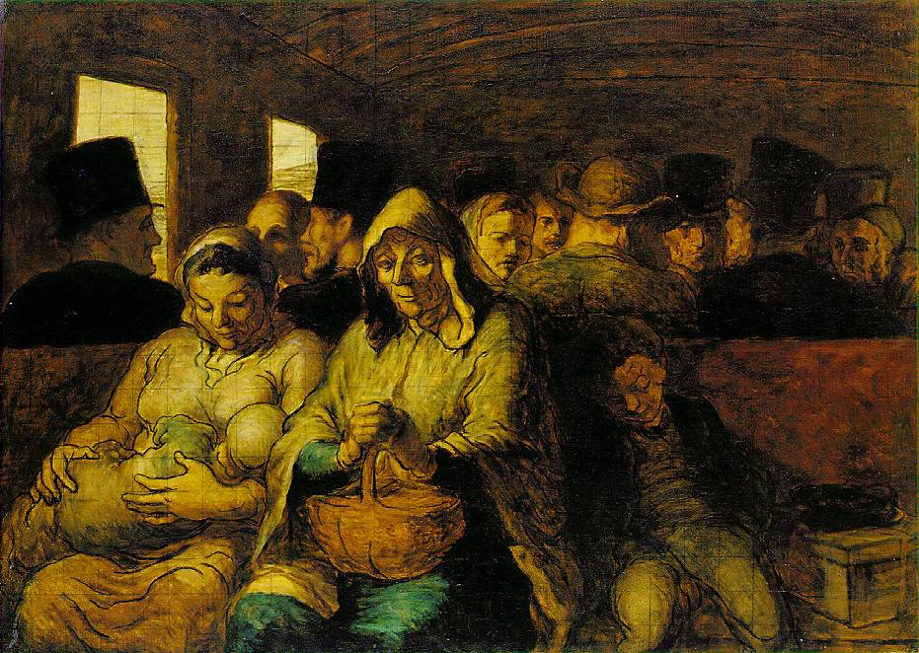
Honore Daumier
Social caricaturist
Wanted to show people how he saw them
Used a grid technique
The Third Class Carriage, 1862

Slide 7
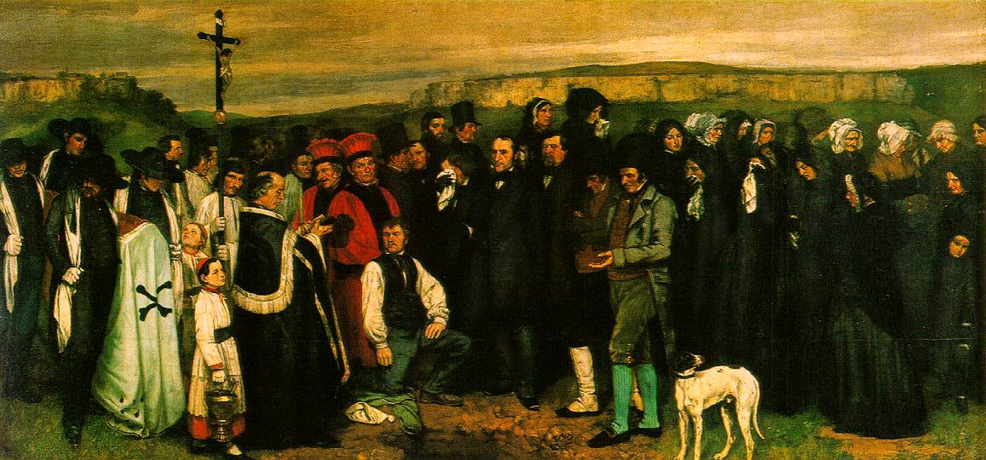
Gustave Courbet
“The art of painting should consist only on the representation of objects which the artist can see and touch”
First modern day one artist exhibition
Burial at Ornans, 1849-1850

Slide 8
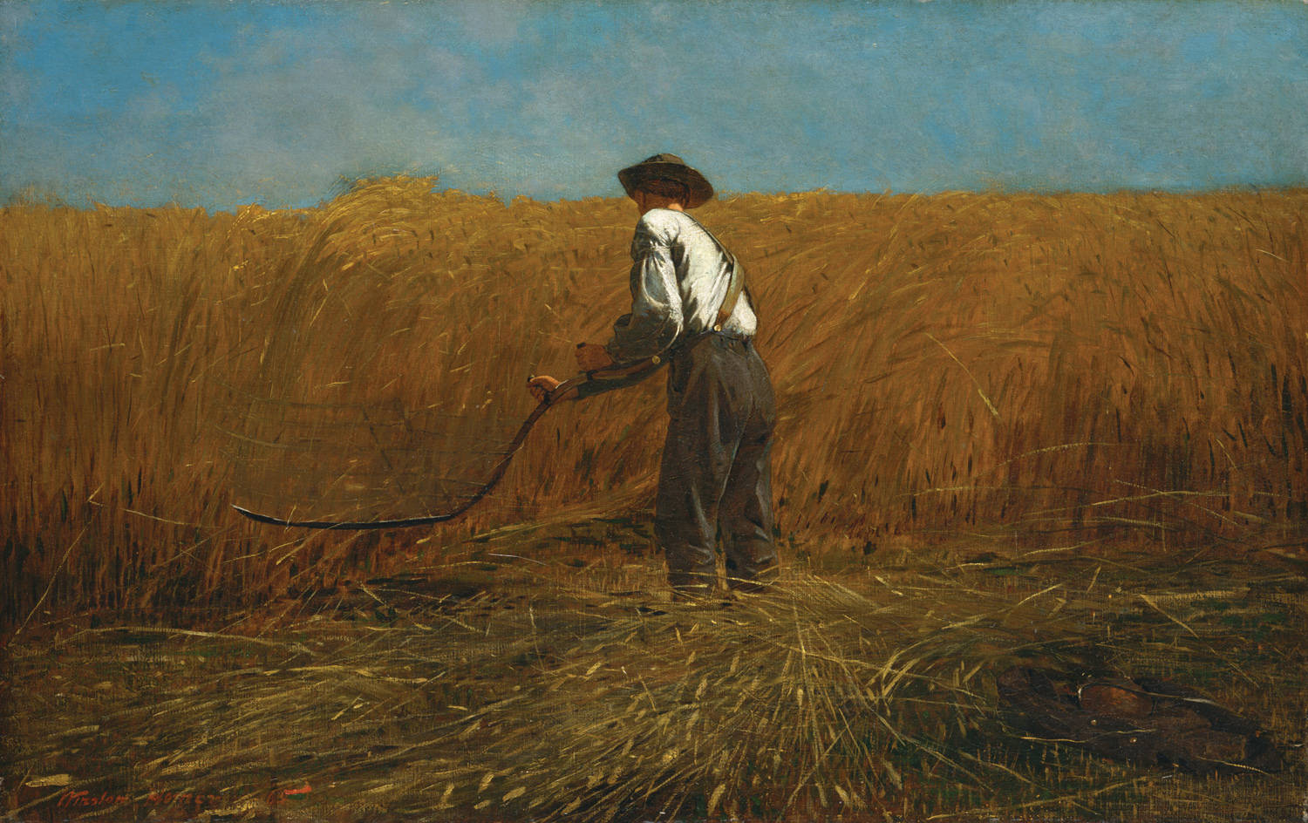
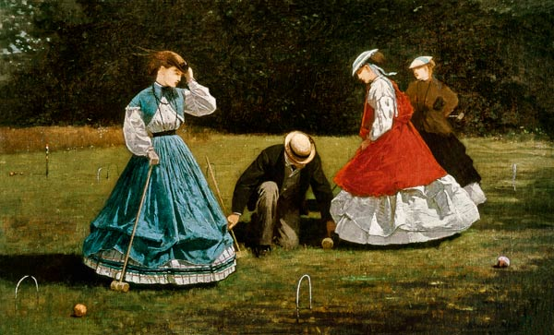
Winslow Homer
American
Worked in water color as well
People liked his watercolor sketches, so he made more
Croquet Scene, 1866
Prisoners from the Front

Slide 9
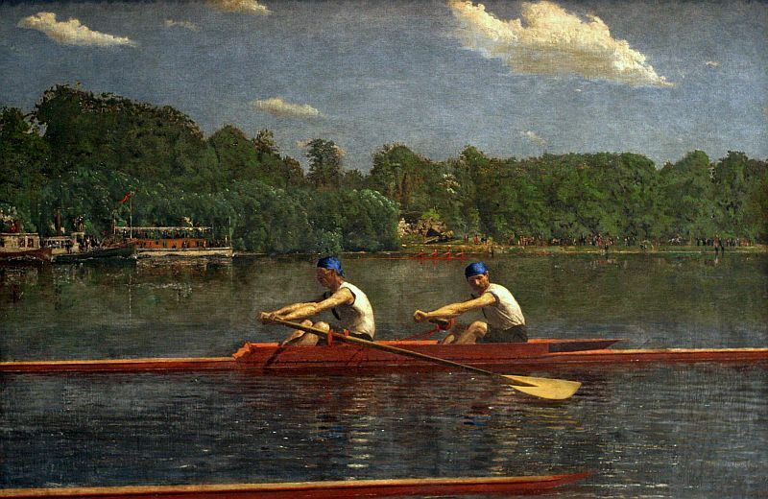
Thomas Eakins
One of finest American painters
Only realistic facts, not exploring the imagination
Biglin Brothers Racing, 1872

