Slide 1
Medieval Art (The Middle Ages)
6th – 12th Centuries CE
(500 – 1100 CE)

Slide 2
Medieval Times
Period of History in Europe between the Collapse of the Roman Empire and The Renaissance
Terms Medieval / Middle Ages reflects the view of early historians who saw this period as an age of ignorance, decline, barbarism between two “golden ages”
But, this period is important in the development of Europe

Slide 3
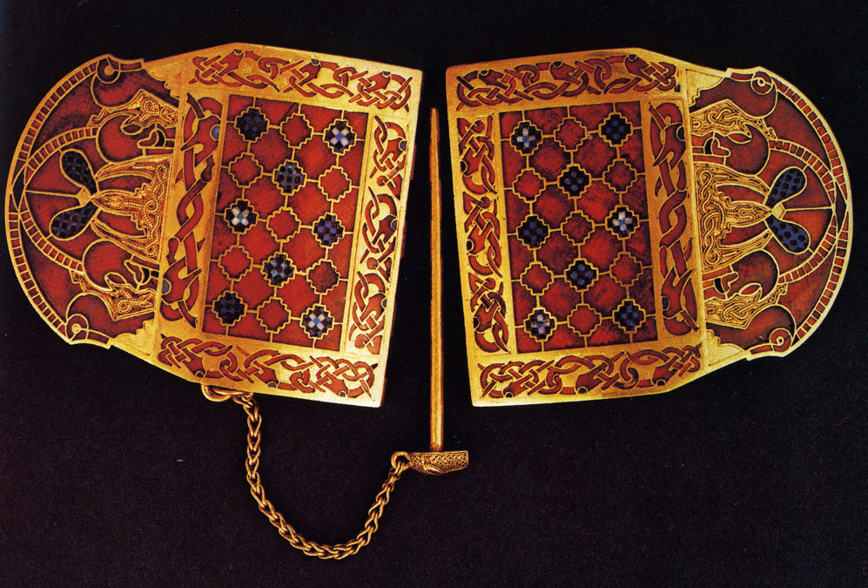
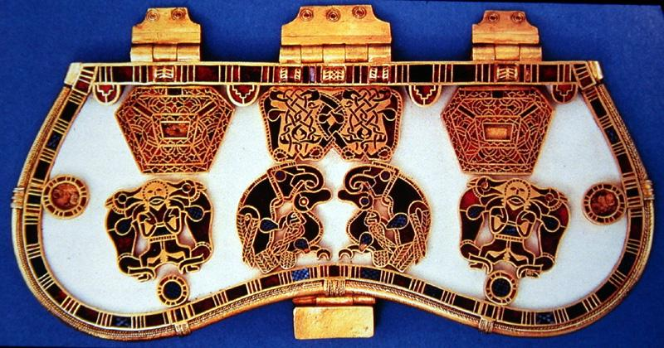
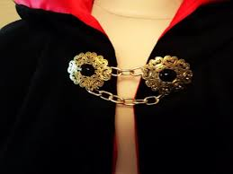
European tribes roamed freely to find permanent homes
Art was small so they could take it with them

Slide 4
The Christian Church
During the Middle Ages in Europe, the Christian Church was very powerful and wealthy
The Christian Church was the main repository of learning and the arts
The Christian Church was the primary Patron of the Arts, hiring artists to make art and architecture

Slide 5
Manuscripts
A manuscript is a handwritten book or document also known as an “Illuminated Manuscript”
Manuscripts were made before the invention of the printing press
Many manuscripts were made by monks
A scribe is the person who writes in a manuscript and the illuminator does the drawings
Most manuscripts during the Middle Ages in Europe told Christian stories

Slide 6
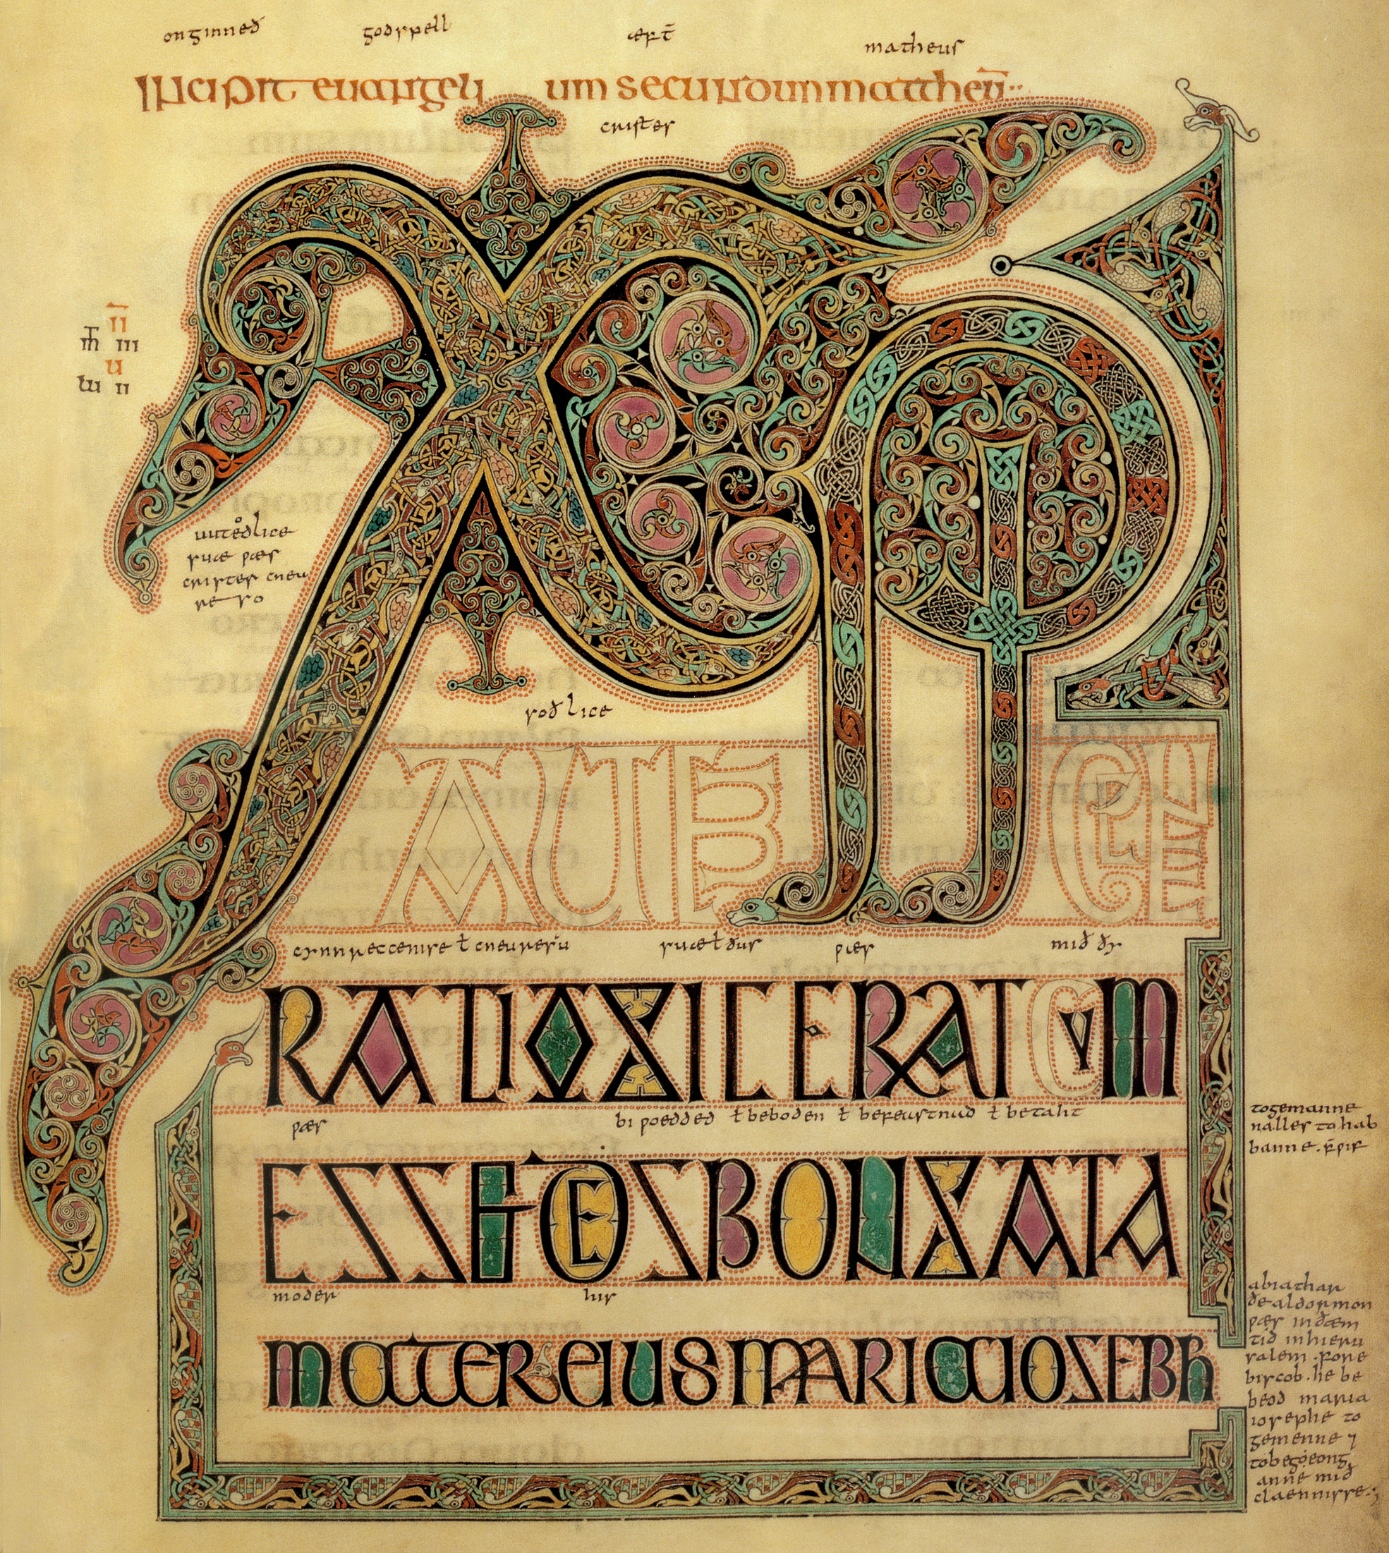
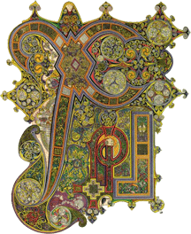
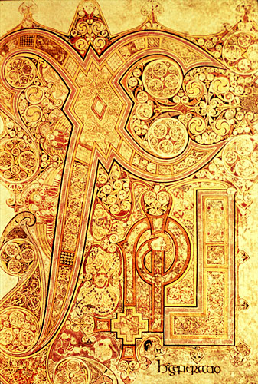
Chi Rho Iota First 3 letters of Christ’s name
Illumination
Vellum
Celtic influence

Slide 7
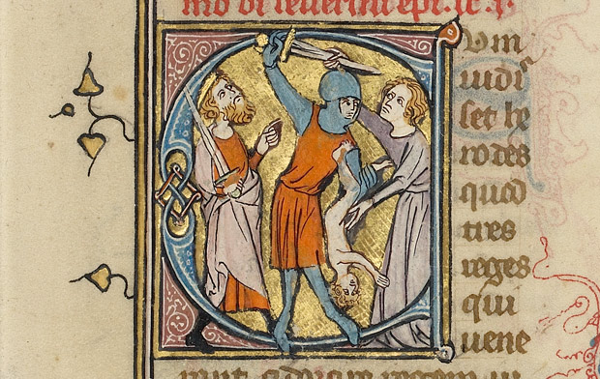
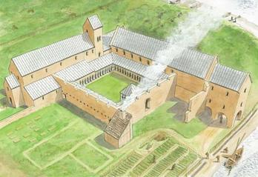
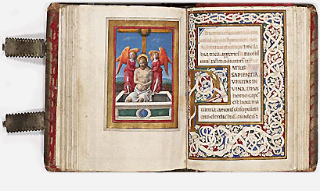
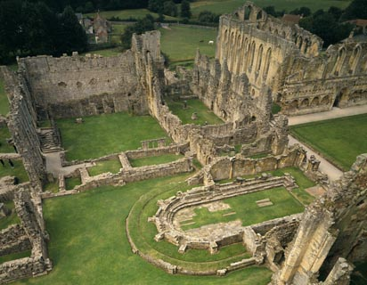
Monasteries
Monks
Manuscripts

Slide 8
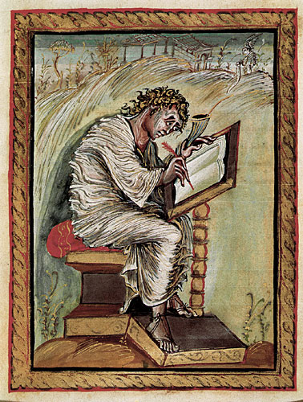
Matthew the Evangelist
An evangelist is someone who receives messages from God
Matthew is listening to the words from God sent from an angel (upper right hand corner).
Matthew wrote stories in the Old Testament (Bible)
Powerful message – feeling of wind blowing and “energy”
Page with Matthew the Evangelist, page from Manuscript (Ink and Colors on Vellum), 850 CE

Slide 9
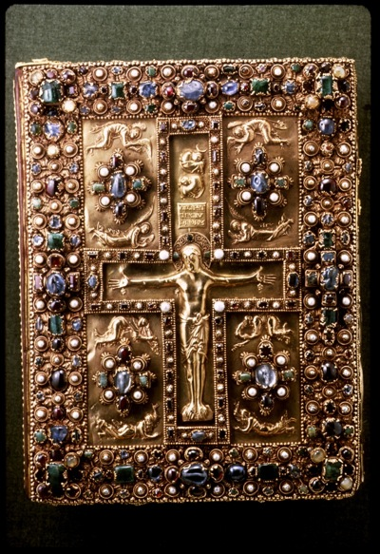
Manuscript Cover
Manuscripts often had elaborate book covers
Story of Crucifixion of Christ (Christ on the Cross / suffering)
Mourning Figures on both sides of the Crucifix
Angels on each side of the Crucifix on the top and in the “frame”
Gold with gemstones and pearls
Repousse technique – type of relief (pushing out from the back with tools)
Crucifixion with Angels and Mourning Figures, outer cover of Lindau Gospels (Gold with relief and Precious Stones / Pearls), 870 CE

Slide 10
Medieval ART
Small precious metal sculptures
Manuscripts

