Slide 1
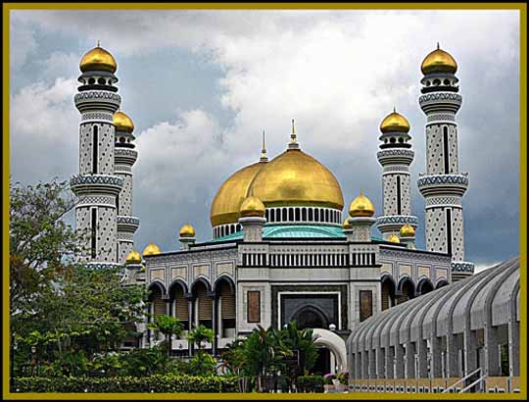
Islamic art

Slide 2
General characteristics
- Islamic art is especially famous for its architecture.
- There are very few paintings and sculptures, because the Koran did not allow the representation of Muhammad, Allah, people or animals.
- However, islamic art is very fine.

Slide 3
Representative buildings
The most important buildings were:
Palaces (for the caliphs)
Mosques (temples for praying)

Slide 4
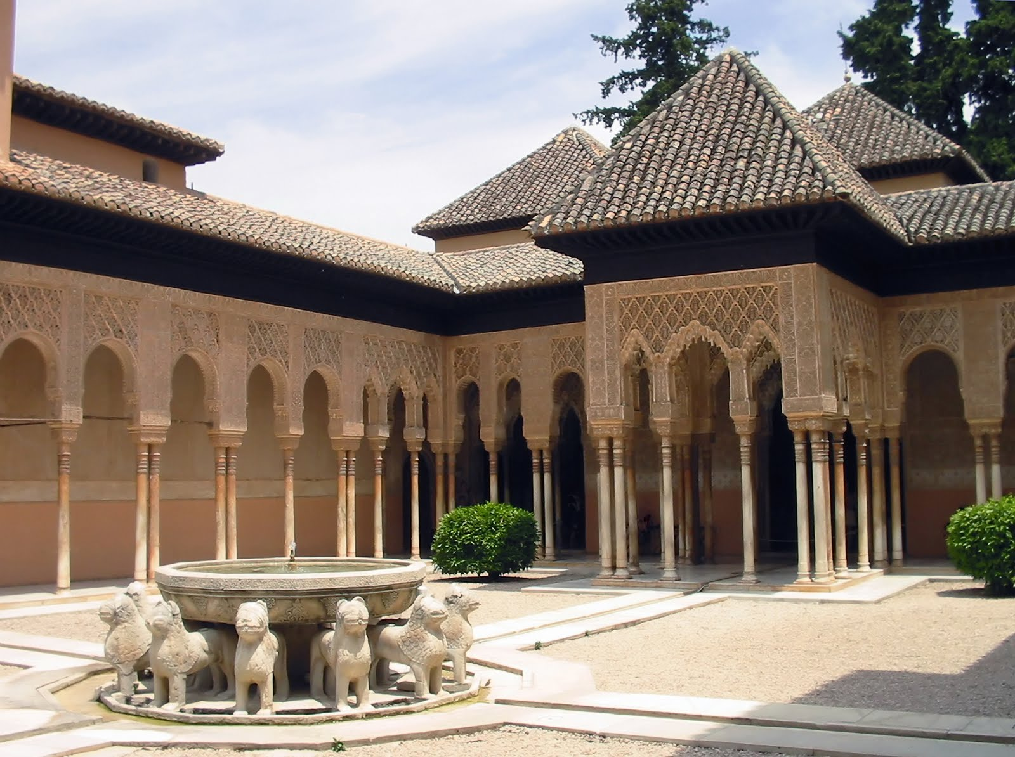
Palaces
gardens and fountains.
The Patio de los Leones of the Alhambra (Granada)

Slide 5
Palaces
Palaces consisted of two areas:
- Public area (used for welcoming the ambassadors who went to visit the caliph)
- Private area (the residence area of the caliph and his family)

Slide 6
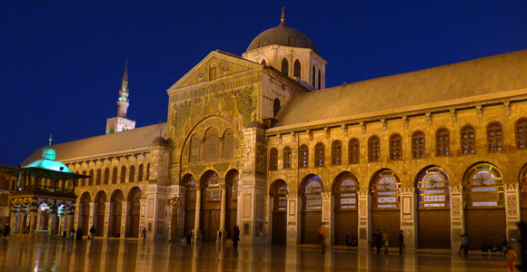
Mosques
Buildings for praying in public, especially on Fridays.
umayyad mosque of Damascus.

Slide 7
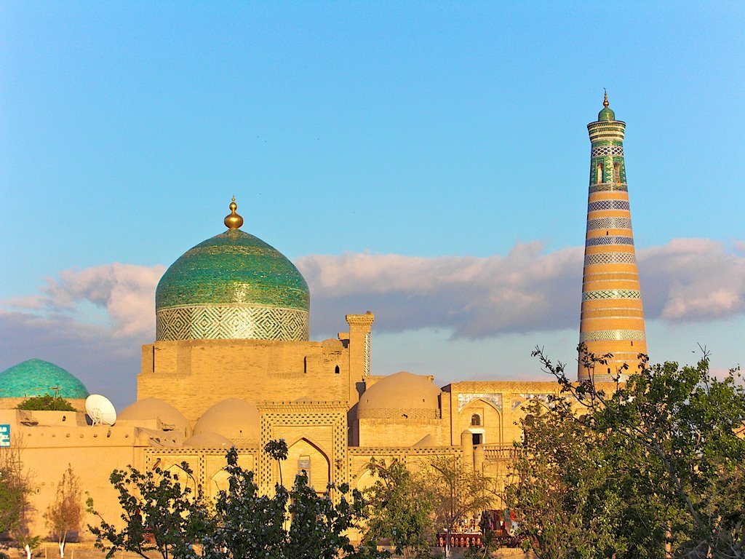
Parts of a mosque
The muezzin called to prayer from the minaret.

Slide 8
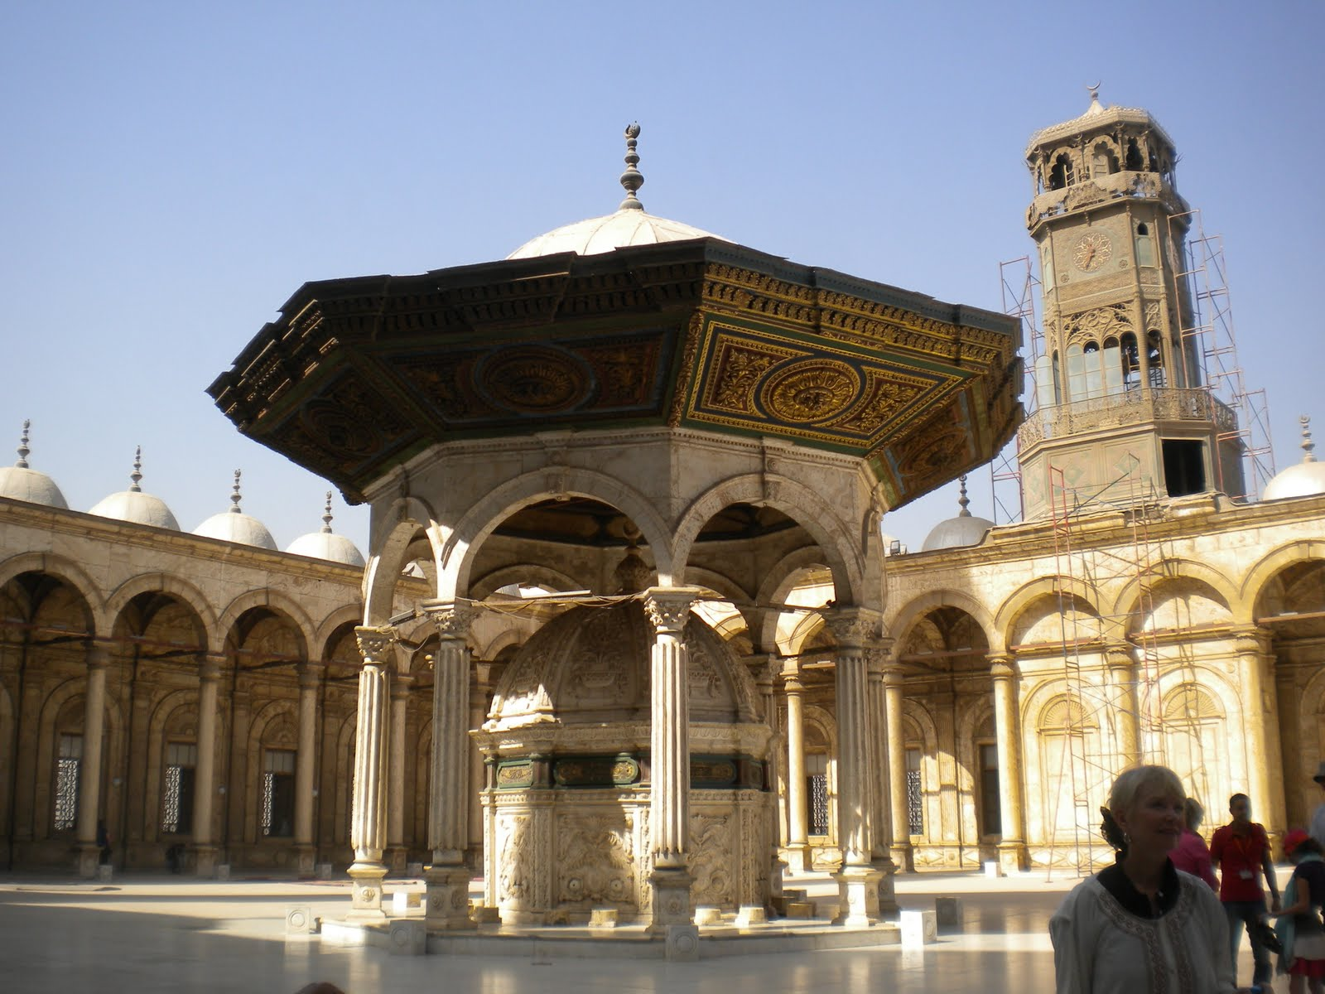
Parts of a mosque
After going through a door, we find a courtyard or patio. There is an ablution fountain which is used for ritual washing and spiritual purification before prayer.

Slide 9
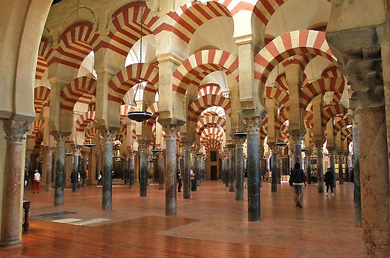
Parts of a mosque
The prayer hall - covered area with columns.
Córdoba mosque

Slide 10
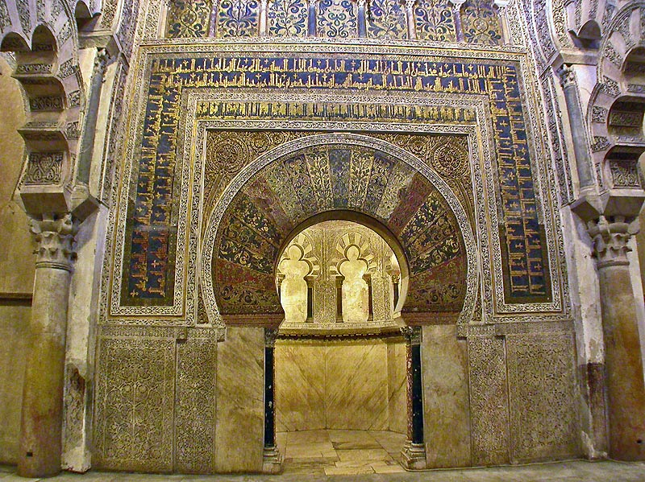
Parts of a mosque
Quibla- the wall muslims face when they pray.
Always orientated towards the holy city of Mecca.

Slide 11
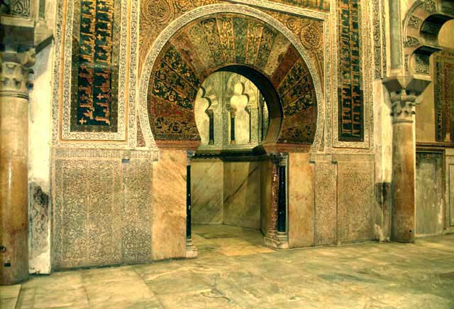
Parts of a mosque
The mihrab is a small niche in the quibla where the Koran is kept.

Slide 12
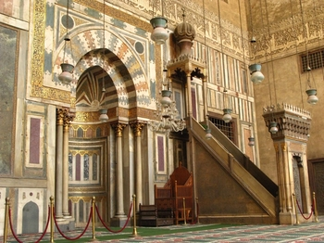
Parts of a mosque
The mimbar or pulpit. The imam (the muslim priest) leads prayers from here.

Slide 13
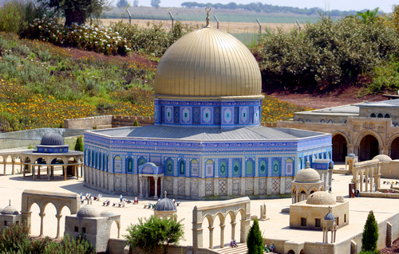
Dome of the Rock, Jerusalem

Slide 14
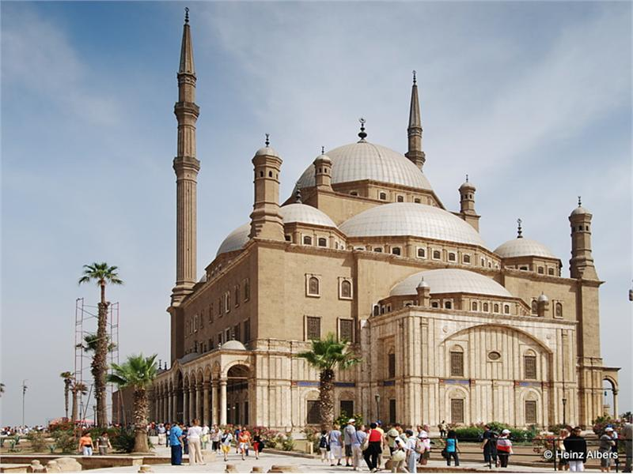
Mosque of Cairo, Egypt

Slide 15
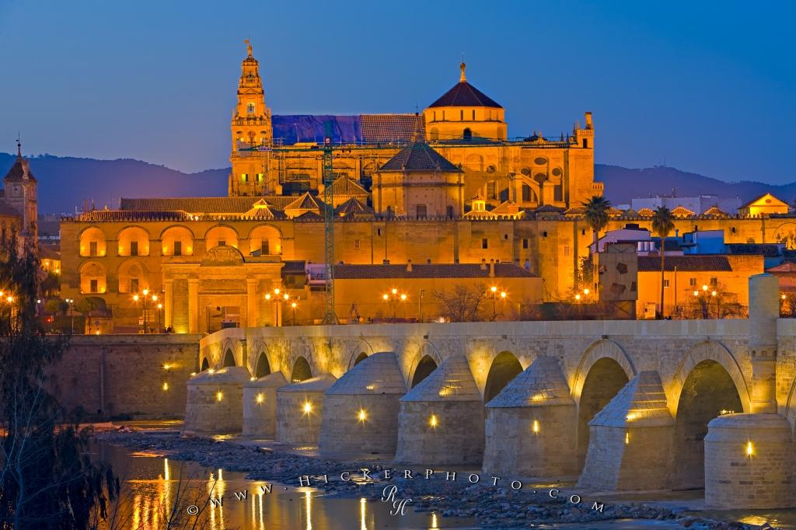
Cordoba mosque, Spain

Slide 16
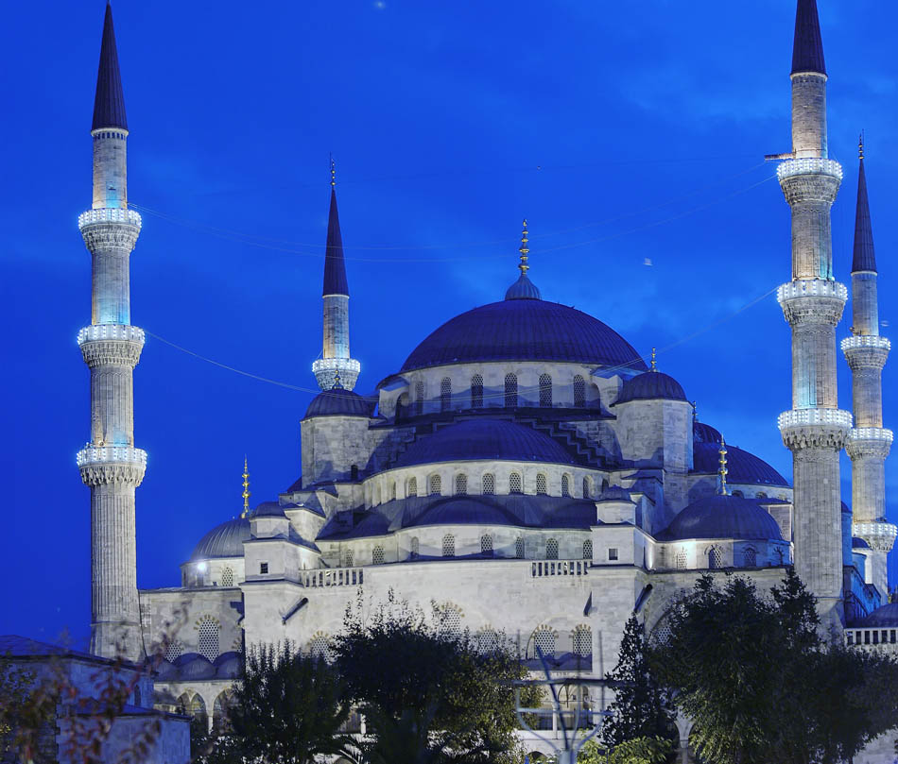
Blue mosque, Istanbul

Slide 17
A summary of the parts of a mosque
Mimbar
Minaret
Courtyard (with an ablution fountain)
Prayer hall
Quibla
Mihrab

Slide 18
The interiors of islamic buildings were richly decorated

Slide 19
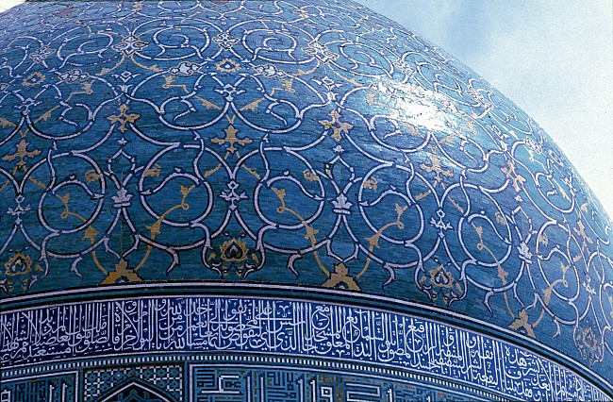
arabic calligraphy
verses from the Koran.
vegetal designs called ataurique.
And geometric designs
arabesque
Simple materials
Brick, plaster, etc
Noble Materials
Tiles and hard wood

Slide 20
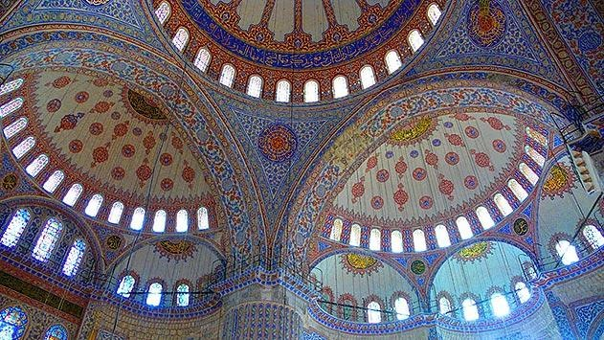
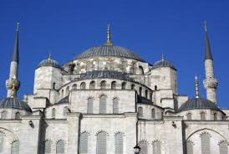
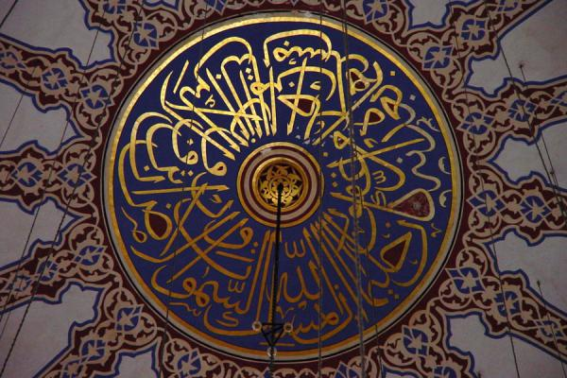
glazed tiles

Slide 21
MORE ARCHES

Slide 22
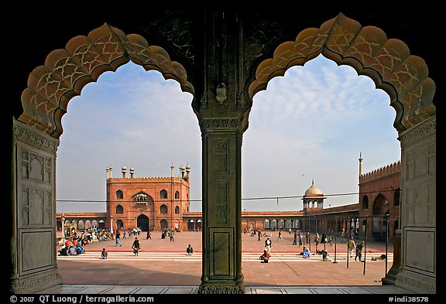
Lobulated arch

Slide 23
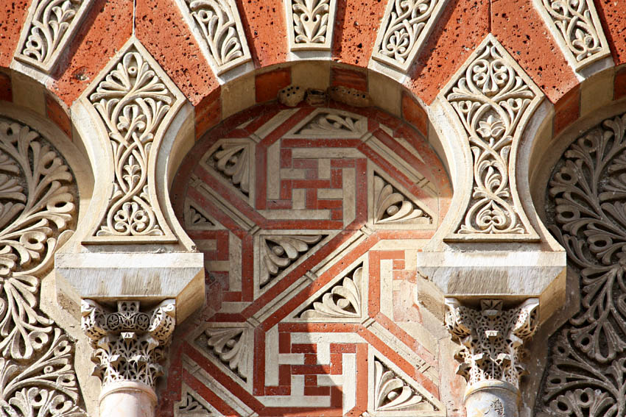
Horseshoe Arch

Slide 24
MORE DOMES

Slide 25
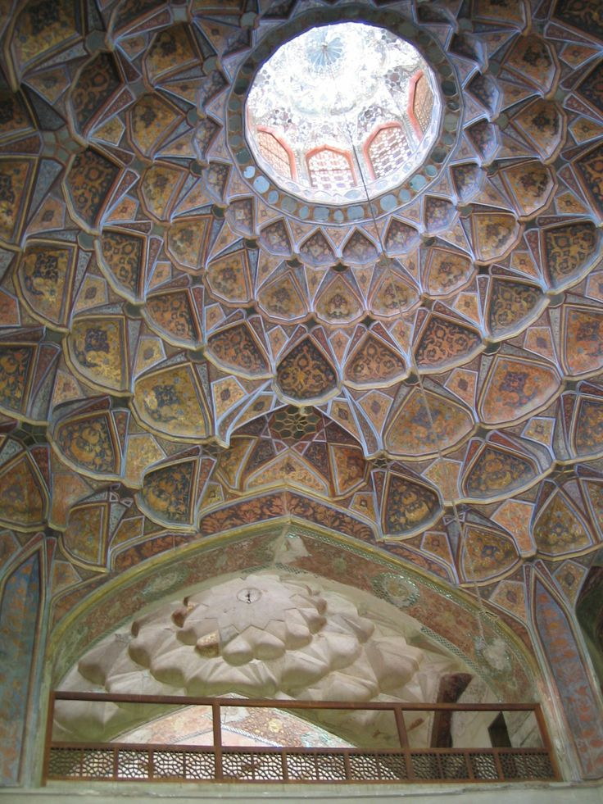
Mocárabes
as if they were forming stalactites

Slide 26
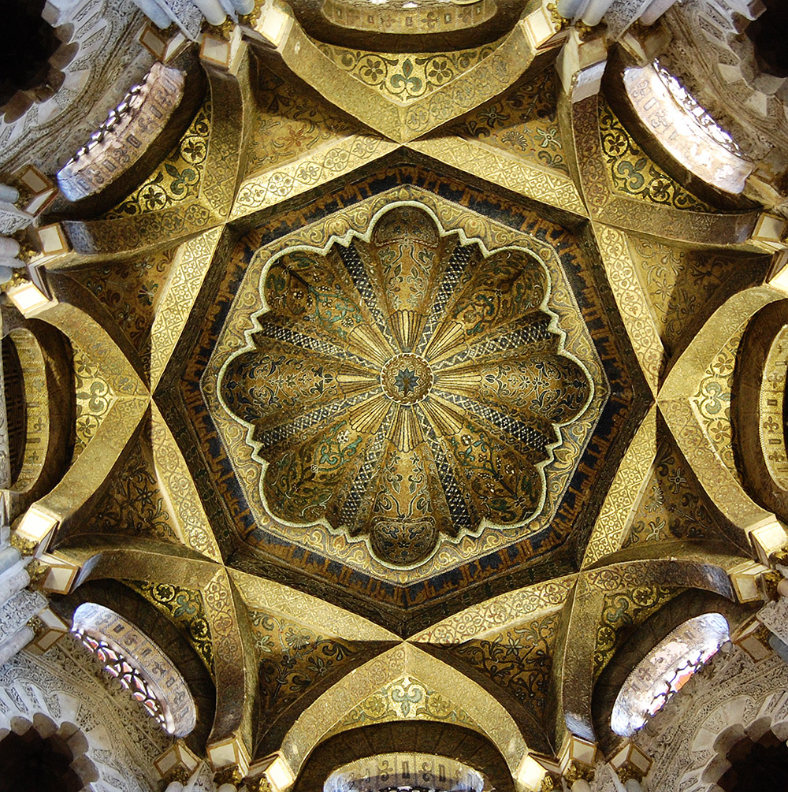
Caliphal crossing dome

Slide 27
