Slide 1
GREEK ART
#TBT

Slide 2
REVIEW
Why were prehistoric sculptures small?
The Post and Lintel system was first demonstrated in…..?
The Egyptian form of picture writing is called …..?
Explain Hierarchy of scale
In Egyptian art, what are the rows in the paintings called?
What is the difference in sculpture in the round and relief sculpture?

Slide 3
Geometric Period (900-700 BC)
Archaic Period (600-480 BC)
Classical Period(480-325 BC)
Hellenistic Period(325-44 BC)

Slide 4
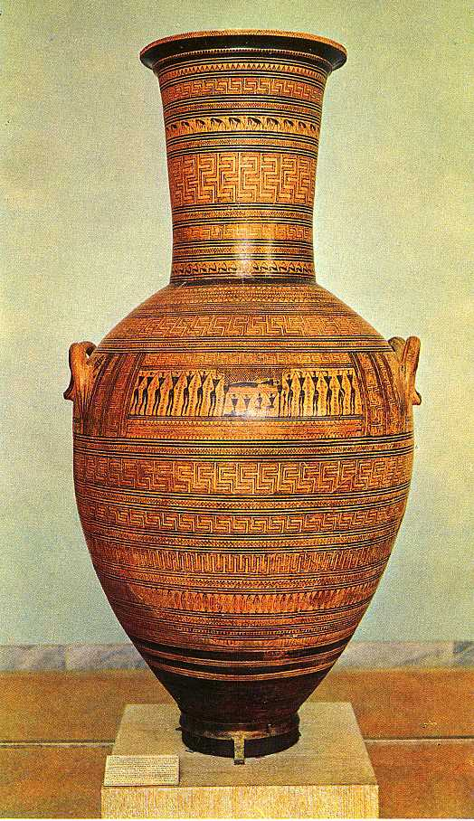
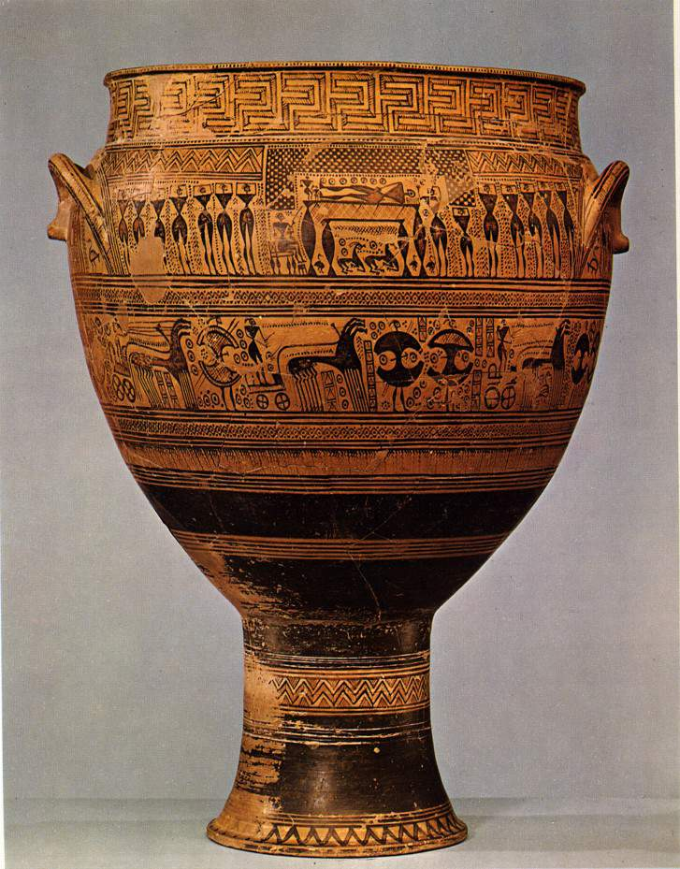
Geometric Period (900-700 BC)
Very large pottery
Geometric designs
Representation of animals and people came later in the time period and were still fairly basic
What were they used for?
Notes:
Vases were used in burials

Slide 5
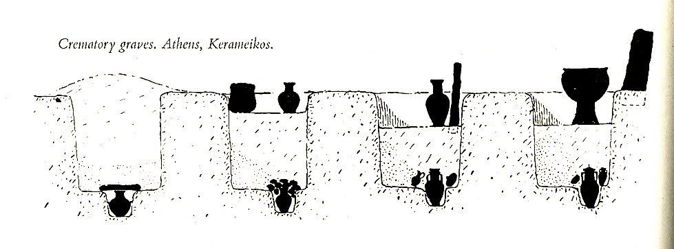

Slide 6
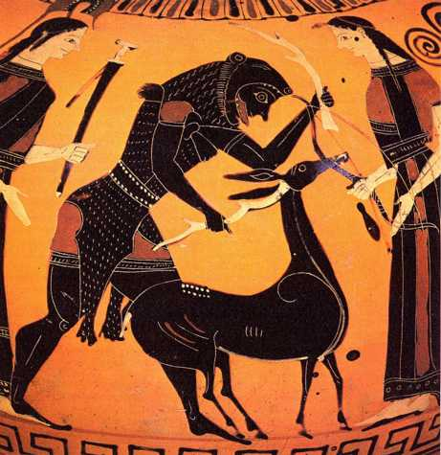
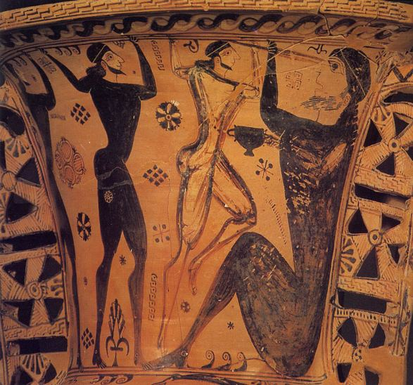
Archaic Period (600-480 BC)
Vase-painting and sculpture
Show a real flourishing of realism and narrative iconography
Not much bronze remaining
BLACK FIGURE

Slide 7
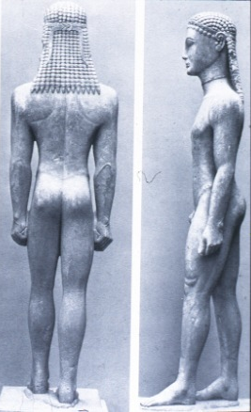
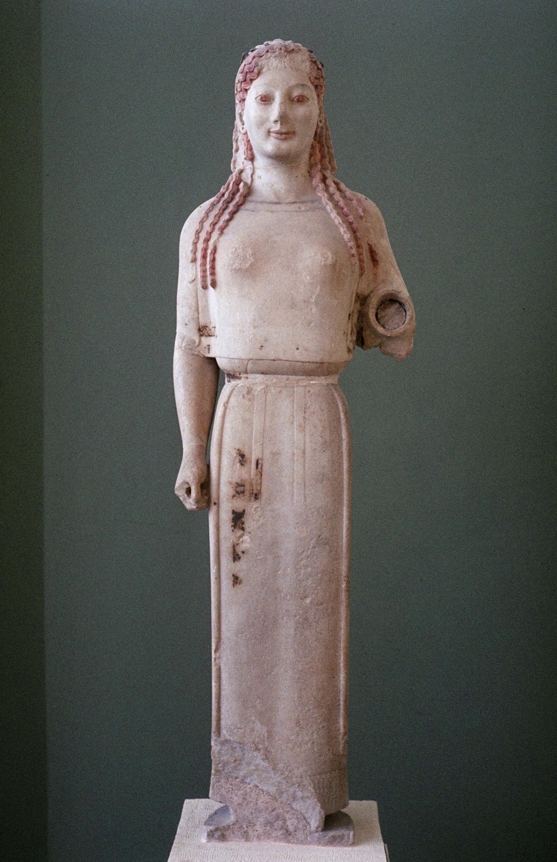
Kouros
& Kore

Slide 8
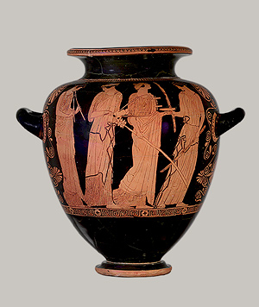
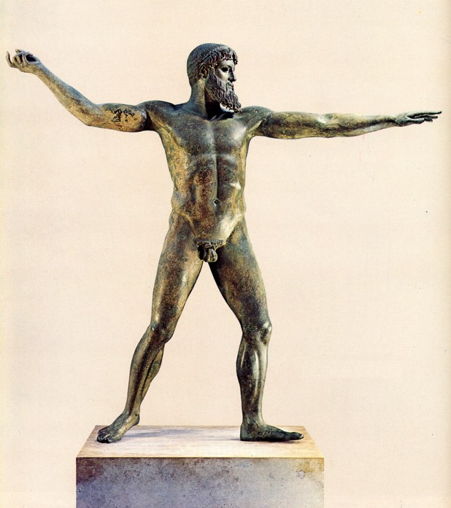
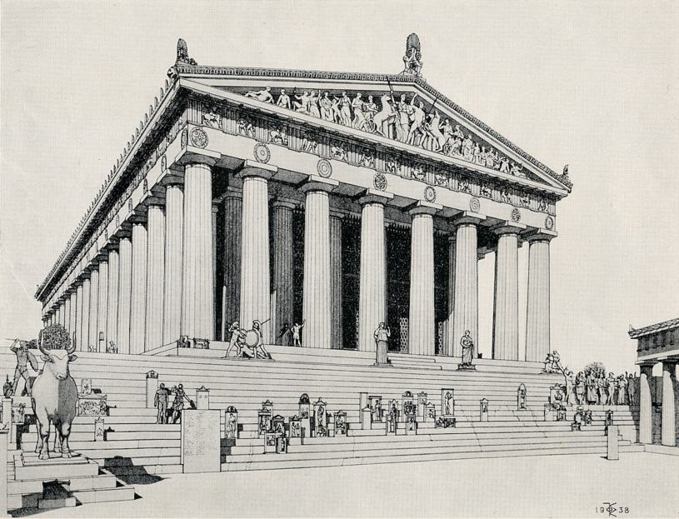
Classical Period(480-325 BC)
Some vase paintings signed
Artists have distinct styles
Very little bronze sculptures remain
Draping fabric
RED FIGURE
The Parthenon
CONTRAPPOSTO

Slide 9
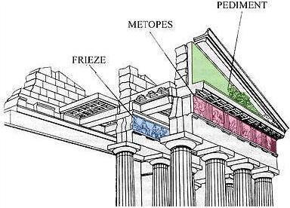
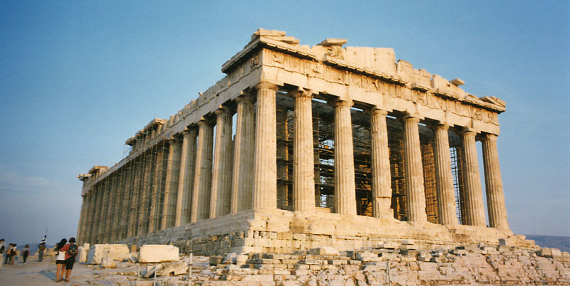
The Parthenon
Temple on the Athenian Acropolis
Post and Lintel
Pediment with sculpture
Frieze
Pediment
Used to be colored

Slide 10
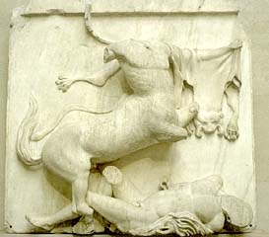
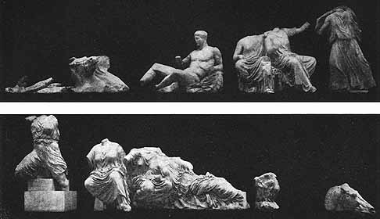
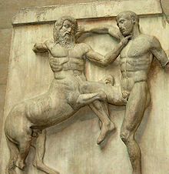

Slide 11
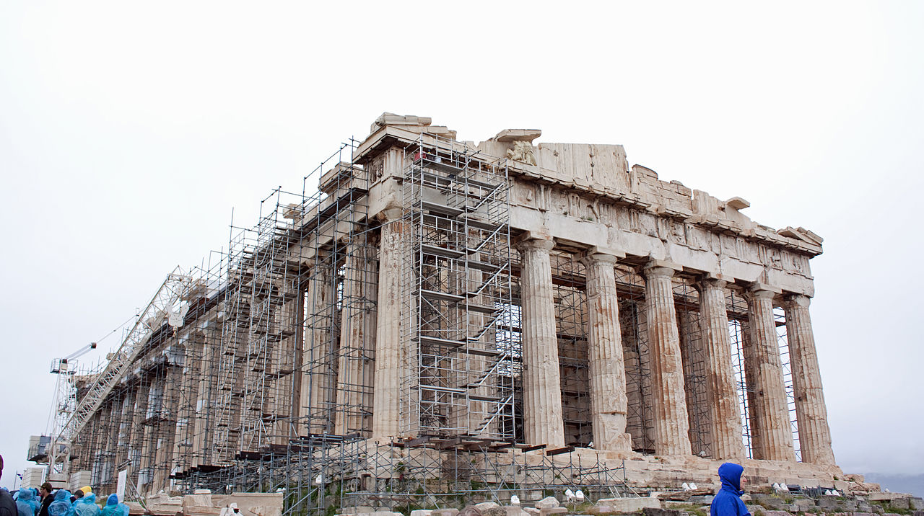

Slide 12
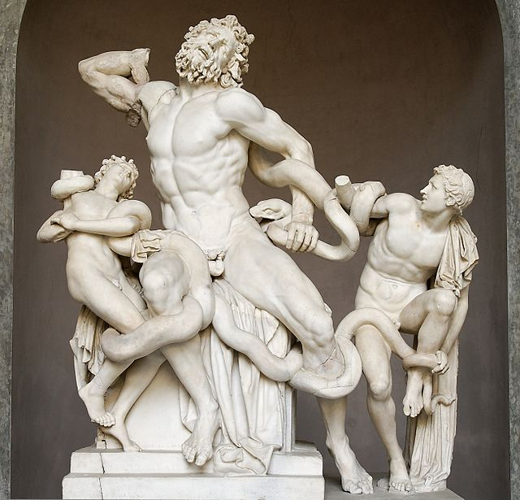
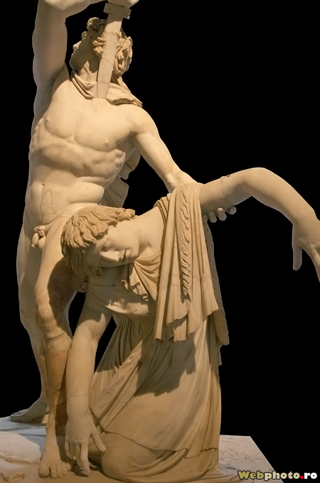
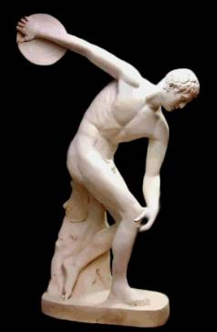
Hellenistic Period(325-44 BC)
Laocoön and His Sons
Much more action
Dynamic sculptures
The “perfect” man
CONTRAPPOSTO

Slide 13
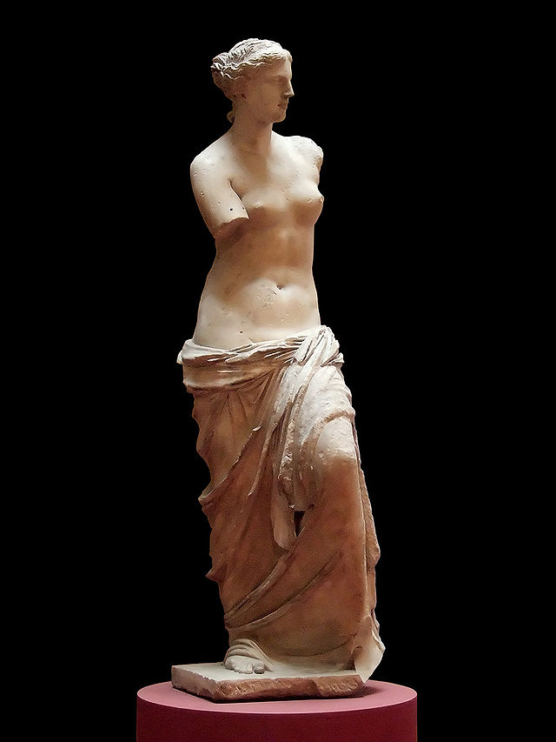
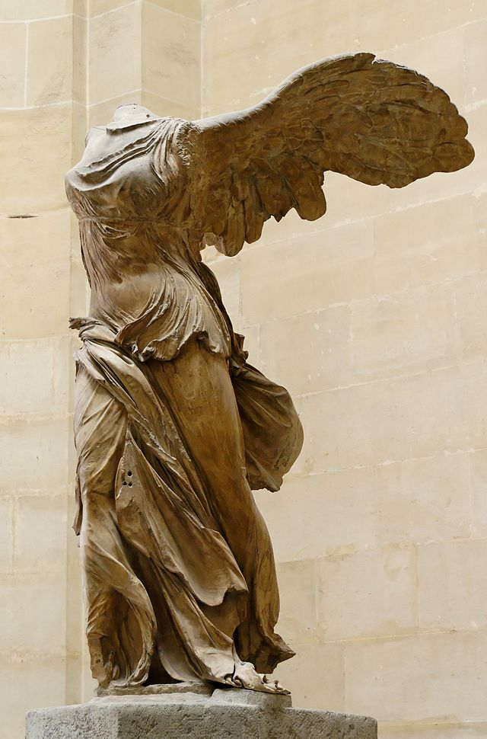
Venus de Milo
The Winged Victory of Samothrace

