Slide 1
Early Christian and byzantine art

Slide 2
After birth of Christ, artists were more concerned with symbolic representation
Christianity became the official religion of the Roman Empire in 313 AD
Roman Empire split into two parts in 337 AD (death of Constantine)

Slide 3
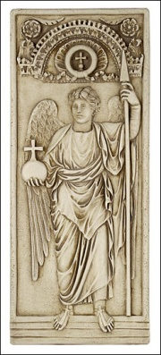
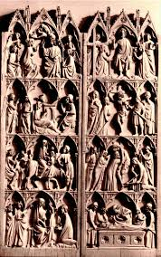
Archangel Michael
Relief sculptures
Symbolism
Influence from classical style
diptych

Slide 4
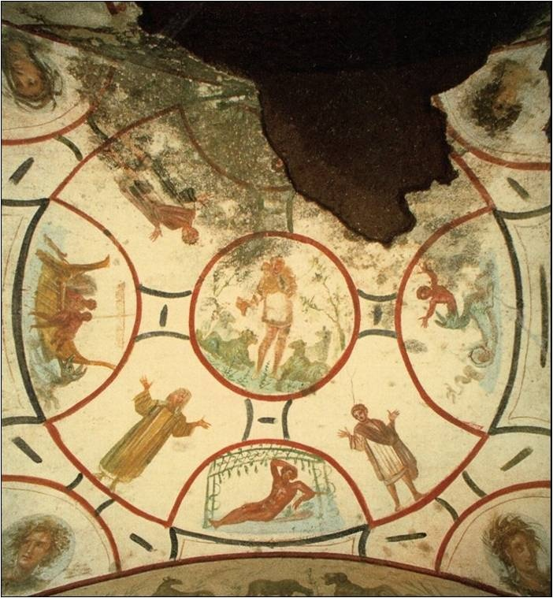
catacombs
Hidden worship
Burial Chambers
“Houses”
Frescos
Catacomb of Saints Peter and Marcellinus, Rome
The good shepherd fresco

Slide 5
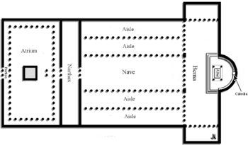
The Basilica
Atrium
Nave
APSE
Brick building with timber roof
Transept

Slide 6
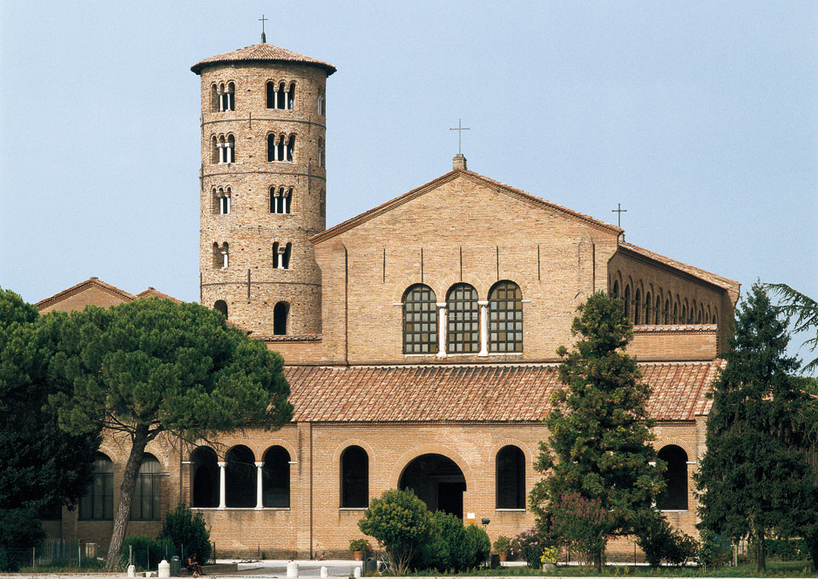
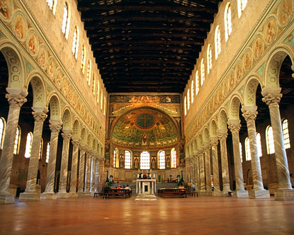
St. Apollinare in Classe
533-549Ravena

Slide 7
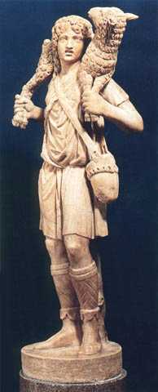
The good shepherd
Very few sculptures survive to this day
Marble
Sculpture more ethereal

Slide 8
Byzantine art - a shift to the east
Mosaics
Tesserae
Extremely extravagant interiors

Slide 9
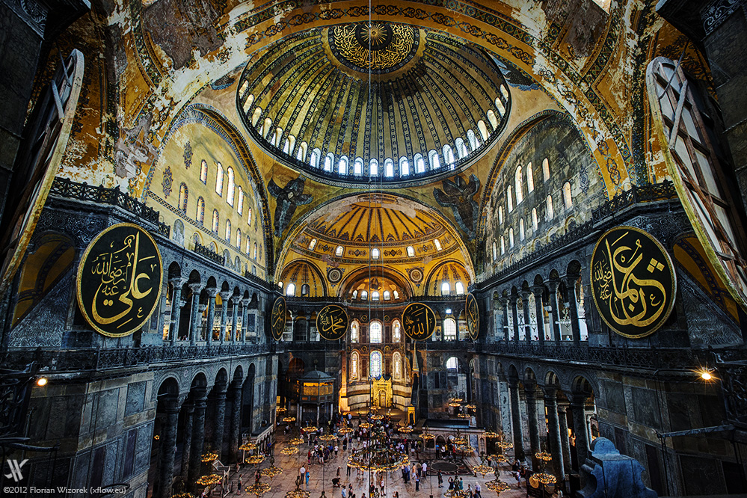
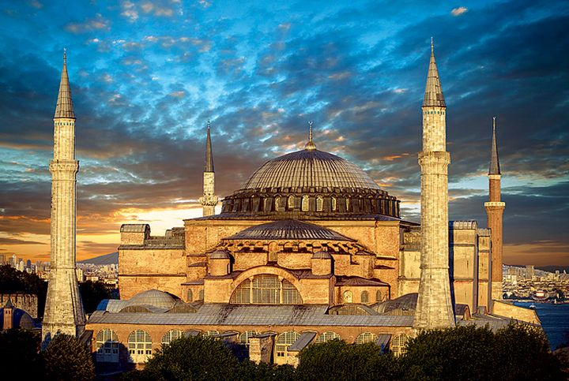
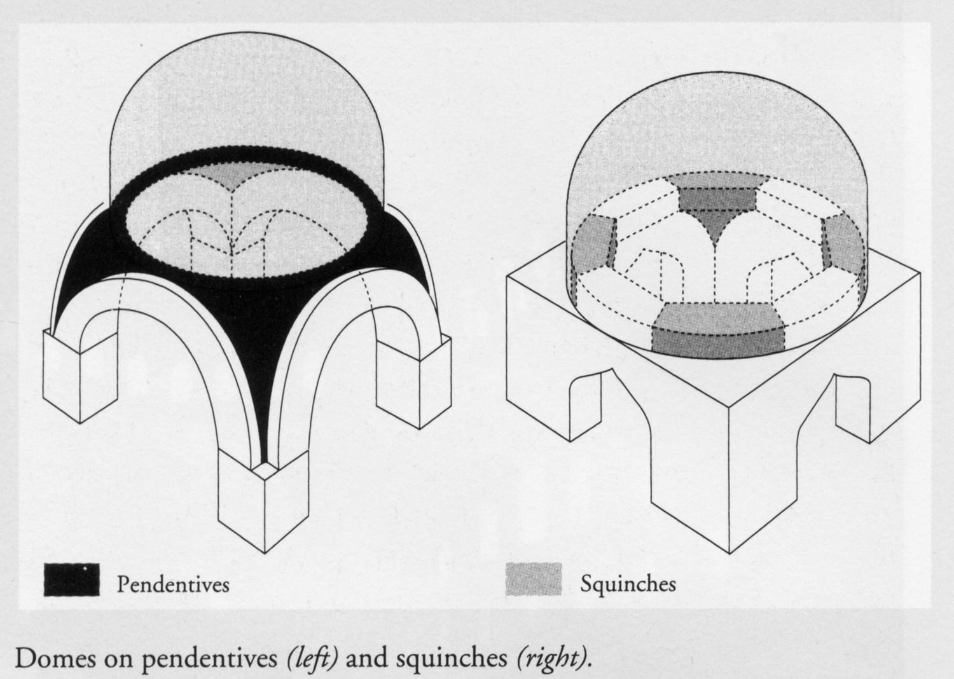
Hagia Sophia - istanbul
Basilica + rotunda
Dome
Pendentives
Piers
Only 6 years to build

Slide 10
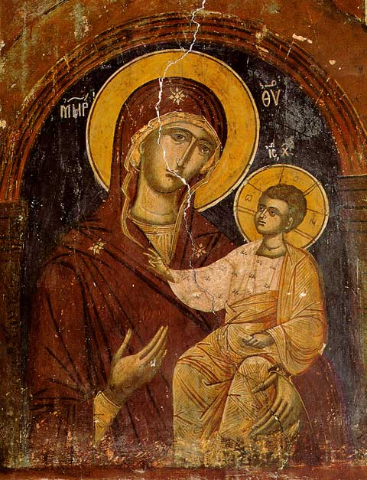
ICONOCLASTS!
Wanted to destroy religious symbols
Icons- religious images
Byzantine Paintings
Triptychs

