Slide 1
ROMAN ART
#TBT
100 BC to 300 AD

Slide 2
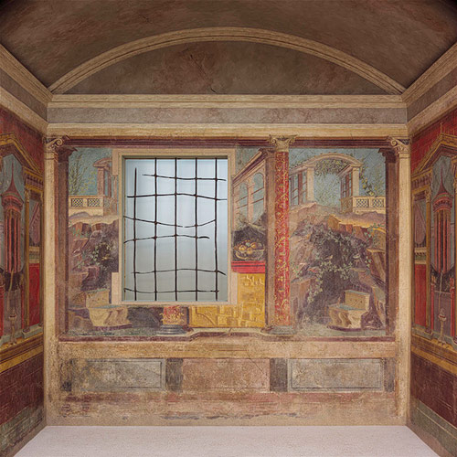
Fresco wall paintings
Painted into the plaster
Used perspective
Made rooms appear larger
Fresco wall painting in a cubiculum
Boscoreale
ca. 40–30 B.C.
Roman Plaster

Slide 3
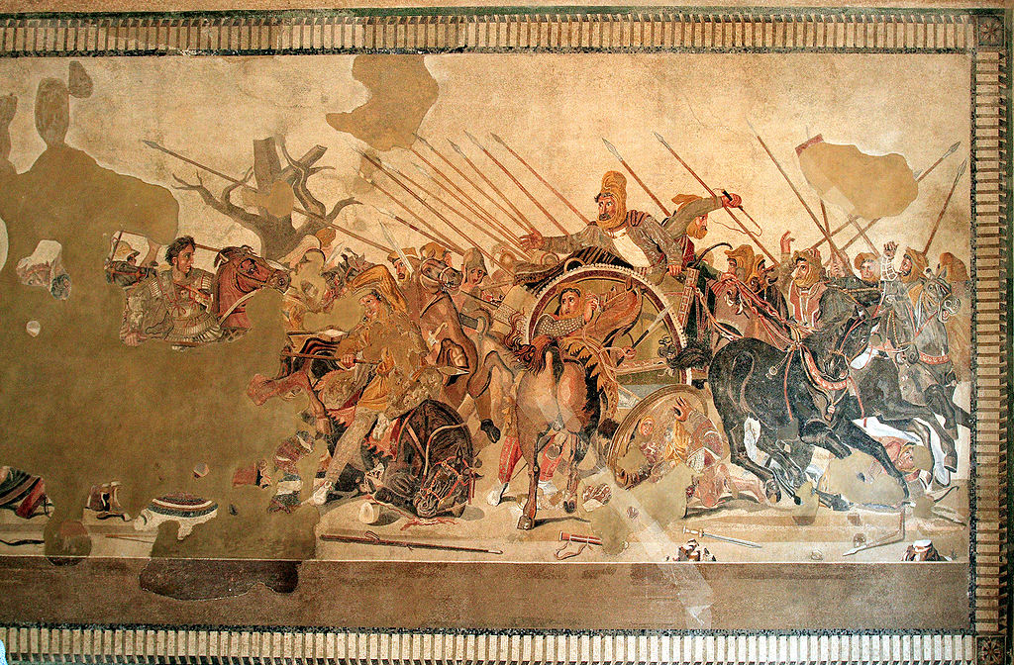
The Alexander Mosaic, ca. 100 BC
Mosaics
Notes:
Strongly influenced by Greek art. Greek god and goddesses depicted a lot

Slide 4
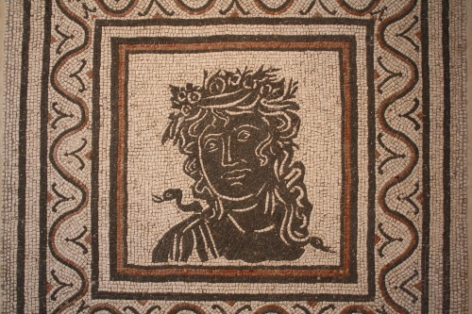
Black and White tesserae

Slide 5
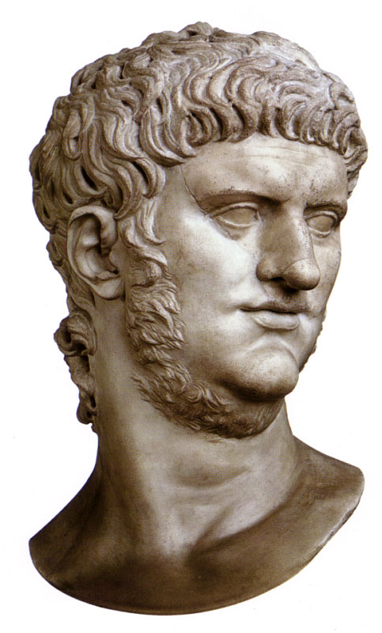
Busts of important figures
More realistic depiction of people
Most sculptures done in Marble
Sculptures popular as decoration
Headless bodies?
Bust of Emperor Nero c. 60 AD Marble Capitoline Museums, Sala degli Imperatori, Rome
Notes:
More realism than the Greeks

Slide 6
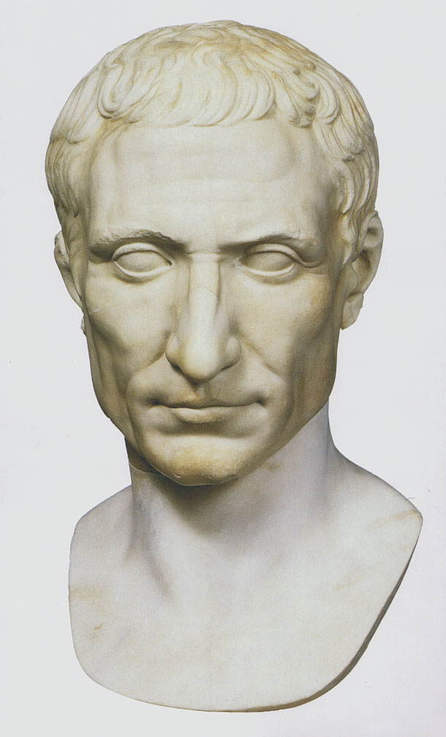
Julius Caesar c. 50 BC Marble Vatican Museums, Vatican City

Slide 7
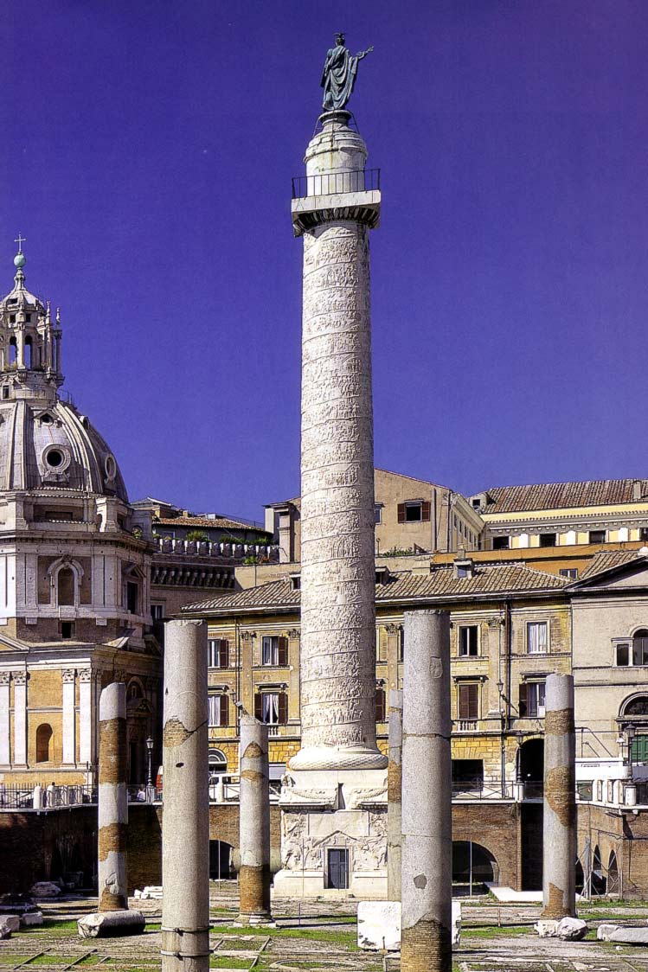
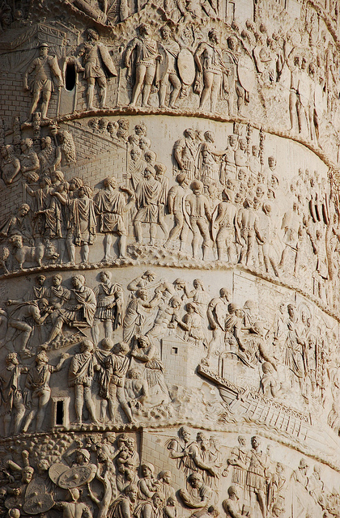
Column of Trajan 113 AD Rome

Slide 8
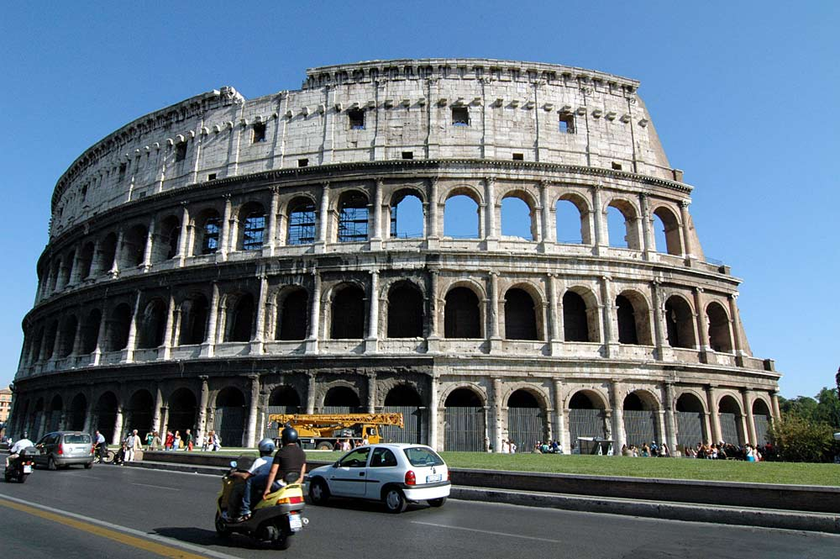
The Coliseum 70-82 AD

Slide 9
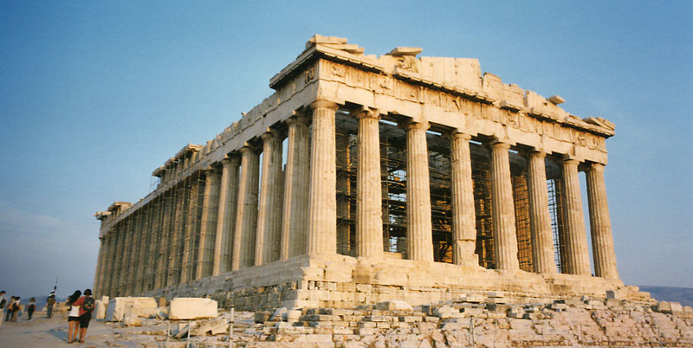
ARCHES!
and concrete
They are both huge accomplishments in history, but
HOW ARE THEY DIFFERENT?

Slide 10
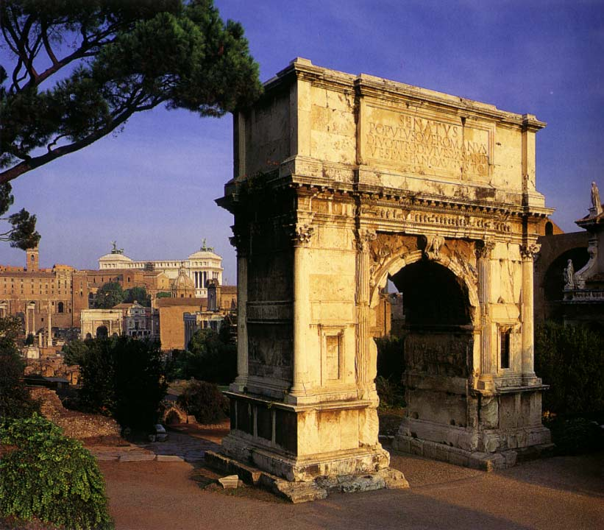
Triumphal Arches
Commemorate special events or achievements
Arch of Titus 81 AD Rome

Slide 11
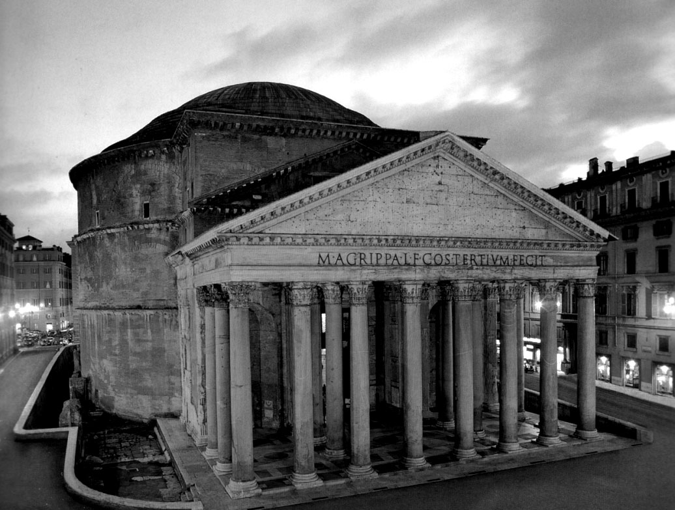
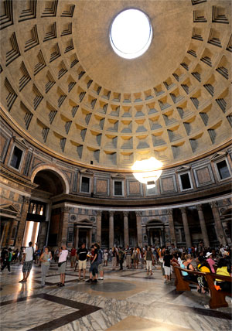
vault, and dome
Pantheon c. 120 AD Rome
Notes:
Whole in top for light. Floor sloops for drainage

Slide 12
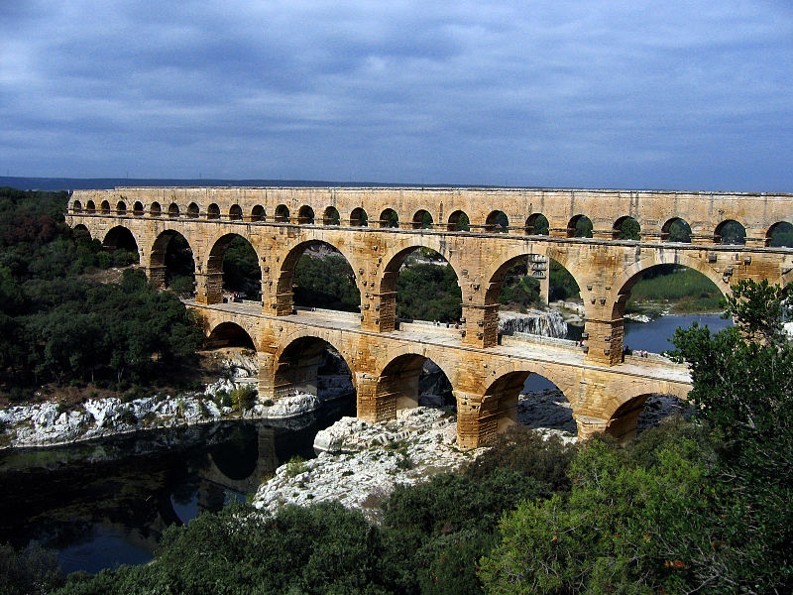
Pont du Gard in Roman Gaul (modern-day southern France)
Aqueduct

